Slide 1

Part I:
Big Questions about Wealth
(1 Timothy 6:6-10)

Slide 2

What Is Financial Contentment?
1 Timothy 6:6
“But godliness actually is a means of great gain when accompanied by contentment.” NASB
“And religion does make your life rich, by making you content with what you have.” CEV

Slide 3


What Is Financial Contentment?
1 Timothy 6:6 “But godliness actually is a means of great gain when accompanied by contentment.” NASB
“And religion does make your life rich, by making you content with what you have.” CEV
1 Timothy 6 has a lot to say about wealth. It tells us about wealth accumulation, wealth management, and wealth enjoyment. And it starts the discussion with contentment. Godliness and religion can make our lives rich. How? Through contentment. The word for contentment in 6:6 is autárkeias. Definitions include:
“A perfect condition of life, in which no aid or support is needed”
“A sufficiency of the necessaries of life”
“A mind contented with its lot, contentment”

Slide 4

Question time: Talk with your neighbor
Discuss the following questions with at least one other person.
We’ll start with 30 seconds of silence for thinking (my stopwatch) and then start talking with your neighbors.

Slide 5


1 Timothy 6:6 “But godliness actually is a means of great gain when accompanied by contentment.” NASB
“And religion does make your life rich, by making you content with what you have.” CEV
How would you define financial contentment?
What would that look like for you? What would it feel like?
Think until the timer ends then start talking with your neighbors.
The word for contentment in 6:6 is autárkeias. Definitions include:
“A perfect condition of life, in which no aid or support is needed”
“A sufficiency of the necessaries of life”
“A mind contented with its lot, contentment”

Slide 6

What Is Financial Contentment?
1 Timothy 6:6 “But godliness actually is a means of great gain when accompanied by contentment.” NASB
“And religion does make your life rich, by making you content with what you have.” CEV
One study looked at those with a net worth over $50 million. Only one in five reported feeling “extremely financially secure.” One in ten felt “somewhat insecure” financially.
Rooney, P. M. & Frederick, H. K. (2007). Portraits of donors: Bank of America study of high net‐worth philanthropy. The Center on Philanthropy at Indiana University. p. 11.

Slide 7


1 Timothy 6:6 “But godliness actually is a means of great gain when accompanied by contentment.” NASB
“And religion does make your life rich, by making you content with what you have.” CEV
Can those with great wealth still live a life without financial contentment? Why?
How might wealth without contentment fail to make your life rich?
How does godliness with contentment create a “great gain” [NASB] or “huge profits” [NET, God’s Word® Translation, ISV] ?
One study looked at those with a net worth over $50 million. Only one in five reported feeling “extremely financially secure.” One in ten felt “somewhat insecure” financially.

Slide 8
What’s Next for Our Wealth?
1 Timothy 6:7
“For we have brought nothing into the world, so we cannot take anything out of it, either.”
Ecclesiastes 5:15
“As he came naked from his mother’s womb, so he will return as he came. He will take nothing from the fruit of his labor that he can carry in his hand.”

Slide 9


What’s Next for Our Wealth?
1 Timothy 6:7
“For we have brought nothing into the world, so we cannot take anything out of it, either.”
Suppose you’re meeting with your financial planner. He starts by asking, “So tell me, in what way would you prefer to lose your wealth?”

Slide 10

1 Timothy 6:7
“For we have brought nothing into the world, so we cannot take anything out of it, either.”
Suppose you’re meeting with your financial planner. He starts by asking, “So tell me, in what way would you prefer to lose your wealth?”
How does this question reveal a truth about wealth holding?
How does it make you feel to answer this question? Why?

Slide 11

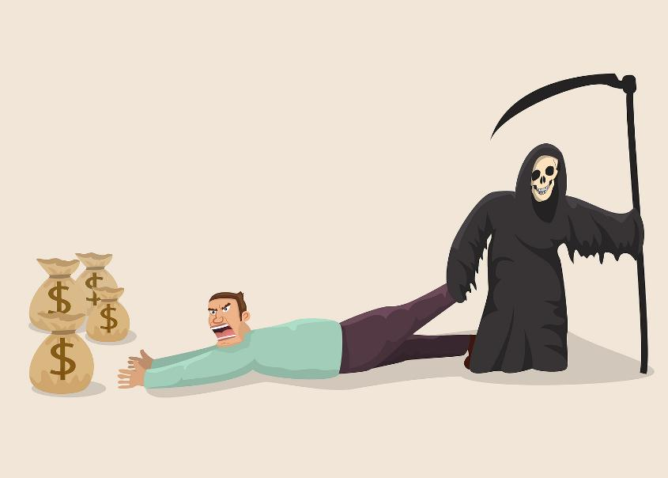
What’s Next for Our Wealth?
1 Timothy 6:7
“For we have brought nothing into the world, so we cannot take anything out of it, either.”
When someone dies, people may ask, “How much did he leave?”
The answer is always the same: “All of it!”

Slide 12



1 Timothy 6:7
“For we have brought nothing into the world, so we cannot take anything out of it, either.”
When someone dies, people may ask, “How much did he leave?”
The answer is always the same: “All of it.”
In what sense is it logically impossible to “die rich?”
How much financial wealth does the dead person get to keep?

Slide 13

Our wealth holding has a hidden timer. It will end.
It may end due to death or financial misfortune.
We just don’t know exactly when.
This means our chance to do something with wealth is temporary.
Once our chance is lost – it’s lost forever.

Slide 14

1 Timothy 6:7
“For we have brought nothing into the world, so we cannot take anything out of it, either.”
Our wealth holding has a hidden timer. It will end. It may end due to death or financial misfortune. We just don’t know exactly when. This means our chance to do something with wealth is temporary. Once our chance is lost – it’s lost forever.
As we plan our savings and spending in life, when do our spending needs stop?
Can we get any personal benefit from unused wealth after the end of this life?

Slide 15

1 Timothy 6:7
“For we have brought nothing into the world, so we cannot take anything out of it, either.”
Anxiously hoarding wealth just to die with it makes no sense. We can’t take it with us when we go. Facing this reality gives us freedom. It allows us to live differently. We can hold things lightly. We can follow the instruction to live as
“those who buy something, as if it were not theirs to keep; those who use the things of the world, as if not engrossed in them. For this world in its present form is passing away.” (1 Cor 7:30b-31 NIV).

Slide 16
1 Timothy 6:7
“For we have brought nothing into the world, so we cannot take anything out of it, either.”
Some people grip their wealth with a tight fist. They worry and strain to protect every penny. Others can hold wealth easily with an open hand. They know it will all disappear soon anyway.
Which wealth management approach leads to a life with more stress and anxiety?
If bad luck wiped out half their money, which type of person is more likely to still have peace and joy?
What examples have you seen of these different types of people in your life?

Slide 17
How Much Do We Need for Contentment?
1 Timothy 6:8
“If we have food and covering, with these we shall be content.” NASB
“But if we have food and shelter, we will be satisfied with that.” NET

Slide 18


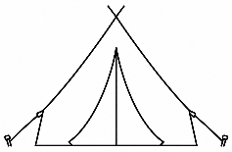

1 Timothy 6:8
“But if we have food and shelter, we will be satisfied with that.”
Consider a student who goes to college and lives in a dorm. Or consider a young, newlywed couple who haven’t yet built any wealth. Or suppose a person spends time with friends at a campground or on a hiking trip. In each case, food and shelter are simple.
Is contentment possible in such simple circumstances?
Are these sad times of life? Why not?

Slide 19
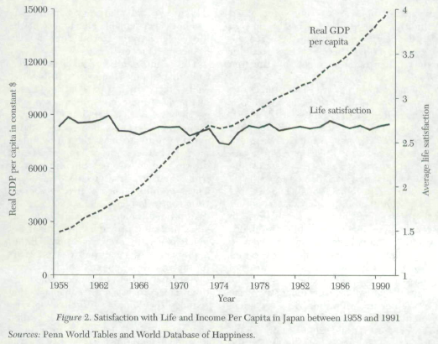

1 Timothy 6:8
“But if we have food and shelter, we will be satisfied with that.”
Over the last 65 years, real income per person in the US has more than quadrupled. Consumer products have multiplied by a hundredfold. Yet, neither life satisfaction nor financial satisfaction has increased at all. (The same is true for other prosperous countries.)
Why do you think this happens?
What does this tell us about money and contentment?

Slide 20


How Much Do We Need for Contentment?
1 Timothy 6:8
“But if we have food and shelter, we will be satisfied with that.”
Economists describe a universal experience called the “hedonic treadmill.” A new purchase or increased income or wealth creates a brief bump in satisfaction. But this feeling quickly fades. Satisfaction rapidly returns to baseline.
Keely, L. C. (2005). Why isn’t growth making us happier? Utility on the hedonic treadmill. Journal of Economic Behavior & Organization, 57(3), 333-355.

Slide 21



1 Timothy 6:8
“But if we have food and shelter, we will be satisfied with that.”
Economists describe a universal experience called the “hedonic treadmill.” A new purchase or increased income or wealth creates a brief bump in satisfaction. But this feeling quickly fades. Satisfaction rapidly returns to baseline.
Have you experienced this?
Why do you think this happens?

Slide 22


How Much Do We Need for Contentment?
1 Timothy 6:8
“But if we have food and shelter, we will be satisfied with that.”
A popular saying is, “The things you own end up owning you.”
As we accumulate more things, how do those things make demands on our lives?
Has the management and care of your possessions ever brought anxiety, stress, or discontentment to your life?

Slide 23

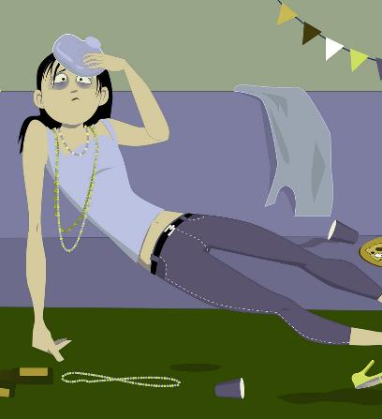

How Much Do We Need for Contentment?
1 Timothy 6:8
“But if we have food and shelter, we will be satisfied with that.”
We can use money to consume more. But filling our lives with more and more consumption doesn’t actually lead to more satisfaction. In fact, it can backfire.
Does bingeing with excess consumption lead to contentment?
What have you seen? What have you experienced?

Slide 24


How Much Do We Need for Contentment?
1 Timothy 6:8
“But if we have food and shelter, we will be satisfied with that.”
In Ecclesiastes 2, Solomon splurged on wine, women, entertainment, buildings, and gardens. He was the richest man on the planet, and he decided, “All that my eyes desired, I did not refuse them.” (Ecc 2:10). What was the result? After “considering all his activities,” he found “there was no benefit under the sun.” (Ecc 2:11). At the end of his experiment with bingeing on massive consumption, he wrote, “So, I hated life.” (Ecc 2:17).

Slide 25


How Much Do We Need for Contentment?
1 Timothy 6:8
“But if we have food and shelter, we will be satisfied with that.”
At the end of his experiment with bingeing on massive consumption, Solomon wrote, “So, I hated life.” (Ecclesiastes 2:17).
Can bingeing on excess consumption lead to depression even today?
Why does this happen?

Slide 26


How Much Do We Need for Contentment?
1 Timothy 6:8
“But if we have food and shelter, we will be satisfied with that.”
A financial consultant to lottery winners explained, “So many of them wind up unhappy... People commit suicide.” So, too, rich and famous rock stars often commit suicide.
Why doesn’t excess consumption lead to more happiness?
Why can it sometimes lead to depression or even suicide?

Slide 27
What about Leaving a Big Inheritance?
1 Timothy 6:7-8
“For we have brought nothing into the world, so we cannot take anything out of it, either. If we have food and covering, with these we shall be content.”

Slide 28


What about leaving a big inheritance?
As Jesus was teaching, a family fight over an inheritance broke out in the crowd. (Luke 12:13-14). Jesus responded by telling the story of a rich man who was blessed with even more wealth. The man planned to use it someday, but he never did. Instead, he just stacked it up and died with it. God called this man a fool. (Luke 12:15-21).

Slide 29
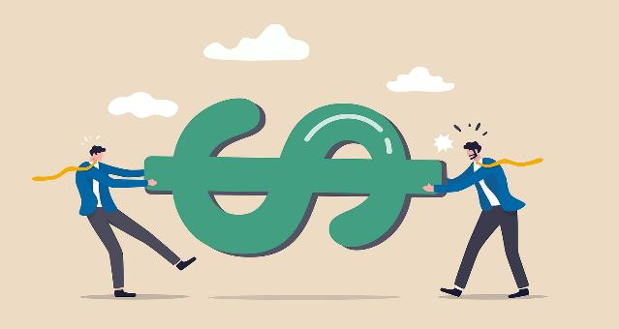

What about leaving a big inheritance?
“For we have brought nothing into the world, so we cannot take anything out of it, either. But if we have food and shelter, we will be satisfied with that.” 1 Timothy 6:7-8
Can a large inheritance lead to more family conflict than if nothing had been left? What have you seen?
This rich man saved all his wealth and died with it. What was God’s opinion of this?

Slide 30


What about leaving a big inheritance?
In the Parable of the Prodigal Son, the younger son “said to his father, ‘Father, give me the share of the estate that is coming to me.’” (Luke 15:12a). He then “squandered his estate in wild living.” (Luke 15:13b). The large inheritance left him in a terrible state, without food and shelter. He declared, “I am dying here from hunger!” (Luke 15:17b).

Slide 31

“For we have brought nothing into the world, so we cannot take anything out of it, either. But if we have food and shelter, we will be satisfied with that.” 1 Timothy 6:7-8
Would the end result have changed if the prodigal son had received an even larger lump sum?
Can leaving a big inheritance still lead to “wild living” today?
Can bingeing or addiction make an heir worse off than if they had received nothing?

Slide 32


What about leaving a big inheritance?
A national study of inheritors found that, within a year, 42% had their net worth fall back to (or below) their pre-inheritance level. They immediately spent it all. Inheritances were spent faster than any other type of financial windfall.
Thompson, C., & James III, R. (2026). Dissipation of inheritance windfalls and the case for time-phased transfers: An empirical assessment from HRS data. Financial Services Review, 34(1), 24-42.

Slide 33
What about leaving a big inheritance?
“For we have brought nothing into the world, so we cannot take anything out of it, either. But if we have food and shelter, we will be satisfied with that.” 1 Timothy 6:8
A national study of inheritors found that, within a year, 42% had their net worth fall back to (or below) their pre-inheritance level.
What do you think causes this rapid spending? Because it’s unearned money? Because it’s tied to grief and death?
What does this tell us about the outcome of leaving a lump sum at death?

Slide 34

Taking care of family, including heirs, is an important goal. (1 Tim 5:8, 16).
But it’s not an unlimited goal.
1 Timothy 6:8 says, “If we have food and covering, with these we shall be content.” This Greek word for “content” means enough, sufficient, and satisfied.

Slide 35


1 Timothy 6:7-8
“For we have brought nothing into the world, so we cannot take anything out of it, either. If we have food and covering, with these we shall be content.”
According to this verse, how much is enough to have contentment?
Why wouldn’t leaving even more to family members guarantee even more contentment?

Slide 36



“For we have brought nothing into the world, so we cannot take anything out of it, either. But if we have food and shelter, we will be satisfied with that.” 1 Timothy 6:7-8
It’s important not to leave family members in a needy circumstance. They should not become a financial burden on the church. (1 Timothy 5:16). This is our first financial responsibility. (1 Timothy 5:8).
Is this family provision goal better accomplished with one lump sum at death or payments spread over time?
After providing for needy heirs and dependents (food, clothing, and shelter) would you have any extra left over?

Slide 37
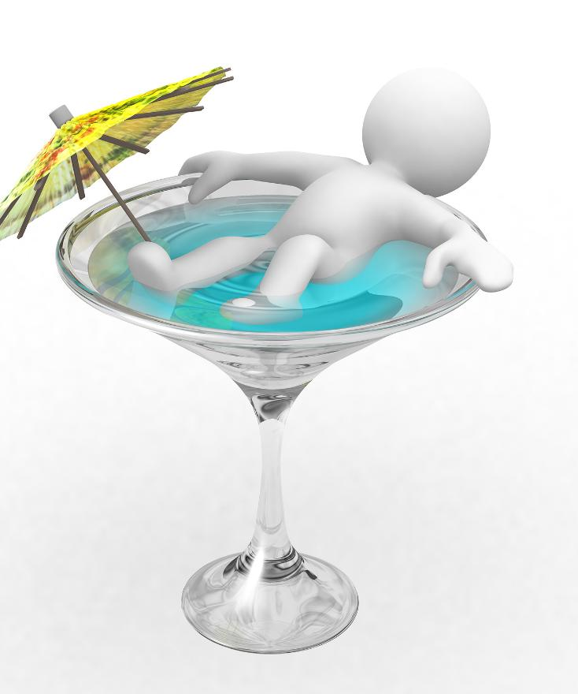
What about leaving a big inheritance?
It’s important to provide for needy family members. And what about family members who could support themselves but won’t? Scripture says this:
“For even when we were with you, we used to give you this order: if anyone is not willing to work, then he is not to eat, either.” (2 Thessalonians 3:10)
Providing for family is an important goal. But this does not mean enabling lazy “trust fund” kids. It does not require supporting those who are not in need.

Slide 38

“For we have brought nothing into the world, so we cannot take anything out of it, either. But if we have food and shelter, we will be satisfied with that.” 1 Timothy 6:7-8
If our family provision goals matched those of scripture, how would this affect the amount, the timing, and the instructions placed with an inheritance?
Why wouldn’t just leaving a larger lump sum guarantee a better outcome?
How does setting our inheritance goals this way change how much of our wealth is “extra” (an abundance freely available to use and enjoy in reaching other goals)?

Slide 39

What about leaving a big inheritance?
Solomon built more wealth than anyone else on the planet. He wrote,
“So, I hated all the fruit of my labor for which I had labored under the sun, because I must leave it to the man who will come after me. And who knows whether he will be wise or a fool?” (Ecclesiastes 2:18-19a).

Slide 40

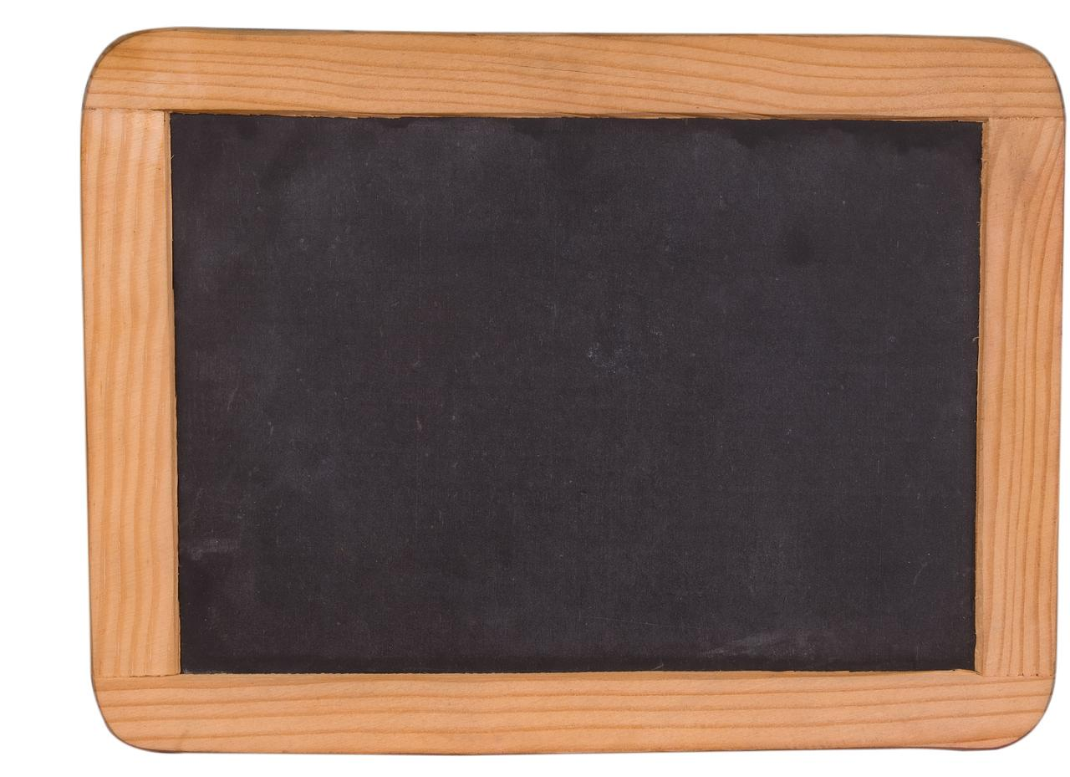
“So, I hated all the fruit of my labor for which I had labored under the sun, because I must leave it to the man who will come after me. And who knows whether he will be wise or a fool?” (Ecclesiastes 2:18-19a).
Does receiving a large windfall of unearned “death money” make wise life choices more likely or less likely?
What do you think? What have you seen?

Slide 41


What about leaving a big inheritance?
Leaving a big inheritance changes the owner of the wealth. It also changes the meaning of the wealth. Solomon explained, “When there is a person who has labored with wisdom, knowledge, and skill, and then gives his legacy to one who has not labored for it; this too is futility and a great evil.” (Ecclesiastes 2:21).

Slide 42

What about leaving a big inheritance?
“When there is a person who has labored with wisdom, knowledge, and skill, and then gives his legacy to one who has not labored for it; this too is futility and a great evil.” (Ecclesiastes 2:21).
Solomon left an enormous estate when he died. Did he think this was a good result?
Inherited wealth is received by “one who has not labored for it.” How does this wealth mean something different than it did to the one who earned it?

Slide 43


What Is the Proverbs 13:22 Inheritance?
In Proverbs, people can inherit many things. They can inherit honor (Proverbs 3:35), foolishness (Proverbs 14:18), good (Proverbs 28:10), or even the wind (Proverbs 11:29). In Proverbs 13:22, Solomon wrote,
“A good person leaves an inheritance to his grandchildren,”

Slide 44

What Is the Proverbs 13:22 Inheritance?
“A good person leaves an inheritance to his grandchildren,”
This Hebrew word for “leaves” describes a direct transfer to the grandchild. Inheritance laws of the time prohibited this. So, this inheritance wasn’t about money. The word for “good” person here means a beautifully good, ethically inspirational person.

Slide 45
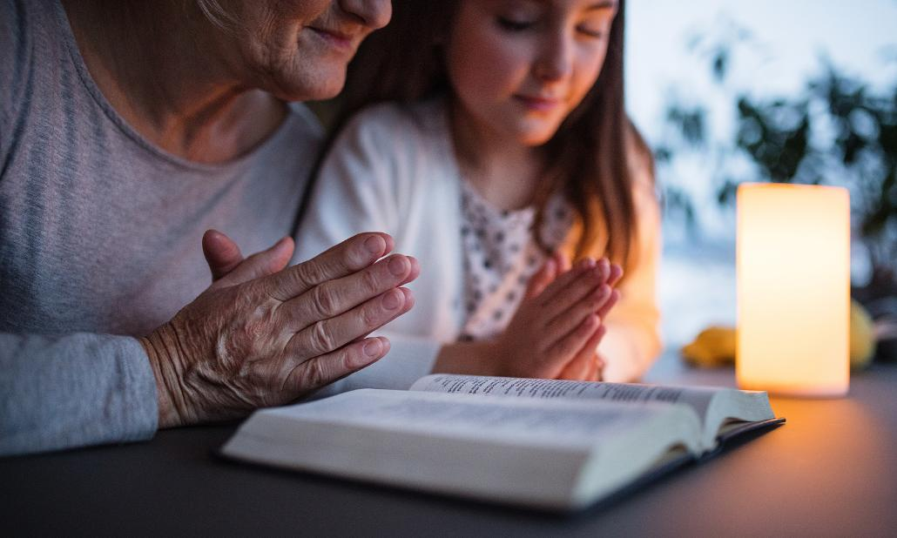

“A good person leaves an inheritance to his grandchildren, ” Proverbs 13:22a
Can grandchildren inherit wisdom, inspiration, or a good family reputation DIRECTLY from a “beautifully good, ethically inspirational” grandparent?
Is leaving this inheritance possible, even without a large financial estate?

Slide 46


“A good person leaves an inheritance to his grandchildren,
And the wealth of a sinner is stored up for the righteous.” Proverbs 13:22
Proverbs 13:22 continues, “And the wealth of a sinner is stored up for the righteous.”
Is inherited wealth sometimes used in ways that oppose the deceased person’s values?
What have you seen?

Slide 47
What’s the Wrong
Wealth Management Goal?
1 Timothy 6:9-10
“But those who want to get rich fall into temptation and a trap, and many foolish and harmful desires which plunge people into ruin and destruction. For the love of money is a root of all sorts of evil, and some by longing for it have wandered away from the faith and pierced themselves with many griefs.”

Slide 48

What’s the Wrong Wealth Management Goal?
Those in verse 9 “want to get rich.” This is not mere wishfulness. The word describes a driving, determined intention. They don’t just build a business, farm, or valuable skills that happen to make them wealthy. The whole point is to become rich.
One problem with working “to get rich” is that the person never gets there. They might accumulate wealth, but their definition of “rich” increases even faster. Solomon explained, “Whoever loves money never has enough; whoever loves wealth is never satisfied with their income.” (Ecclesiastes 5:10a). As mentioned earlier, only one in five with $50 million or more felt “extremely financially secure.”

Slide 49
“But those who want to get rich fall into temptation and a trap, and many foolish and harmful desires which plunge people into ruin and destruction. For the love of money is a root of all sorts of evil, and some by longing for it have wandered away from the faith and pierced themselves with many griefs.”
1 Timothy 6:9-10
How much money does it take to be “rich?”
Has your answer changed during your life? Why?
Do you think this happens to other people who accumulate wealth?

Slide 50


What’s the Wrong Wealth Management Goal?
“But those who want to get rich fall into temptation and a trap, and many foolish and harmful desires which plunge people into ruin and destruction. For the love of money is a root of all sorts of evil, and some by longing for it have wandered away from the faith and pierced themselves with many griefs.” 1 Timothy 6:9-10
Another problem with working “to get rich” is that this purpose prevents the enjoyment of the wealth. Spending feels painful because it hurts accumulation. It contradicts the goal.

Slide 51

What’s the Wrong Wealth Management Goal?
In 387 A.D., John Chrysostom wrote of 1 Tim 6:17, “The hoarder is a keeper, not a master, of wealth; a slave, not a Lord. For he would sooner give anyone part of his own flesh, than his buried gold. It’s as though he were ordered and compelled of someone to touch nothing of these hidden treasures. So with all earnestness he watches and keeps them, abstaining from them, as if it were another’s. And certainly, they are not his own. For what he can neither decide to share with others, nor distribute to the needy, even on pain of infinite punishments, how can he possibly account his own? How can he be a real owner of those things, of which he has neither free use, nor enjoyment?”

Slide 52
What’s the Wrong Wealth Management Goal?
“But those who want to get rich fall into temptation and a trap, and many foolish and harmful desires which plunge people into ruin and destruction. For the love of money is a root of all sorts of evil, and some by longing for it have wandered away from the faith and pierced themselves with many griefs.”
1 Timothy 6:9-10
If a person’s purpose is “to get rich,” why might this prevent him from using or enjoying his accumulated wealth?

Slide 53

What’s the Wrong Wealth Management Goal?
“But those who want to get rich fall into temptation and a trap, and many foolish and harmful desires which plunge people into ruin and destruction. For the love of money is a root of all sorts of evil, and some by longing for it have wandered away from the faith and pierced themselves with many griefs.”
1 Timothy 6:9-10
If our goal is just to die financially rich, how might this path lead to “ruin,” “destruction,” and “many griefs”? (1 Timothy 6:9-10).

Slide 54

What’s the Wrong Wealth Management Goal?
Both work and the right use of its financial fruits can be enjoyable. But toiling and suffering just to get rich makes for a terrible life experience. It’s doubly bad because this goal also prevents enjoying the wealth. It leads to hoarding. It leads to burying the wealth just to die with it. Solomon describes the painful path this way: “When there is a person who has labored with wisdom, knowledge, and skill, and then gives his legacy to one who has not labored for it; this too is futility and a great evil. For what does a person get in all his labor and in his striving with which he labors under the sun? Because all his days his activity is painful and irritating; even at night his mind does not rest. This too is futility.” (Ecclesiastes 2:21-23).

Slide 55

What’s the Wrong Wealth Management Goal?
1 Timothy 6:17-18 describes an alternative. We can enjoy wealth as a gift from God. We can enjoy it by using it “to do good.” We can use it “to be rich in good works.”
Solomon describes the alternative this way:
“I know that there is nothing better for them than to be glad and to do good in one’s lifetime; moreover, that every man who eats and drinks and sees good in all his labor—it is the gift of God.” (Ecclesiastes 3:12-13).

Slide 56
What’s the Wrong Wealth Management Goal?
“When there is a person who has labored with wisdom, knowledge, and skill, and then gives his legacy to one who has not labored for it; this too is futility and a great evil. For what does a person get in all his labor and in his striving with which he labors under the sun? Because all his days his activity is painful and irritating; even at night his mind does not rest. This too is futility.” (Ecclesiastes 2:21-23).
“I know that there is nothing better for them than to be glad and to do good in one’s lifetime; moreover, that every man who eats and drinks and sees good in all his labor—it is the gift of God.” (Ecclesiastes 3:12-13).
How would working “to get rich” as compared with working “to be rich in good works” match Solomon’s two paths?

Slide 57

What’s the Wrong Wealth Management Goal?
“But those who want to get rich fall into temptation and a trap, and many foolish and harmful desires which plunge people into ruin and destruction. For the love of money is a root of all sorts of evil, and some by longing for it have wandered away from the faith and pierced themselves with many griefs.”
1 Timothy 6:9-10
It is possible to anxiously hoard wealth, grasping it tightly.
How might holding it more open-handedly allow for more enjoyment?
Might this help us to be ready for an opportune moment when we can use it to do good?

Slide 58
Part II:
The Wealth Enjoyment Manual
(1 Timothy 6:17-19)

Slide 59
Wealth Enjoyment: That’s the Point!
1 Timothy 6:17-19
“Instruct those who are rich in this present world not to be high-minded or to set their hope on the uncertainty of riches but on God, who richly supplies us with all things for enjoyment: to do good, to be rich in good works, to be generous and ready to share,”

Slide 60


Wealth Enjoyment: That’s the Point
“Instruct those who are rich in this present world not to be high-minded or to set their hope on the uncertainty of riches but on God, who richly supplies us with all things for enjoyment: to do good, to be rich in good works, to be generous and ready to share,”
1 Timothy 6:17-18
God richly provides all things. This can include wealth. It can include the ability to produce wealth. (Deuteronomy 8:18). But why? What is it for? What is its purpose?
This passage gives the answer. God gave it to us for enjoyment. The phrase “for enjoyment” is eis [for] apolausin [enjoyment]. In technical terms,
“The construction eis plus the noun expresses purpose.”
The purpose is enjoyment. The reason God richly supplies us with all things, including wealth, is for enjoyment.

Slide 61
“Instruct those who are rich in this present world not to be high-minded or to set their hope on the uncertainty of riches but on God, who richly supplies us with all things for enjoyment: to do good, to be rich in good works, to be generous and ready to share,”
1 Timothy 6:17-18
Does this surprise you?
How do you feel about this?
God richly provides all things. This can include wealth. It can include the ability to produce wealth. (Deuteronomy 8:18). But why? What is it for? What is its purpose?
This passage gives the answer. God gave it to us for enjoyment. The phrase “for enjoyment” is eis [for] apolausin [enjoyment]. In technical terms,
“The construction eis plus the noun expresses purpose.”
The purpose is enjoyment. The reason God richly supplies us with all things, including wealth, is for enjoyment.

Slide 62

“Instruct those who are rich in this present world not to be high-minded or to set their hope on the uncertainty of riches but on God, who richly supplies us with all things for enjoyment: to do good, to be rich in good works, to be generous and ready to share,”
1 Timothy 6:17-18
The word used for “enjoyment” here is extreme. It’s party-time enjoyment. It’s used only one other time in scripture:
“By faith Moses, when he had grown up, refused to be called the son of Pharaoh’s daughter, choosing rather to endure ill-treatment with the people of God than to enjoy [apolausin] the temporary pleasures of sin,” (Hebrews 11:24-25).
In Hebrews, this word describes the enjoyment of “the temporary pleasures of sin.” In 1 Timothy, it’s not sinful, but it’s still physical, sensual, material enjoyment.

Slide 63
“Instruct those who are rich in this present world not to be high-minded or to set their hope on the uncertainty of riches but on God, who richly supplies us with all things for enjoyment: to do good, to be rich in good works, to be generous and ready to share,”
1 Timothy 6:17-18
Does this surprise you?
How do you feel about this?
The word used for “enjoyment” here is extreme. It’s party-time enjoyment. It’s used only one other time in scripture:
“By faith Moses, when he had grown up, refused to be called the son of Pharaoh’s daughter, choosing rather to endure ill-treatment with the people of God than to enjoy [apolausin] the temporary pleasures of sin,” (Hebrews 11:24-25).
In Hebrews, this word describes the enjoyment of “the temporary pleasures of sin.” In 1 Timothy, it’s not sinful, but it’s still physical, sensual, material enjoyment.

Slide 64

“Instruct those who are rich in this present world not to be high-minded or to set their hope on the uncertainty of riches but on God, who richly supplies us with all things for enjoyment: to do good, to be rich in good works, to be generous and ready to share,”
1 Timothy 6:17-18
There are only four wealth management options: binge, bury, toil, or enjoy. We can,
BINGE on excess consumption and wild living.
BURY the wealth and die with it.
TOIL ceaselessly to stack up even more.
ENJOY it (by using it to do good, to be rich in good works, to be generous and ready to share).
The point of this passage is “for enjoyment.” Everything before this phrase explains why wealth holders should enjoy their wealth. Everything after it explains how they can do so.
BINGE BURY
TOIL
ENJOY

Slide 65
“Instruct those who are rich in this present world not to be high-minded or to set their hope on the uncertainty of riches but on God, who richly supplies us with all things for enjoyment: to do good, to be rich in good works, to be generous and ready to share,”
1 Timothy 6:17-18
How does choosing to binge with wealth contradict
wealth
enjoyment?
There are only four wealth management options: binge, bury, toil, or enjoy. We can,
BINGE on excess consumption and wild living.
BURY the wealth and die with it.
TOIL ceaselessly to stack up even more.
ENJOY it (by using it to do good, to be rich in good works, to be generous and ready to share).
The point of this passage is “for enjoyment.” Everything before this phrase explains why wealth holders should enjoy their wealth. Everything after it explains how they can do so.
BINGE BURY
TOIL
ENJOY

Slide 66
“Instruct those who are rich in this present world not to be high-minded or to set their hope on the uncertainty of riches but on God, who richly supplies us with all things for enjoyment: to do good, to be rich in good works, to be generous and ready to share,”
1 Timothy 6:17-18
How does choosing to bury wealth and die with it contradict wealth enjoyment?
There are only four wealth management options: binge, bury, toil, or enjoy. We can,
BINGE on excess consumption and wild living.
BURY the wealth and die with it.
TOIL ceaselessly to stack up even more.
ENJOY it (by using it to do good, to be rich in good works, to be generous and ready to share).
The point of this passage is “for enjoyment.” Everything before this phrase explains why wealth holders should enjoy their wealth. Everything after it explains how they can do so.
BINGE BURY
TOIL
ENJOY

Slide 67
“Instruct those who are rich in this present world not to be high-minded or to set their hope on the uncertainty of riches but on God, who richly supplies us with all things for enjoyment: to do good, to be rich in good works, to be generous and ready to share,”
1 Timothy 6:17-18
How does choosing to toil ceaselessly to stack up even more wealth contradict wealth enjoyment?
There are only four wealth management options: binge, bury, toil, or enjoy. We can,
BINGE on excess consumption and wild living.
BURY the wealth and die with it.
TOIL ceaselessly to stack up even more.
ENJOY it (by using it to do good, to be rich in good works, to be generous and ready to share).
The point of this passage is “for enjoyment.” Everything before this phrase explains why wealth holders should enjoy their wealth. Everything after it explains how they can do so.
BINGE BURY
TOIL
ENJOY

Slide 68
Wealth Enjoyment: Move from Wealth to Abundance!
1 Timothy 6:17-19
“Instruct those who are rich in this present world not to be high-minded or to set their hope on the uncertainty of riches but on God, who richly supplies us with all things for enjoyment: to do good, to be rich in good works, to be generous and ready to share,”

Slide 69

Wealth vs. Abundance
It’s easy to think that wealth brings abundance. It doesn’t. A miser or hoarder may have great wealth, but they’ll have no abundance. They’ll have nothing that’s “extra.”

Slide 70


“not to … set their hope on the uncertainty of riches but on God”
“Instruct those who are rich in this present world not to be high-minded or to set their hope on the uncertainty of riches but on God, who richly supplies us with all things for enjoyment: to do good, to be rich in good works, to be generous and ready to share,” 1 Timothy 6:17-18
If we set our hope in wealth, we will never have enough. We’ll never have enough because wealth is uncertain. What if we save up more than our remaining lifetime of spending minus earning? That’s still not enough. Why not? Because we can still be afraid.

Slide 71

What if an injury happens and we can’t earn income as expected?

Slide 72

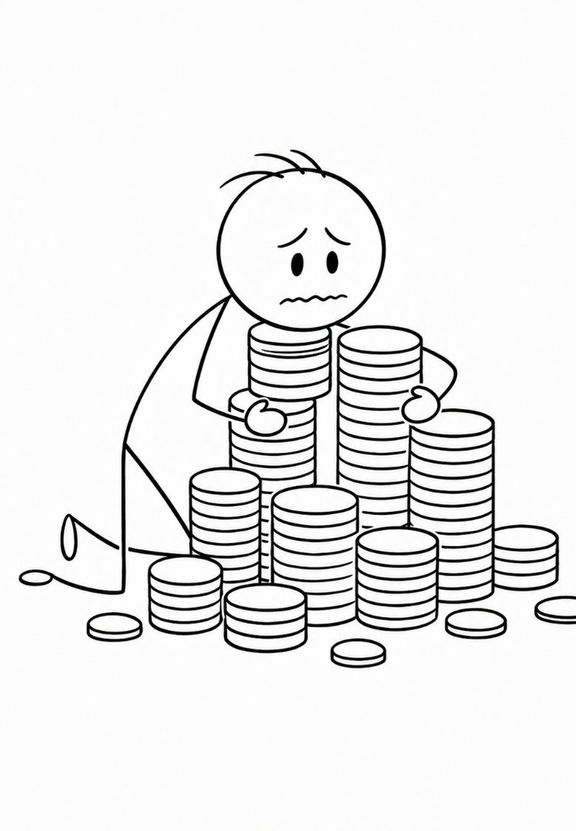
What if an injury happens and we can’t earn income as expected?
We might need to pile up even more. (Or buy disability insurance.)

Slide 73


But we can still be afraid
What if an injury happens and we can’t earn income as expected?
We might need to pile up even more. (Or buy disability insurance.)

Slide 74
What if we live a really long time?

Slide 75

What if we live a really long time?
We might need to pile up even more. (Or we can buy a deferred annuity.)

Slide 76
But we can still be afraid
What if we live a really long time?
We might need to pile up even more. (Or we can buy a deferred annuity.)

Slide 77
What if inflation makes money worth much less?

Slide 78

What if inflation makes money worth much less?
We might need to pile up more assets. (Or we can buy inflation-protected government bonds.)

Slide 79
But we can still be afraid
What if inflation makes money worth much less?
We might need to pile up more assets. (Or we can buy inflation-protected government bonds.)

Slide 80
What if we need to pay for a nursing home?

Slide 81
What if we need to pay for a nursing home?
We might need to pile up even more. (Or we can buy nursing home insurance.)

Slide 82
But we can still be afraid
What if we need to pay for a nursing home?
We might need to pile up even more. (Or we can buy nursing home insurance.)

Slide 83
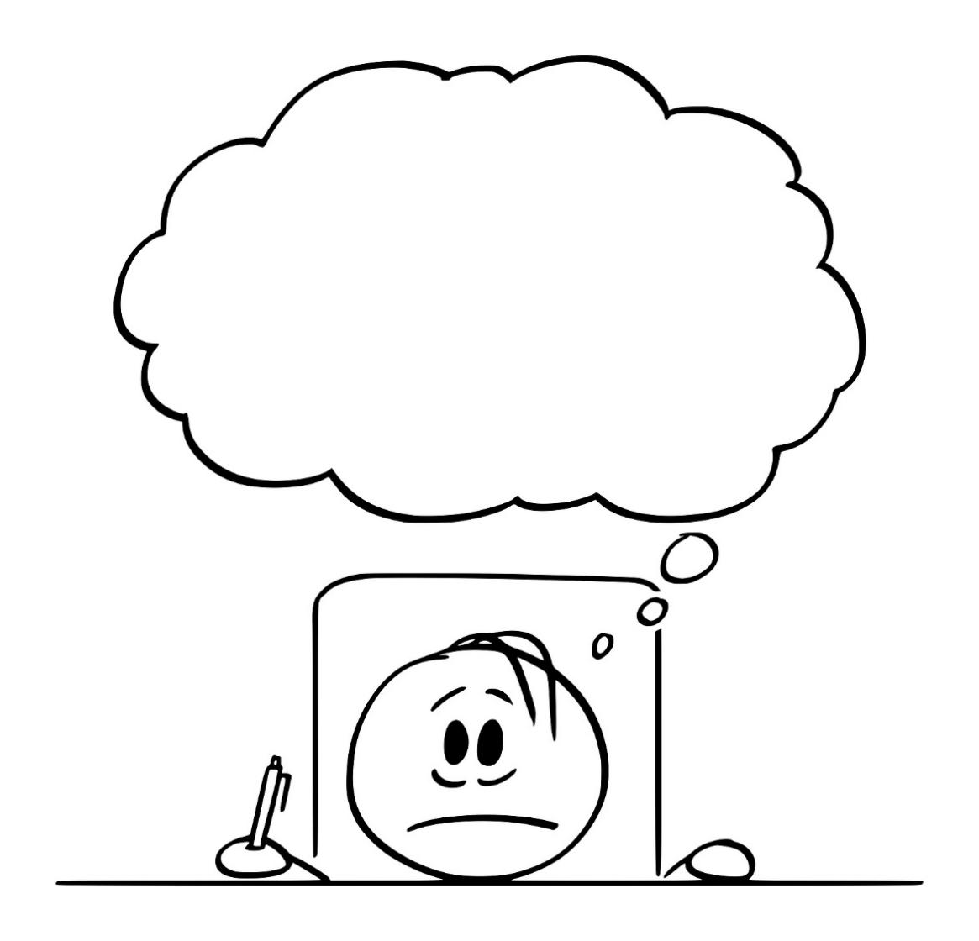
What if
we get sued?

Slide 84
What if
the market collapses?

Slide 85
What if the insurance company collapses?

Slide 86
What if there’s a war or revolution?

Slide 87
What if the government taxes or takes our stuff?

Slide 88
What if a thief breaks in and steals?

Slide 89
What if moths and rust destroy?

Slide 90

There is no limit to financial fear.
Why?
Because wealth is uncertain.

Slide 91
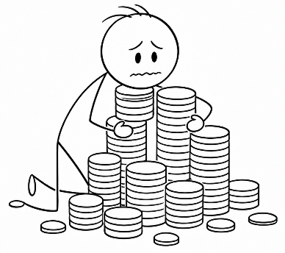
“Instruct those who are rich in this present world not to be high-minded or to set their hope on the uncertainty of riches but on God, who richly supplies us with all things for enjoyment: to do good, to be rich in good works, to be generous and ready to share,” 1 Timothy 6:17-18
If we hope in riches, security means having more than enough for every fear, like theft, lawsuits, war, and investment failure. How much is this?
Can any amount of savings erase these fears?

Slide 92
“Instruct those who are rich in this present world not to be high-minded or to set their hope on the uncertainty of riches but on God, who richly supplies us with all things for enjoyment: to do good, to be rich in good works, to be generous and ready to share,” 1 Timothy 6:17-18
If we’re always afraid that we might need the money, will it ever feel like we have extra?
Will we ever live in abundance?

Slide 93


“Instruct those who are rich in this present world not to be high-minded or to set their hope on the uncertainty of riches but on God, who richly supplies us with all things for enjoyment: to do good, to be rich in good works, to be generous and ready to share,” 1 Timothy 6:17-18
Suppose instead we set our hope and trust in God’s ongoing, rich provision. Does this make it easier for part of our accumulated wealth to become “extra”?
How does this help us to live in a state of abundance?

Slide 94


Fear leads to burying wealth.
“Instruct those who are rich in this present world not to be high-minded or to set their hope on the uncertainty of riches but on God, who richly supplies us with all things for enjoyment: to do good, to be rich in good works, to be generous and ready to share,” 1 Timothy 6:17-18
In the Parable of the Talents, a “talent” is a weight. It’s about 130 pounds (58 kilograms) of gold. In this parable, the bad steward buried his chunk of gold. He explained,
“And I was afraid, so I went away and hid your talent in the ground.” (Matthew 25:25).

Slide 95

Fear leads to burying wealth.
“Instruct those who are rich in this present world not to be high-minded or to set their hope on the uncertainty of riches but on God, who richly supplies us with all things for enjoyment: to do good, to be rich in good works, to be generous and ready to share,” 1 Timothy 6:17-18
In the Parable of the Minas, the bad steward hides money away in a napkin. He explained,
“here is your mina, which I kept tucked away in a handkerchief; for I was afraid”. (Luke 19:20b-21a).

Slide 96

“Instruct those who are rich in this present world not to be high-minded or to set their hope on the uncertainty of riches but on God, who richly supplies us with all things for enjoyment: to do good, to be rich in good works, to be generous and ready to share,” 1 Timothy 6:17-18
How can fear lead to burying wealth rather than using or enjoying it?
How can fear affect our willingness to enjoy wealth by using it to do good?
“And I was afraid, so I went away and hid your talent in the ground.” (Matthew 25:25).
“here is your mina, which I kept tucked away in a handkerchief; for I was afraid”. (Luke 19:20b-21a).

Slide 97

“Instruct those who are rich in this present world not to be high-minded or to set their hope on the uncertainty of riches but on God, who richly supplies us with all things for enjoyment: to do good, to be rich in good works, to be generous and ready to share,” 1 Timothy 6:17-18
How might setting our hope in a richly providing God rather than in hidden riches affect this fear?
“And I was afraid, so I went away and hid your talent in the ground.” (Matthew 25:25).
“here is your mina, which I kept tucked away in a handkerchief; for I was afraid”. (Luke 19:20b-21a).

Slide 98

Move from Wealth to Abundance!
In this passage, God richly “supplies” [parechonti] all things. This word starts with pare meaning “from close-beside.” It means to give in an “up-close-and-personal” way.
This isn’t a disconnected transfer. It’s part of an up-close-and-personal relationship. And it’s not a one-time event. The verb tense includes the ongoing past, present, and future. One translation uses, “God, the One who is constantly offering us all things”. Setting our hope in a close-beside, constantly providing God changes wealth into abundance. More of it can become extra. This is a great gain. As 1 Timothy 6:6 (NIV) says,
“But godliness with contentment is great gain.”

Slide 99
Move from Wealth to Abundance
“Instruct those who are rich in this present world not to be high-minded or to set their hope on the uncertainty of riches but on God, who richly supplies us with all things for enjoyment: to do good, to be rich in good works, to be generous and ready to share,” 1 Timothy 6:17-18
Move from Wealth to Abundance!
Consider the good things God has supplied in any area of your life. (This includes relationships, work, school, leisure, physical and mental health, spirituality, money, daily living and so forth.)
What are the first three that come to mind?

Slide 100
Move from Wealth to Abundance
“Instruct those who are rich in this present world not to be high-minded or to set their hope on the uncertainty of riches but on God, who richly supplies us with all things for enjoyment: to do good, to be rich in good works, to be generous and ready to share,” 1 Timothy 6:17-18
Move from Wealth to Abundance!
How does trusting in an “up-close-and-personal,” “constantly providing” God affect our anxiety about money and our future?
How does it free us to enjoy more of what we have by using it to do good?

Slide 101
Wealth Enjoyment:
Don’t Give Until It Hurts!
1 Timothy 6:17-19
“Instruct those who are rich in this present world not to be high-minded or to set their hope on the uncertainty of riches but on God, who richly supplies us with all things for enjoyment: to do good, to be rich in good works, to be generous and ready to share,”

Slide 102

Wealth Enjoyment:
Don’t Give Until It Hurts!
Not all giving is acceptable to God. Scripture describes acceptable giving as
Hilariously cheerful (2 Corinthians 9:7)
Overflowing from abundant joy (2 Corinthians 8:2)
“Party-time” enjoyable (1 Timothy 6:17)
Happy and blessed (Acts 20:35)
With love (1 Corinthians 13:3) and from the heart (Exodus 25:2, 35:5; Deuteronomy 15:10; 1 Chronicles 29:9, 17, 18; 2 Corinthians 9:7)
These all describe a consistent attitude, emotion, and feeling.

Slide 103
Move from Wealth to Abundance
“Instruct those who are rich in this present world not to be high-minded or to set their hope on the uncertainty of riches but on God, who richly supplies us with all things for enjoyment: to do good, to be rich in good works, to be generous and ready to share,” 1 Timothy 6:17-18
Wealth Enjoyment:
Don’t Give Until It Hurts!
When you think of an ideal giver, what image comes to mind? Is it an image of happiness, love, and hilarious joy?
In scriptural terms, what should it feel like to make a good gift?
Have you ever made a gift that brought you joy? What was it?

Slide 104
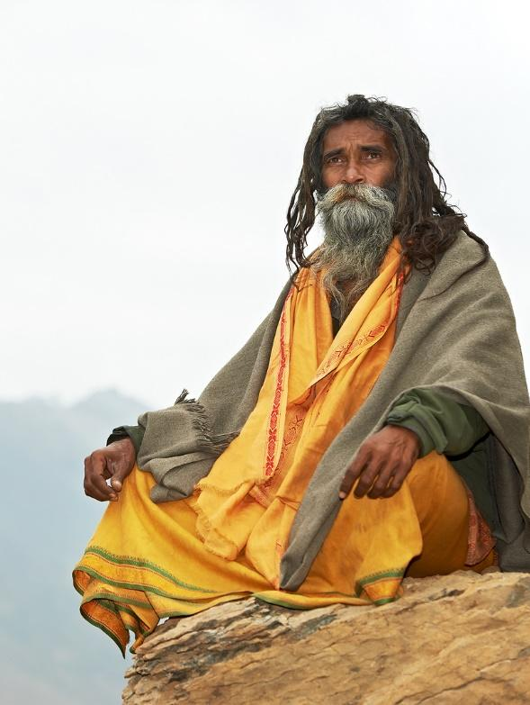
Wealth Enjoyment:
Don’t Give Until It Hurts!
Scripture describes giving with happiness, love, and hilarious joy. The opposite of this is painful giving. This conflict isn’t just practical. It’s theological.
In asceticism, a person proves their spirituality through self-denial and suffering. Asceticism says that the ideal giver is the suffering giver. Scripture opposes this philosophy.
“Let no one disqualify you, insisting on asceticism … These have indeed an appearance of wisdom in promoting self-made religion and asceticism and severity to the body, but they are of no value in stopping the indulgence of the flesh.” (Colossians 2:18a, 23 ESV).

Slide 105

Asceticism rejects material enjoyment. It does not follow the “God who richly supplies us with all things for [the purpose of] enjoyment.” (1 Timothy 6:17b).
Hilariously cheerful (2 Corinthians 9:7); Overflowing from abundant joy (2 Corinthians 8:2); “Party-time” enjoyable (1 Timothy 6:17); Happy and blessed (Acts 20:35)
Is the correct image of an ideal giver one of suffering and painful sacrifice? Or is it one of happiness, love, and hilarious joy?
Which one matches scripture?

Slide 106

Wealth Enjoyment:
Don’t Give Until It Hurts!
Giving the right way is about happiness, love, and joy. We see this joy even in the ultimate gift of God. We see it in Jesus, “who for the joy set before Him endured the cross.” (Hebrews 12:2).
A good gift might be costly. But being costly or painful doesn’t make it a good gift. The largest possible gift is to give away everything. Does that make it a good gift? No. Scripture says,
  “If I give away all I have, and if I deliver up my body to be burned, but have not love, I gain nothing.” (1 Corinthians 13:3 ESV).
Other versions read, “It does me no good” or “I have helped nothing.” This is the biggest gift possible. It’s the most painful gift possible. But it’s not a good gift.

Slide 107
Asceticism rejects material enjoyment. It does not follow the “God who richly supplies us with all things for [the purpose of] enjoyment.” (1 Timothy 6:17b).
“If I give away all I have, and if I deliver up my body to be burned, but have not love, I gain nothing.” (1 Corinthians 13:3 ESV).
Giving everything you have means you made the biggest possible gift. Why doesn’t that make it a good gift?
How important is our emotional experience when making a gift? Does it really matter as long as we still give?

Slide 108

Wealth Enjoyment:
Don’t Give Until It Hurts!
In the story of the widow’s mite, Jesus says she “put in all she owned.” (Mark 12:44). Was this a good gift? We can’t tell because we don’t know her emotional experience. (1 Corinthians 13:3).
Jesus simply says, “She put in more.” (Mark 12:43; Luke 21:3). He doesn’t say, “She did it the right way.” He doesn’t say, “Go and do likewise.”
He ends the story by explaining why donating to the temple was pointless, for both for the poor widow and for the rich. The temple they were donating to was about to be destroyed. Jesus reveals, “Not one stone will be left upon another” (Mark 13:2b).

Slide 109
Asceticism rejects material enjoyment. It does not follow the “God who richly supplies us with all things for [the purpose of] enjoyment.” (1 Timothy 6:17b).
“If I give away all I have, and if I deliver up my body to be burned, but have not love, I gain nothing.” (1 Corinthians 13:3 ESV).
The widow put in more. She gave everything she owned. Does this make it a good gift? If not, what else is needed?

Slide 110

Wealth Enjoyment:
Don’t Give Until It Hurts!
Jesus said to the rich young ruler,
“One thing you lack: Go your way, sell whatever you have and give to the poor, and you will have treasure in heaven; and come, take up the cross, and follow Me.” (Mark 10:21 NKJV).
Jesus is offering this man a chance to join His disciples. And He’s telling him that joining will likely end in the man’s execution. (The cross wasn’t yet a symbol of redemption. It was just an instrument of execution – like a hangman’s noose or an electric chair.)

Slide 111
Consider a similar situation today. Suppose a young man was flying out tomorrow with a missionary group. They’ll preach Jesus in the streets of Afghanistan until they’re arrested and likely executed. He’s young, unmarried, and has no family needing support. Suppose he also has some stored wealth.
What’s the most enjoyment this person could get from his wealth before leaving on a likely fatal mission?
Might this include “making it rain” money on those in need?

Slide 112

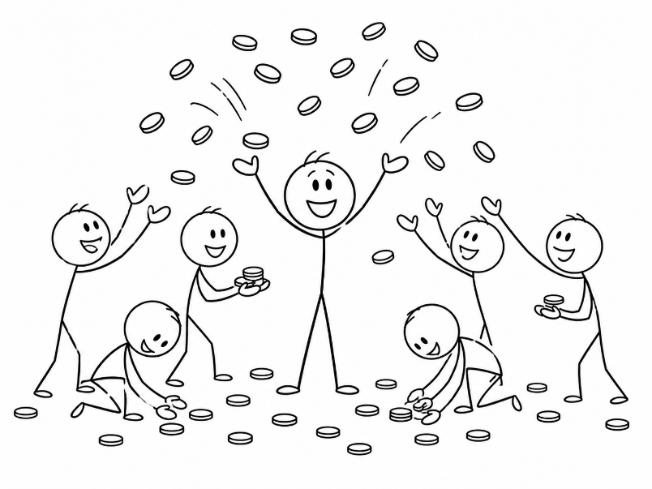
“One thing you lack: Go your way, sell whatever you have and give to the poor, and you will have treasure in heaven; and come, take up the cross, and follow Me.” (Mark 10:21 NKJV).
Is Jesus calling the rich young ruler to give as a painful sacrifice?
Or is Jesus calling him to get enjoyment (and lasting benefit) from his wealth before it’s all lost at the man’s imminent death? What do you think?

Slide 113


Wealth Enjoyment:
Don’t Give Until It Hurts!
Scripture tells us to hold material things open-handedly. It instructs,
  “those who buy something, as if it were not theirs to keep; those who use the things of the world, as if not engrossed in them. For this world in its present form is passing away.” (1 Corinthians 7:30b-31 NIV).
This doesn’t say, “Don’t buy.” It doesn’t say, “Don’t use.” It says to use it, but know it’s all passing away. Buy it, but know you can’t keep it. We can’t take it with us when we die.

Slide 114
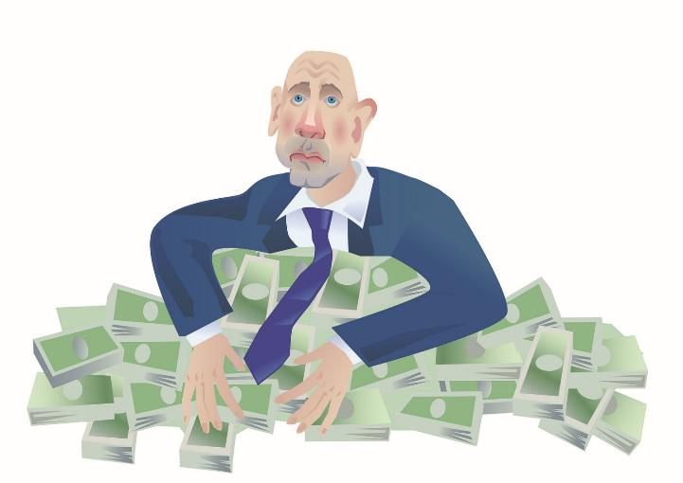

Wealth Enjoyment:
Don’t Give Until It Hurts!
The greedy miser says, “Hold every penny tightly.” The harsh ascetic says, “Never hold wealth.” These might seem like opposites. But they both live the same way.
Both the ascetic and the greedy miser refuse to enjoy wealth. Both view this as a virtue. The ascetic looks down on the one who enjoys wealth. So does the miser.
The idea that God richly provides us with all things for the purpose of enjoyment opposes them both.

Slide 115
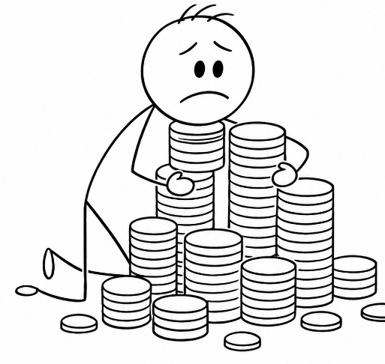
Move from Wealth to Abundance
“Instruct those who are rich in this present world not to be high-minded or to set their hope on the uncertainty of riches but on God, who richly supplies us with all things for enjoyment: to do good, to be rich in good works, to be generous and ready to share,” 1 Timothy 6:17-18
Wealth Enjoyment:
Don’t Give Until It Hurts!
Have you known people who had wealth but refused to use it for anything?
In what way do the ascetic “holy man” of Eastern religions and the greedy miser live the same way?

Slide 116
Wealth Enjoyment:
People Like Us Do Things Like This!
1 Timothy 6:17-19
“Instruct those who are rich in this present world not to be high-minded or to set their hope on the uncertainty of riches but on God, who richly supplies us with all things for enjoyment: to do good, to be rich in good works, to be generous and ready to share,”

Slide 117
This passage starts with the wealth holders. Then, it switches to “us” all. Not everyone must decide what to do with their wealth. But everyone must decide what to do with the things God has richly supplied. Rich Christians should be rich “in good works.” So should poor Christians. Even elderly widows seeking financial support from the church have the same obligation. (1 Timothy 5:10).
How does God richly provide for us in ways other than wealth?
How have you seen others using their gifts from God in a way that makes them “rich in good works?”

Slide 118
Move from Wealth to Abundance
“Instruct those who are rich in this present world not to be high-minded or to set their hope on the uncertainty of riches but on God, who richly supplies us with all things for enjoyment: to do good, to be rich in good works, to be generous and ready to share,”
1 Timothy 6:17-18
Wealth Enjoyment:
People Like Us Do Things Like This!
When you were young, who taught you to be generous?
Did you have any role models for sharing and giving?
Were they all financially wealthy?

Slide 119


Wealth Enjoyment:
People Like Us Do Things Like This!
In the Parable of the Talents, the good steward immediately put his talent to work. And by doing so, he ends up with even more. By putting the talent to work, it grows. He gets more. Plus, he gets much, much more when the master returns.
Consider those who have the gift of teaching. Fear could cause them to keep it hidden. But hiding it won’t allow it to grow. (It might even rust, fade, or begin to disappear.) Or they could choose to enjoy it by putting it to work. They could use their gift of teaching to do good. They could use it to become rich in visible good works. They could share it with the fellowship community.

Slide 120


“Instruct those who are rich in this present world not to be high-minded or to set their hope on the uncertainty of riches but on God, who richly supplies us with all things for enjoyment: to do good, to be rich in good works, to be generous and ready to share,” 1 Timothy 6:17-18
Wealth Enjoyment:
People Like Us Do Things Like This!
We can hide a gift. Or we can enjoy it by putting it to work to do good. How might this apply to a person with gifts of leading, serving, encouraging, or teaching?
How might fear motivate their choice to hide or bury their gift rather than share it?
How does the wealth holder face this same choice between burying a gift and using it for good?

Slide 121
Wealth Enjoyment:
Accomplish Something with It!
1 Timothy 6:17-19
“Instruct those who are rich in this present world not to be high-minded or to set their hope on the uncertainty of riches but on God, who richly supplies us with all things for enjoyment: to do good, to be rich in good works, to be generous and ready to share,”

Slide 122


Wealth Enjoyment:
Accomplish Something with It!
In this passage, what follows “for enjoyment” explains how to accomplish that enjoyment. It’s the “how to” manual for wealth enjoyment.
Notice that it doesn’t say to just give. Instead, it says, “to do good.”
This Greek word references,
  “a work or worker who accomplishes something … a deed (action) that carries out (completes) an inner desire (intention, purpose).”

Slide 123

“…God, who richly supplies us with all things for enjoyment: to do good, to be rich in good works, to be generous and ready to share,” 1 Timothy 6:17b-18
Wealth Enjoyment:
Accomplish Something with It!
What’s the difference between doing good and just giving away money?
How is it more enjoyable to “accomplish,” “carry out,” and “complete” an inner desire to do good rather than to just give away money?

Slide 124
Wealth Enjoyment:
Accomplish Something with It
In the Bible, God wants only a specific kind of giving. He wants giving only with the right emotion.
It should be hilariously cheerful (2 Corinthians 9:7), overflowing from abundant joy (2 Corinthians 8:2), from the heart (Exodus 25:2, 35:5; Deuteronomy 15:10; 1 Chronicles 29:9, 17, 18; 2 Corinthians 9:7), with love (1 Corinthians 13:3), happy and blessed (Acts 20:35), and “party-time” enjoyable (1 Timothy 6:17). Even if we give away everything, without the right emotion, it’s all pointless. (1 Corinthians 13:3).

Slide 125
“…God, who richly supplies us with all things for enjoyment: to do good, to be rich in good works, to be generous and ready to share,” 1 Timothy 6:17b-18
Wealth Enjoyment:
Accomplish Something with It!
Does it matter to God if our giving brings us positive emotion and enjoyment?
Is this experience more likely when our giving does good by fulfilling an inner desire?
Think about the future possibilities for your own giving. What types of good works would you most enjoy creating? What would match your inner desires?

Slide 126


Wealth Enjoyment: Accomplish Something with It!
Achieving enjoyment from our own personal consumption is limited. Bingeing by stuffing in even more often ends poorly. But enjoyment from accomplishing good works is unlimited. In 1946, Professor Richard Lenski explained 1 Timothy 6:17-19 this way:
“Riches furnish a rich man special means for tasting this enjoyment. He can be in only one suit of clothes, sit only in one chair, eat only one meal at mealtime; but with his wealth he can reach out in a thousand directions and work good.”

Slide 127

“…God, who richly supplies us with all things for enjoyment: to do good, to be rich in good works, to be generous and ready to share,” 1 Timothy 6:17b-18
Wealth Enjoyment:
Accomplish Something with It!
How does the enjoyment from accomplishing good works differ from personal consumption?
Which is more enjoyable to look back on a month later? A year later? At the end of this life? After this life?

Slide 128

Wealth Enjoyment:
Accomplish Something with It
This passage says, “To do good.” This Greek word is special. It had never appeared anywhere before in all of Greek literature except one time in the Book of Acts. There, it describes God: “yet He did not leave Himself without witness, in that He did good and gave you rains from heaven and fruitful seasons, satisfying your hearts with food and gladness.” (Acts 14:17). In Acts, the word describes God richly providing us with material things. In 1 Timothy, it describes our response to God’s rich provision. We respond to God’s blessings by blessing others. We imitate God.

Slide 129

“…God, who richly supplies us with all things for enjoyment: to do good, to be rich in good works, to be generous and ready to share,” 1 Timothy 6:17b-18
Wealth Enjoyment:
Accomplish Something with It!
How is using our rich provision from God “to do good” a form of imitating God?
If what we have was a gift to us, how does that make sharing it with others easier or more enjoyable?
How does this relate to gratitude?

Slide 130


Wealth Enjoyment:
Accomplish Something with It
In 2 Corinthians 8, Paul encourages people to give. He explains, “But in this matter I give you an opinion; for my doing this helps forward your own intentions” (2 Cor 8:10, Weymouth NT).
Good giving helps a person accomplish their intentions.

Slide 131
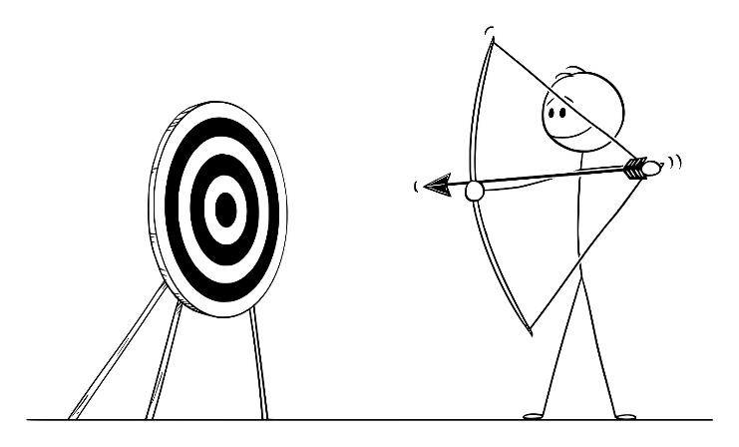
“…God, who richly supplies us with all things for enjoyment: to do good, to be rich in good works, to be generous and ready to share,” 1 Timothy 6:17b-18
Wealth Enjoyment:
Accomplish Something with It!
What about your intentions? If money were no object – the sky is the limit – what impact would match your inner desires?
If you could accomplish any change with a gift, what would it do? How would it make a difference in the world?

Slide 132
Wealth Enjoyment:
Build Your Personal Collection of Beautiful Works!
1 Timothy 6:17-19
“Instruct those who are rich in this present world not to be high-minded or to set their hope on the uncertainty of riches but on God, who richly supplies us with all things for enjoyment: to do good, to be rich in good works, to be generous and ready to share,”

Slide 133
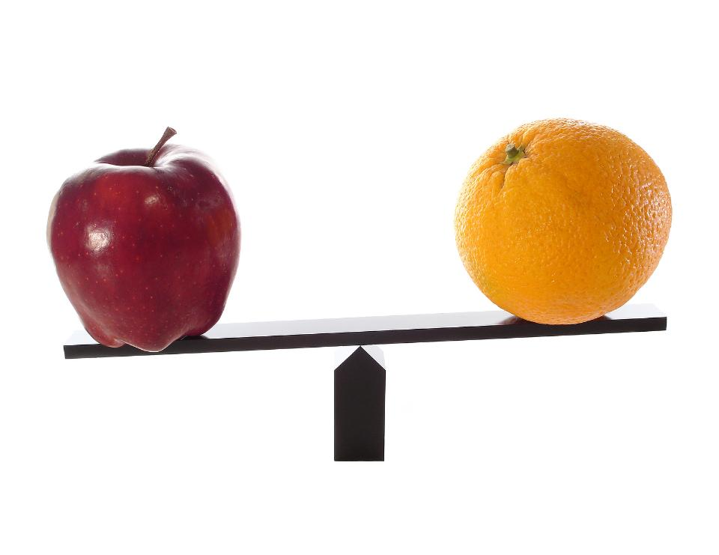
Wealth Enjoyment:
Build Your Personal Collection of Beautiful Works!
We can enjoy wealth by using it “to do good” and “to be rich in good works.” In English, this repeats the word “good.” But in Greek, these are two different words.
The first “good” is from agathos. This is, “intrinsically good, good in nature, good whether it be seen to be so or not.”
The second good is from kalos. This is, “beautiful, as an outward sign of the inward good, noble, honorable character; good, worthy, honorable, noble, and seen to be so.”

Slide 134
Wealth Enjoyment:
Build Your Personal Collection of Beautiful Works!
The first “good” is from agathos. This is, “intrinsically good, good in nature, good whether it be seen to be so or not.”
The second good is from kalos. This is, “beautiful, as an outward sign of the inward good, noble, honorable character; good, worthy, honorable, noble, and seen to be so.”
How are these two types of good works different?
What kind of good works would fit more with the second definition?

Slide 135


Wealth Enjoyment:
Build Your Personal Collection of Beautiful Works!
1 Timothy 6:18 directs us “to be rich in good [from kalos] works”. Kalos good is “beautiful to look at, shapely, magnificent.” It is “visibly or noticeably good.” Jesus says,
  “Your light must shine before people in such a way that they may see your good [from kalos] works, and glorify your Father who is in heaven.” (Matthew 5:16).

Slide 136


Wealth Enjoyment:
Build Your Personal Collection of Beautiful Works!
Paul uses kalos “good” to describe the public reputation of church leaders (1 Timothy 3:7), deacons (1 Timothy 3:13), and widows supported by the church (1 Timothy 5:10). In each case, it’s not enough that they do good. These works must be known as their good works.

Slide 137
“…God, who richly supplies us with all things for enjoyment: to do good, to be rich in good works, to be generous and ready to share,” 1 Timothy 6:17b-18
Wealth Enjoyment:
Build Your Personal Collection of Beautiful Works!
Why is it necessary for good [kalos] works to be seen?
How might this influence others to act in the same way?
Why does it matter if a Christian has a public reputation for good [kalos] works?

Slide 138

The poetic structure of this passage creates a contrast. Relying on “the uncertainty of riches” contrasts with being “rich in good works.” One kind of riches is uncertain and disappearing. The other kind is lasting.
A-Riches [Death] 6:7,9-10 …
B-Riches [Now/temporary] 6:17b
C-Riches [Leading to community separation] 6:17c
D-Riches [Tightly grasped as one’s hope] 6:17d
E-Riches [Hidden/disappearing/uncertain] 6:17e
F-Riches [Source/inflow: God’s rich provision to us] 6:17f
G-Riches [Purpose: for enjoyment] 6:17g
F'-Riches [Use/outflow: Our reciprocal provision to others] 6:18a
E'-Riches [Visible/beautiful good works] 6:18b
D'-Riches [Open-handedly shared] 6:8c
C'-Riches [Leading to community connection] 6:18d
B'-Riches [Future/permanent] 6:19a
A'-Riches [Life] 6:19b

Slide 139

“not … to set their hope on the uncertainty of riches but on God, who richly supplies us with all things for enjoyment: to do good, to be rich in good works, to be generous and ready to share,” 1 Timothy 6:17b-18
Suppose a person’s giving created many beautiful, visible good works. If their wealth suddenly disappeared, would they still be “rich in good works”? Why?

Slide 140
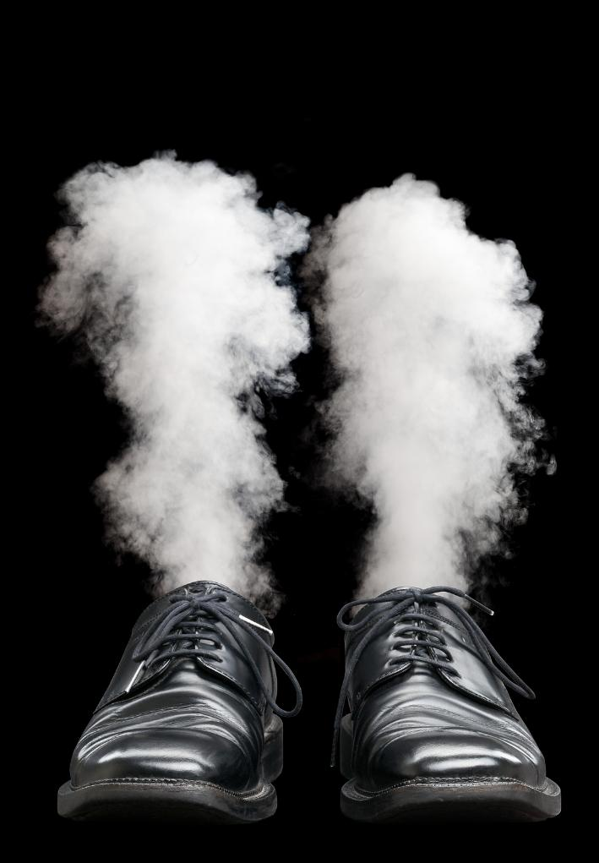
“not … to set their hope on the uncertainty of riches but on God, who richly supplies us with all things for enjoyment: to do good, to be rich in good works, to be generous and ready to share,” 1 Timothy 6:17b-18
A person’s wealth holding stops at the end of life. Does their reputation of being rich in beautiful, visible good works also stop? Why not?

Slide 141

“not … to set their hope on the uncertainty of riches but on God, who richly supplies us with all things for enjoyment: to do good, to be rich in good works, to be generous and ready to share,” 1 Timothy 6:17b-18
The Greek word for the uncertainty of riches has an additional meaning. It also references the hiddenness of riches.
Thus, we do not put our trust in hidden riches. Instead, we become rich in beautiful, visible good works.

Slide 142
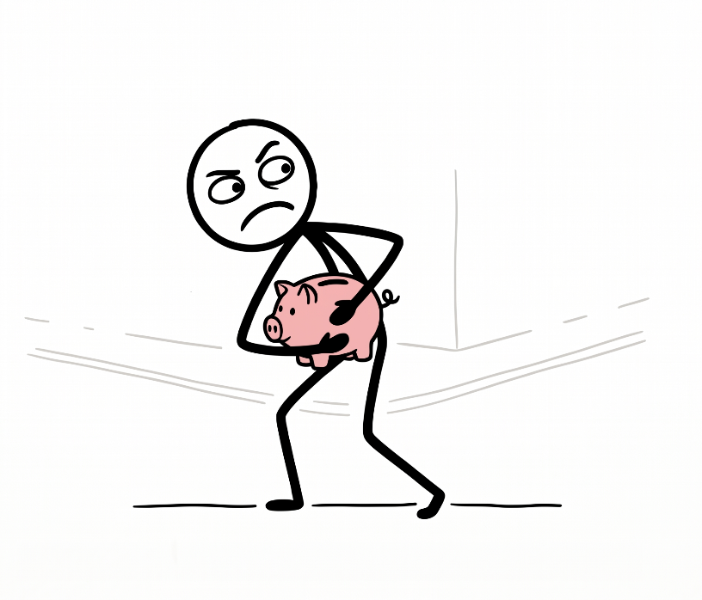
“not … to set their hope on the uncertainty of riches but on God, who richly supplies us with all things for enjoyment: to do good, to be rich in good works, to be generous and ready to share,” 1 Timothy 6:17b-18
Wealth Enjoyment:
Build Your Personal Collection of Beautiful Works!
How would a desire to keep riches hidden conflict with using them to be rich in publicly visible good works?

Slide 143
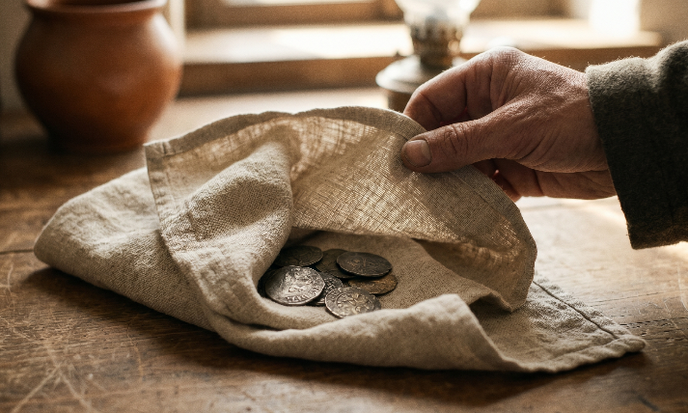
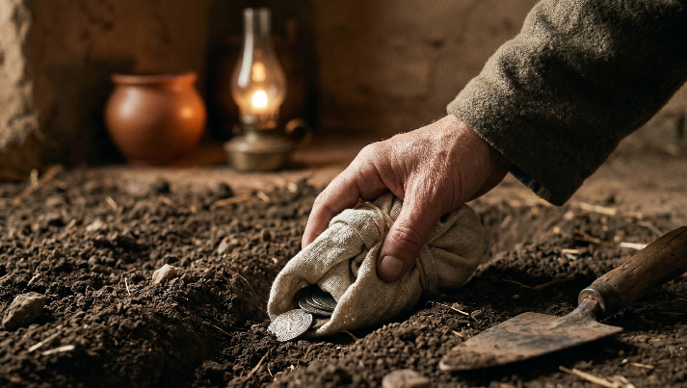
“not … to set their hope on the uncertainty of riches but on God, who richly supplies us with all things for enjoyment: to do good, to be rich in good works, to be generous and ready to share,” 1 Timothy 6:17b-18
Wealth Enjoyment:
Build Your Personal Collection of Beautiful Works!
What does the Bible say about a steward who just hides their money away in a napkin or buries it in the ground? (Matt 25:14-30; Luke 19:11-27)

Slide 144
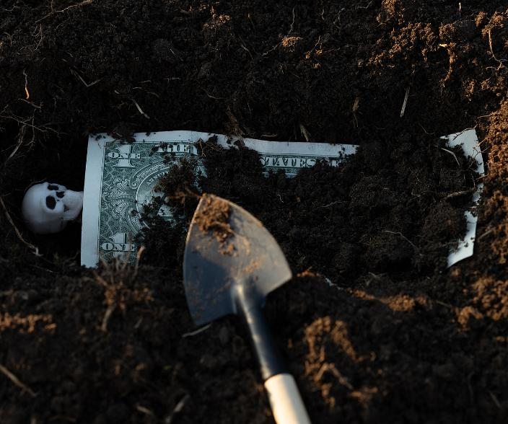
“not … God, who richly supplies us with all things for enjoyment: to do good, to be rich in good works, to be generous and ready to share,” 1 Timothy 6:17b-18
Wealth Enjoyment:
Build Your Personal Collection of Beautiful Works!
Some people use and enjoy their wealth.
Others just hide and protect it only to die with it.
Which set of life experiences would you rather have? Why?

Slide 145


Wealth Enjoyment:
Build Your Personal Collection of Beautiful Works!
It’s often said that beauty is in the eye of the beholder. The most “beautiful-good” works for you may be different from someone else. The Greek word kalos means
  “beautiful, as an outward sign of the inward good, noble, honorable character.”
This means that our “beautiful-good” works must be personal. They must connect with positive aspects of our own character, values, and life story.

Slide 146


“…God, who richly supplies us with all things for enjoyment: to do good, to be rich in good works, to be generous and ready to share,” 1 Timothy 6:17b-18
Wealth Enjoyment:
Build Your Personal Collection of Beautiful Works!
What causes or ministries have been important in your life story?
Which ones closely align with your values?
What good works could a gift create that you would consider to be beautiful?

Slide 147
Wealth Enjoyment:
Live the Life of a Ready, Joyful, Abundance Sharer!
1 Timothy 6:17-19
“Instruct those who are rich in this present world not to be high-minded or to set their hope on the uncertainty of riches but on God, who richly supplies us with all things for enjoyment: to do good, to be rich in good works, to be generous and ready to share,”

Slide 148

One way to get enjoyment from wealth is “to be generous and ready” to share. That phrase comes from a single Greek word. It was a new word. Paul created it just for this verse. It’s a three-part word: Eu-meta-dotous. Dotous means to be a giver. Meta-dotous means to be a sharer. (It’s giving “with” or “among” others.) Eu-meta-dotous means to be a good sharer. But this good is different. It means
1) Ready/willing
2) Joyful/abounding
3) Abundance/wealth

Slide 149


“…God, who richly supplies us with all things for enjoyment: to do good, to be rich in good works, to be generous and ready to share,” 1 Timothy 6:17b-18
Eu-meta-dotous isn’t saying to just give (dotous). It’s not saying to just share (meta-dotous). Instead, it’s saying to be
1) A good ready/willing sharer
2) A good joyful/abounding sharer
3) A good abundance/wealth sharer
These ideas are connected. Recognizing our abundance makes us more ready and willing to share. It also makes giving more joyful. Sharing from abundance is more fun!

Slide 150

“…God, who richly supplies us with all things for enjoyment: to do good, to be rich in good works, to be generous and ready to share,” 1 Timothy 6:17b-18
Wealth Enjoyment:
Live the Life of a Ready, Joyful, Abundance Sharer!
How would recognizing that we have an abundance make us more ready or willing to share? How would it make giving more fun or joyful?
How does feeling fear and scarcity make us less willing to share? How do these make giving less fun or joyful?

Slide 151
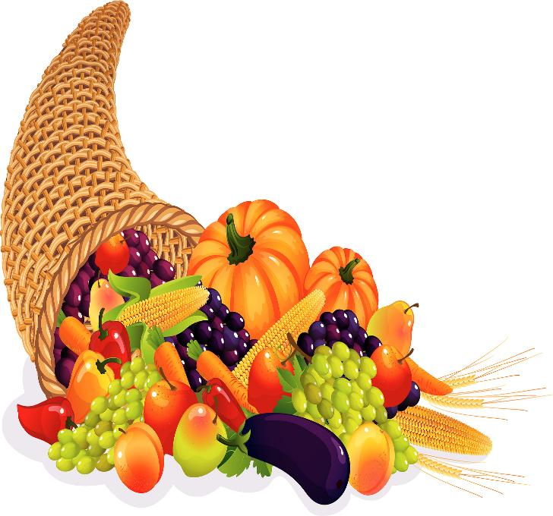
Wealth Enjoyment:
Live the Life of a Ready, Joyful, Abundance Sharer!
Sharing is more fun when we share abundance. Abundance sharing means two things. It describes the source of the gift. (We share from abundance.) And it describes the result of the gift. (Our sharing leaves the recipients with abundance.) Both giver and receiver share in the experience of abundance.
We see this kind of giving elsewhere in scripture. In thanking the Philippians for their gift, Paul writes, “But I have received everything in full and have an abundance [perisseuō]; I am amply supplied, having received from Epaphroditus what you have sent” (Philippians 4:18a).

Slide 152

Wealth Enjoyment:
Live the Life of a Ready, Joyful, Abundance Sharer!
In requesting a donation for Christians in Jerusalem, Paul explains the result of the gift. It will be
“not only fully supplying the needs of the saints, but is also overflowing through many thanksgivings to God.” (2 Cor 9:12b).
In the late 300s A.D., John Chrysostom explained of this verse,
“What he says is this; ‘in the first place ye not only supply the wants of the saints, but you are abundant even;’ that is, ‘ye furnish them with even more than they need’”.

Slide 153


“…God, who richly supplies us with all things for enjoyment: to do good, to be rich in good works, to be generous and ready to share,” 1 Timothy 6:17b-18
This kind of giving is different. The goal is different. It’s not simply to meet a need. It’s to leave the recipients in abundance.
Giving this way is more fun.
This extravagancy matches the idea of the hilariously joyful [hilaron] giver. (2 Corinthians 9:7b).

Slide 154

“…God, who richly supplies us with all things for enjoyment: to do good, to be rich in good works, to be generous and ready to share,” 1 Timothy 6:17b-18
Can you think of a Christmas gift that might meet a need but wouldn’t be fun to give? (A carton of milk? A bag of flour? White tube socks?) Why wouldn’t these be fun to give?
Barely meeting minimum needs might be technically “efficient,” but is it a better way to experience “party-time” wealth enjoyment [apolausin] than sharing abundantly? Why not?

Slide 155

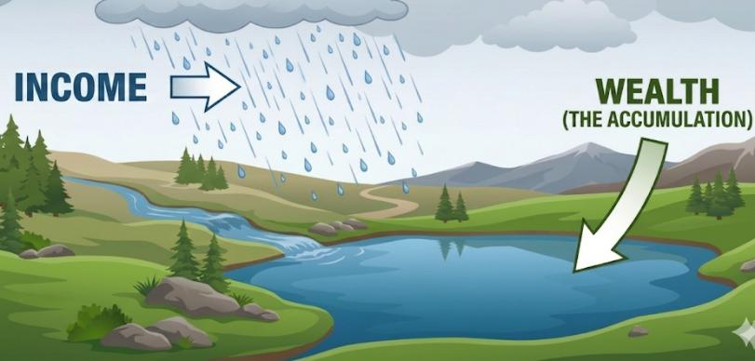
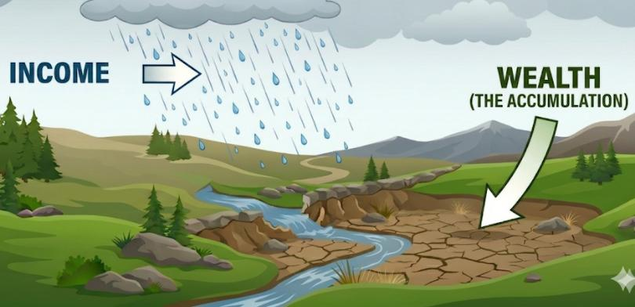
“those who are rich in this present world … the uncertainty of riches but on God, who richly supplies: ... to be rich in good works,… storing up for themselves the treasure ...” 1 Timothy 6:17-19
Income and wealth are different. Many with high incomes spend even more. This results in little or no wealth. Many with great wealth reinvest profits and never sell their assets. This results in little or no income.
Income and wealth are different. This passage makes that same distinction. It’s all about wealth – not income. It’s about wealth accumulation, wealth enjoyment, and wealth sharing. Income sharing is great, but wealth sharing is different.

Slide 156

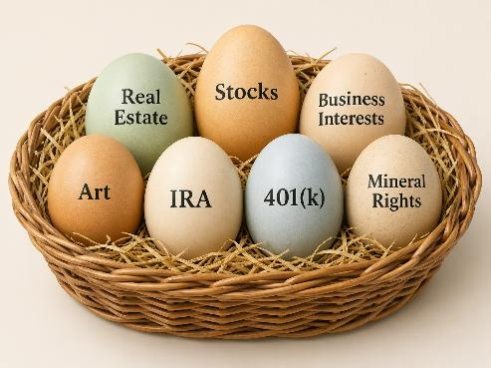
Were these gifts of regular income or gifts of accumulated wealth (assets)?
In the first days of the church, “They sold their lands and other property, and distributed the proceeds among all” (Acts 2:45a).
Later, “all who were owners of land or houses would sell them and bring the proceeds of the sales” (Acts 4:34b).
Barnabas “owned a tract of land. So he sold it, and brought the money and laid it at the apostles’ feet.” (Acts 4:37).
In Mark 14:3-5, “She broke the jar and poured the perfume on his head.… It could have been sold for more than a year’s wages.”

Slide 157

These verses use SIX DIFFERENT kinds of wealth descriptions
Notice the variety of assets in the donor stories!
Oikiṓn: A house; property, wealth, goods
Agroú: A field; the country, lands, property in land, a country estate
Hypárxeis: Possessions, goods, wealth, property
Perfume that “could have been sold for over three hundred denarii”
Ktḗmata: A piece of landed property, a field, possessions
Chōríōn: A place, piece of land, field, property, estate

Slide 158

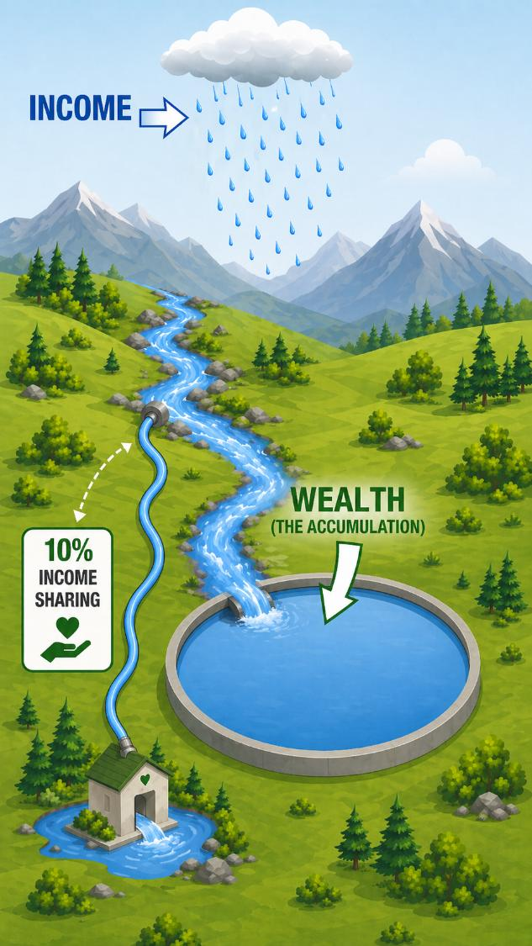
Wealth sharing is a different financial issue than income sharing. It can also be a different heart issue. Suppose a person’s heart is attached to their buried wealth. Then, they decide to start sharing 10% of their income.
Will this type of giving touch any of their buried wealth?
How might wealth sharing be a different heart issue than income sharing?

Slide 159
Wealth Enjoyment:
Strengthen Your Fellowship Community!
1 Timothy 6:17-19
“Instruct those who are rich in this present world not to be high-minded or to set their hope on the uncertainty of riches but on God, who richly supplies us with all things for enjoyment: to do good, to be rich in good works, to be generous and ready to share,”

Slide 160
The poetic structure of this passage links not being high-minded with being ready to share. The Greek word for “share” references koinōnia-sharing. The koinōnia is a mutually supportive, family-like, fellowship community.
A-Riches [Death] 6:7,9-10 …
B-Riches [Now/temporary] 6:17b
C-Riches [Leading to community separation] 6:17c
D-Riches [Tightly grasped as one’s hope] 6:17d
E-Riches [Hidden/disappearing/uncertain] 6:17e
F-Riches [Source/inflow: God’s rich provision to us] 6:17f
G-Riches [Purpose: for enjoyment] 6:17g
F'-Riches [Use/outflow: Our reciprocal provision to others] 6:18a
E'-Riches [Visible/beautiful good works] 6:18b
D'-Riches [Open-handedly shared] 6:18c
C'-Riches [Leading to community connection] 6:18d
B'-Riches [Future/permanent] 6:19a
A'-Riches [Life] 6:19b

Slide 161

Wealth Enjoyment:
Strengthen Your Fellowship Community!
The rich Christian’s wealth does not make them high-minded. It does not separate them from the fellowship community. Instead, their sharing more deeply connects them with the fellowship community. They use their wealth to strengthen the fellowship community.

Slide 162

“…not to be high-minded … God, who richly supplies us with all things for enjoyment: to do good, to be rich in good works, to be generous and ready to share” 1 Timothy 6:17b-18
Wealth Enjoyment:
Strengthen Your Fellowship Community!
Have you ever known people who were “high-minded” because of wealth?
What enjoyable social connections and life experiences might a “high-minded” person miss because of this attitude?

Slide 163

“…not to be high-minded … God, who richly supplies us with all things for enjoyment: to do good, to be rich in good works, to be generous and ready to share” 1 Timothy 6:17b-18
Wealth Enjoyment:
Strengthen Your Fellowship Community!
When we need help, friends, family, and a fellowship community can assist. But with enough money, we can just pay for services instead. How might being “independently wealthy” make it easier to become socially isolated?

Slide 164

“…not to be high-minded … God, who richly supplies us with all things for enjoyment: to do good, to be rich in good works, to be generous and ready to share” 1 Timothy 6:17b-18
Wealth Enjoyment:
Strengthen Your Fellowship Community!
Could having wealth make it harder to trust other people’s intentions?
How might it cause a person to become socially isolated?

Slide 165

“…not to be high-minded … God, who richly supplies us with all things for enjoyment: to do good, to be rich in good works, to be generous and ready to share” 1 Timothy 6:17b-18
Wealth Enjoyment:
Strengthen Your Fellowship Community!
Does social isolation lead to a more enjoyable life experience?
What about being a valuable member of a deeply connected fellowship community?

Slide 166

Wealth Enjoyment:
Strengthen Your Fellowship Community!
Luke 8:2-3 publicly names donors to Jesus’ ministry: Joanna, Susanna, and Mary Magdalene. Romans 16:1-2 publicly shares the name of a donor to Paul’s ministry: Phoebe. Acts 4:36-37 names an individual donor: Barnabas. It also describes the gift itself: a tract of land. 2 Cor 8:1-5 provides massive publicity for the Macedonians’ gift. 2 Cor 9:2-4 describes massive publicity for the Corinthians’ charitable pledge. 2 Cor 8:24 directs people to give in this way:
“Therefore, openly before the churches, show them the proof of your love and of our reason for boasting about you.”

Slide 167

Wealth Enjoyment:
Strengthen Your Fellowship Community!
Yet, Jesus says,
  “So, when you give to the poor [eleēmosynē], do not sound a trumpet before you … But when you give to the poor [eleēmosynē], do not let your left hand know what your right hand is doing, so that your charitable giving [eleēmosynē] will be in secret.” (Matthew 6:2-4).
Is this a contradiction?
No.
Why not? …

Slide 168

Wealth Enjoyment:
Strengthen Your Fellowship Community!
These are two different types of giving. In Greek, giving “down,” “almsgiving” or “giving to the poor” is eleēmosynē. It refers to mercy, pity, or alms. Sharing “across,” koinōnia-sharing, within the fellowship community [the koinōnia], is a different word.
The charitable giving described in the Epistles is not almsgiving: eleēmosynē. It is koinōnia-sharing (e.g., koinōnikous in 1 Timothy 6:17-19). Just as in the Old Testament, different gifts have different rules. Giving down, eleēmosynē, is best done in secret. Sharing across within the fellowship community (koinōnia-sharing) is best done in public.

Slide 169

“…not to be high-minded … God, who richly supplies us with all things for enjoyment: to do good, to be rich in good works, to be generous and ready to share” 1 Timothy 6:17b-18
Wealth Enjoyment:
Strengthen Your Fellowship Community!
Why might giving “down” (almsgiving) take dignity away from the recipient if it’s done in public?
Why is sharing “across” within a reciprocal, mutually sharing fellowship community different?
How might publicly sharing “across” strengthen this kind of group? How might it inspire others to do the same with whatever God has richly provided to them?

Slide 170
Wealth Enjoyment:
Plan for the Future by Making an Investment with Real Permanence!
1 Timothy 6:17b-19b
Instruct those who are rich in this present world … God, who richly supplies us with all things for enjoyment: to do good, to be rich in good works, to be generous and ready to share, storing up for themselves the treasure of a good foundation for the future

Slide 171

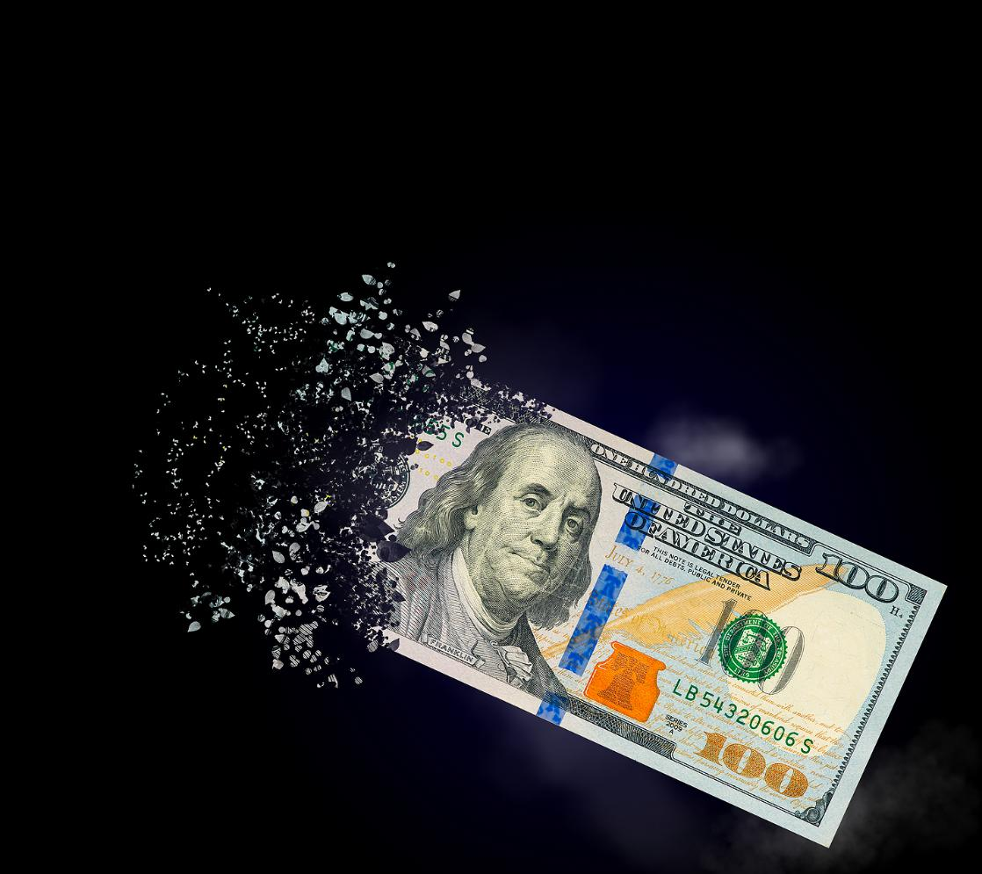
Wealth Enjoyment:
Plan for the Future by Making an Investment with Real Permanence!
“Instruct those who are rich in this present world … God, who richly supplies us with all things for enjoyment: … storing up for themselves the treasure of a good foundation for the future …” 1 Timothy 6:17b-18
Wealth holding is short-term.
What we hold, we hold only “in this present world.”
More literally, we hold it only “in the now time” or “at this opportune moment.”
Wealth holding is temporary.
Wealth enjoyment need not be.

Slide 172

Wealth Enjoyment:
Plan for the Future by Making an Investment with Real Permanence!
When we use wealth correctly, looking back on its impact is enjoyable. We can enjoy having used it to accomplish good. We can enjoy having used it to be rich in beautiful, good works. We can enjoy having been a good sharer who built up the fellowship community.
This kind of enjoyment is lasting. It’s enjoyable not only for the moment but also for the future.
Joyful wealth management creates lasting enjoyment.
Bad wealth management doesn’t. In fact, it does the opposite. It leads to regret...

Slide 173

Wealth Enjoyment:
Plan for the Future by Making an Investment with Real Permanence!
For the bingeing bad steward, regret happens quickly. Bingeing and wild living soon end poorly.
For the burying bad steward, the regret is often later but also greater. These people never enjoy their wealth. They simply bury it and die with it. Their opportunity is lost.
The ultimate use of the wealth rarely matches their values or beliefs. Often, the unused wealth leads to family fights. These results are painful to look back on.

Slide 174
Wealth Enjoyment:
Plan for the Future by Making an Investment with Real Permanence!
“Instruct those who are rich in this present world … God, who richly supplies us with all things for enjoyment: … storing up for themselves the treasure of a good foundation for the future …” 1 Timothy 6:17b-18
Why might using wealth to binge on excess consumption not be enjoyable to look back on years from now?
Suppose you’re in charge of your wealth. You just bury it and die with it. Others then use it in a way that contradicts your values and beliefs. Whose fault is that? Who was in charge of your wealth? Would that result be enjoyable to look back on?

Slide 175
Wealth Enjoyment:
Plan for the Future by Making an Investment with Real Permanence!
“Instruct those who are rich in this present world … God, who richly supplies us with all things for enjoyment: … storing up for themselves the treasure of a good foundation for the future …” 1 Timothy 6:17b-19a
Holding wealth can feel secure. It can feel permanent. Both practical reality and scripture show us that’s a false feeling. Wealth holding is uncertain. It’s disappearing. It’s guaranteed to end. Often, it ends without warning. Wealth holding can’t last. But some things do last even when the wealth disappears…

Slide 176
Suppose one person used their wealth to accomplish good, to be rich in beautiful, good works, and to build up their fellowship community.
Suppose another person never used their wealth to accomplish good, to be rich in beautiful, good works, or to build up their fellowship community.
Then inevitably, due to misfortune or death, wealth holding ends for both of them.
What lasting reputation would remain for each person?
What could each report to God about their use of the temporary wealth He provided?

Slide 177
Suppose one person used their wealth to accomplish good, to be rich in beautiful, good works, and to build up their fellowship community.
Suppose another person never used their wealth to accomplish good, to be rich in beautiful, good works, or to build up their fellowship community.
Then inevitably, due to misfortune or death, wealth holding ends for both of them.
In what way did the first person diversify their portfolio to be rich in more ways?
Which person likely got more enjoyment from their wealth?

Slide 178

In 1 Tim 6:17-19, wealth enjoyment is not just a fleeting experience.
It lasts.
We can use wealth in a way that is enjoyable to look back on in 2 years, 20 years, or even 200 years.

Slide 179
Having created intrinsically good works is always enjoyable to look back on.
Having become rich in beautifully good works is also enjoyable to look back on.
Having lived the life of a joyful, abounding, good sharer is enjoyable to look back on, too.
Having built up our fellowship community is likewise enjoyable to look back on.

Slide 180

“Instruct those who are rich in this present world … God, who richly supplies us with all things for enjoyment: … storing up for themselves the treasure of a good foundation for the future …” 1 Timothy 6:17b-19a
Wealth Enjoyment:
Plan for the Future by Making an Investment with Real Permanence!
When you look back 200 years from now, are there any ministries or causes where you would like to have made a lasting impact? How do they connect with your life story?

Slide 181
“Instruct those who are rich in this present world … God, who richly supplies us with all things for enjoyment: … storing up for themselves the treasure of a good foundation for the future …” 1 Timothy 6:17b-19a
Wealth Enjoyment:
Plan for the Future by Making an Investment with Real Permanence!
The most repeated command in the Bible is “Do not be afraid.” How might we use wealth differently if we trusted in our richly providing God?
Suppose God personally gave you permission to use your wealth right now to make an impact that matched your values. What would that look like for you? What instruments or organizations might you choose to use to make this impact?

Slide 182
Wealth Enjoyment:
Aggressively Grab the Best Life Experience!
1 Timothy 6:17b-19
God, who richly supplies us with all things for enjoyment: to do good, to be rich in good works, to be generous and ready to share, storing up for themselves the treasure of a good foundation for the future, so that they may take hold of that which is truly life.”

Slide 183

Wealth Enjoyment:
Aggressively Grab the Best Life Experience!
A few sentences earlier, Paul writes about “eternal life.”
Here, he uses a different word.
Different versions call it “true life,” “life indeed,” “really life,” or “real life.”
This is about the quality of our life experience. It’s about feeling like, “This is the life!” It’s about feeling like, “This is really living!”

Slide 184

Consider a person who lives their life anxiously hoarding their wealth. They constantly worry about lawsuits, inflation, taxes, theft, market crashes, and other threats. They mistrust others because people might act deceptively to get at their money. They never use their wealth. They bury it. They anxiously protect it. And then they lose it, inevitably, to misfortune or death.
Would this life experience make you say, “Now, this is really living!”?
Would it make you say, “Ah, now this is the life!”? Why not?

Slide 185


Suppose God blessed you with the ability to make wealth. (Deuteronomy 8:18).
Now, you get to pick between two eulogies describing your life.
“He really took hold of that which is truly life! He did a lot of real good! He was so rich in beautiful, good works! He was certainly good at being generous in the best ways! He was always ready to share with his fellowship community and build the Kingdom! He really stored up for himself the treasure of a good foundation for the future!”
“He made a lot of money.
The end.”

Slide 186
How does each description reflect the kind of life that is “life indeed,” “really life,” or “real life”?
How might the way we use (or don’t use) wealth lead to one of these two descriptions being accurate?
“He really took hold of that which is truly life! He did a lot of real good! He was so rich in beautiful, good works! He was certainly good at being generous in the best ways! He was always ready to share with his fellowship community and build the Kingdom! He really stored up for himself the treasure of a good foundation for the future!”
“He made a lot of money.
The end.”

Slide 187

Wealth Enjoyment:
Aggressively Grab the Best Life Experience!
Does this actually work? Does living life this way produce “real life” or “life indeed” right now? It does. And it’s not just a matter of faith. It’s also a matter of science. Charitable giving increases happiness and health.
Professor Christian Smith and Hilary Davidson summarize, “The more generous Americans are, the more happiness, health, and purpose in life they enjoy.” [Smith, C. & Davidson, H. (2014). The paradox of generosity. Oxford University Press. p. 2.];
“participants who had donated to a charity were able to squeeze a handgrip for more than 20 seconds longer than were control participants. Participants also reported happier moods after donating, but their enhanced strength did not stem from their elevated happiness. Thus, prosocial spending may have independent positive effects on both emotional and physical vitality.” [Dunn, E. W., Aknin, L. B., & Norton, M. I. (2014). Prosocial spending and happiness: Using money to benefit others pays off. Current Directions in Psychological Science, 23(1), 41-47, p. 45.]
In the fourth century, John Chrysostom called charitable giving “the foundation of health, the abundance of light and the origin of joyfulness.” [Chrysostom, J. (1862). Homily 64.5 in Matthew. In Migne, J. P., (Ed.), Patrologia Graeca. Volume 58:615. p. 48-49.]

Slide 188
Wealth Enjoyment:
Aggressively Grab the Best Life Experience!
Giving in the scriptural way is even more powerful. One secular textbook summarizes everything we know from research about increasing well-being and life satisfaction. It reports only six “established interventions” proven to work. Aside from forgiveness, these are:
Gratitude
Appreciating what we have (savoring)
Empathy
Highlighting our strengths
Meaningful purpose
In The Wiley Blackwell Handbook of Positive Psychological Interventions, these are the six chapter topics listed under “Established areas of intervention” [Parks, A. C., & Schueller, S. M. (Eds.). (2014). The Wiley Blackwell handbook of positive psychological interventions. Wiley-Blackwell.]

Slide 189

According to modern science, what impact would this have on our personal well-being and life satisfaction?
Suppose we receive all things from a close-beside, richly-providing God. He gives them for the purpose of enjoyment. We then enjoy these things by using them to accomplish beautifully good works. These good works are uniquely meaningful for us. They reflect the best parts of our own personal characters. How would living this way help us to
Experience gratitude?
Appreciate what we have?
Feel empathy?
Highlight our strengths?
Fulfill a personally meaningful purpose?

Slide 190
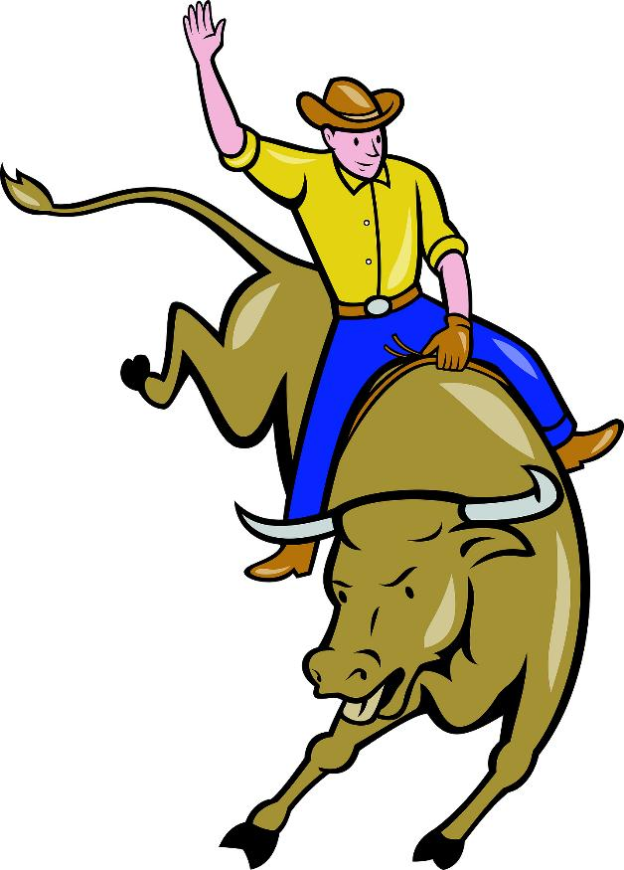
Wealth Enjoyment:
Aggressively Grab the Best Life Experience!
The instruction here is to “take hold” of real life. This taking hold is aggressive – even violent. It’s the word used when the soldiers “seized” Simon of Cyrene, forcing him to carry the cross. (Luke 23:26). It’s the word used when the crowd “took hold of Sosthenes, the leader of the synagogue, and began beating him in front of the judgment seat.” (Acts 18:17).
This is aggressive, fighting language. This instruction is like saying, “Grab life by the horns!” or “Grab life by the throat!” One commentary calls it “riding life for all it is worth.”

Slide 191

Wealth Enjoyment:
Aggressively Grab the Best Life Experience!
And what’s the opposite of this approach to life? It’s the burying bad steward’s explanation in the Parable of the Talents:
“So I was afraid and went out and hid your gold in the ground. See, here is what belongs to you.” (Matt 25:25 NIV).
It’s also the burying bad steward’s explanation in the Parable of the Mina Coins:
“here is your mina, which I kept tucked away in a handkerchief; for I was afraid”. (Luke 19:20b-21a).
What’s the opposite of aggressively grabbing real life? It’s living a life of fear.

Slide 192


“God, who richly supplies us with all things for enjoyment: to do good, to be rich in good works, to be generous and ready to share, storing up for themselves the treasure of a good foundation for the future, so that they may take hold of that which is truly life.” 1 Timothy 6:17b-19
In what way does fear lead to burying our chunk of gold or hiding our coins in today’s world?
How is this different from the instruction to aggressively grab hold of real life by using wealth “for enjoyment: to do good, to be rich in good works, to be generous and ready to share”?

Slide 193

The End:
Which Life Story Will You Choose?

Slide 194

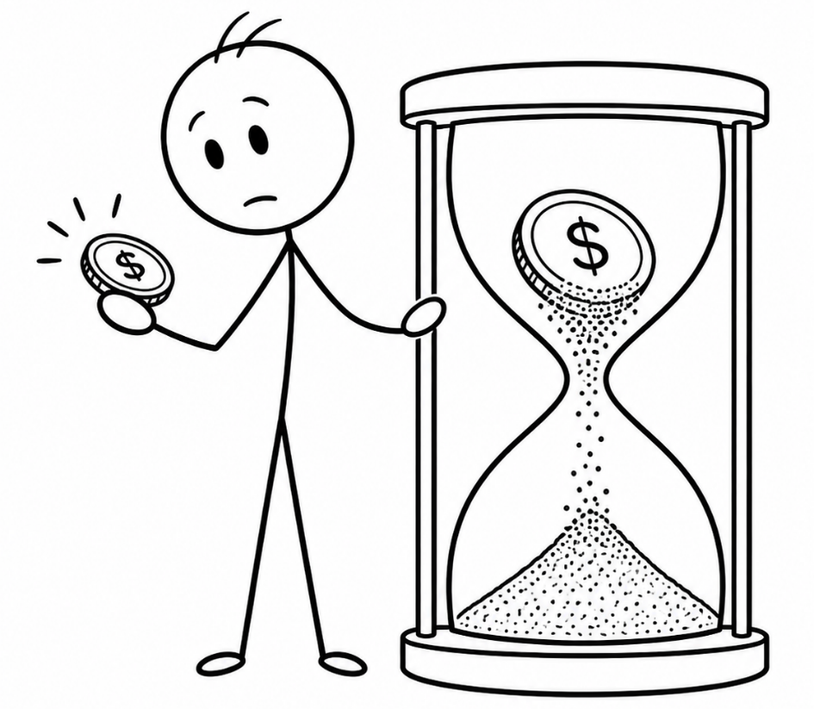
The End:
Which life story will you choose?
Our wealth-holding story will end. We’ve brought nothing into the world. We’ll take nothing out of it.
Often, wealth holding ends much sooner. Thieves break in and steal. Rust and moths destroy. So do taxes, inflation, lawsuits, and a hundred other things.
Wealth is unreliable. Wealth holding is temporary. It might be ours at this moment. But it’s not ours to keep.

Slide 195


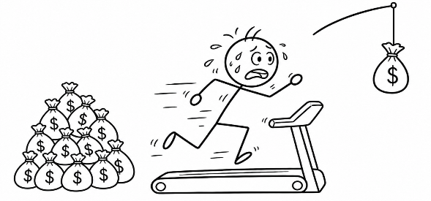

BINGE
Before that inevitable loss, we get to choose. We get to choose how we want to lose our wealth. We can
Binge: Binge with it through excessive personal consumption.
Bury: Bury it in the ground and die with it.
Toil: Toil ceaselessly to bury even more.
Enjoy: Enjoy it by using it
To accomplish meaningful good,
To become rich in beautiful, good works,
To live as a good, joyful sharer of abundance,
To build up our fellowship community, and
To store up for ourselves the treasure of a good foundation for the future.
BURY
TOIL
ENJOY

Slide 196

BINGE
Before we lose it, we can choose to use it.
This is not just a choice about our wealth.
It’s a choice about our life.
BURY
When you look back at the end of your life, which of these four paths would you most enjoy having chosen?
Why?
TOIL
ENJOY

Slide 197

One approach to wealth management is to always focus on stacking up more and more. This path ends tragically. In the meantime, it’s more anxious. It’s more self-focused and isolated. Scripture calls this path a “temptation and a trap.” It’s “foolish and harmful.” It causes people to “plunge into ruin and destruction.” It causes them to “pierce themselves with many griefs.” (1 Timothy 6:9-10).
The End:
Which life story will you choose?

Slide 198

The End: Which life story will you choose?
And what is the result of all this anxious suffering? The physical result is still, inevitably, to lose it all. The spiritual result is to approach the master who provided you with the wealth (or the ability to earn wealth) and report:
  “So I was afraid and went out and hid your gold in the ground.” (Matt 25:25a NIV).
It’s to report that you never used it. You never trusted in God’s ongoing rich provision. So, you hid the money away in a corner. Why?
  “For I was afraid.” (Luke 19:21a).

Slide 199




This approach to wealth management creates anxious hoarding and isolation. It’s a life of scarcity and fear. It leads to inevitable loss, disappointment, and suffering. This is not the good life.
Why is toiling and burying to “die rich” pursuing a logically impossible goal?
What does a dead person take with him?
How can toiling and burying to pursue a goal of “dying rich” contradict the goal of “living rich?”
How can it prevent “taking hold of that which is truly life?”

Slide 200



Joyful wealth management starts by facing the truth
We’re going to lose it anyway.
Enjoying it now (by creating beautiful good works) makes sense. Why wouldn’t we do so, given the alternative?

Slide 201
Joyful wealth management starts by facing the truth
Contentment doesn’t require that much.
We can enjoy wealth by using it to accomplish real good and still have plenty left over for our contentment.

Slide 202
Joyful wealth management starts by facing the truth
It was all a gift to us in the first place.
It’s more fun to share from a gift. We can respond to the gift by using it to make the giver happy.

Slide 203
Joyful wealth management starts by facing the truth
We can trust in our richly providing God.
God’s supply doesn’t stop. This gives us a great abundance. Sharing from abundance is joyful!

Slide 204

The End: Which life story will you choose?
We’re going to lose it anyway.
These truths lead to joyful wealth management. They help fulfill God’s purpose of enjoyment. They help avoid the tragic options of bingeing with it, burying it just to die with it, or toiling to bury even more.
Contentment doesn’t require that much.
It was all a gift to us in the first place.
We can trust in our richly providing God.

Slide 205

The good news is this:
You get to choose.
You don’t have to passively accept a life of anxious hoarding and inevitable loss. Instead, you can expand your portfolio to become rich in even more ways. You can accomplish meaningful good. You can make beautiful things happen. You can live a life that inspires others. You can aggressively grab hold of a life that is really living!

Slide 206
“Instruct those who are rich in this present world not to be high-minded or to set their hope on the uncertainty of riches, but on God, who richly supplies us with all things for enjoyment: to do good, to be rich in good works, to be generous and ready to share, storing up for themselves the treasure of a good foundation for the future, so that they may take hold of that which is truly life.” 1 Timothy 6:17-19
If you chose to enjoy your wealth, how might your future differ from a life of bingeing, burying, or toiling to bury more?
What financial fear might make you ultimately report to God, “I buried my wealth and hid it because I was afraid?” How might you overcome this barrier to enjoying your wealth?
How would you live differently tomorrow if you took just one step towards enjoying your wealth in these ways?

