Slide 1

Why Financial Planners Should Study Charitable Planning
Dr. Russell James
Texas Tech University

Slide 2

1.
The clients you want care about charitable planning

Slide 4

2. The clients you really,
really
want
care about charitable planning

Slide 5


Slide 6

You can provide BIG* value to clients
3.
* We aren’t talking about 3 extra basis points on a comparable risk-adjusted portfolio here…

Slide 7

A couple wants to sell their $10 million low-basis business, invest in securities returning 5%, withdraw 5% per year, then at death leave half to children and half to charity
With sophisticated charitable planning (CRT-ILIT) they can
Receive an immediate INCOME TAX deduction
Pay no CAPITAL GAINS TAX on the business sale
Receive more lifetime income
Make their children’s inheritance 100% ESTATE TAX free
Without sophisticated charitable planning they
Receive no INCOME TAX deduction
Pay all CAPITAL GAINS TAX on the business sale
Receive less lifetime income
Pay ESTATE TAXES taking half or more of the children’s inheritance

Slide 8

4. Yes, you can even make money doing it
Did I mention that last transaction involves the sale of a $5,000,000+ life insurance policy?

Slide 9

5. What is the hottest part of the financial services industry right now?

Slide 10

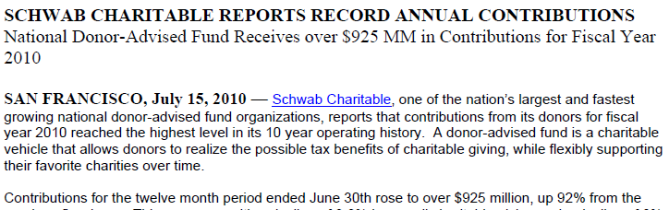
(Here is a hint…)

Slide 11

6. Donor advised funds may be assets under management
DAF: Asset depletion from transfers
Owned: Asset depletion from consumption
Both may be largely second generation activities

Slide 12

7. Make a difference, not just a dollar
Knowledgeable financial planners can effectively encourage generosity and consequently profoundly affect on our world.

Slide 13


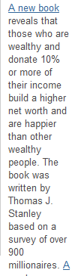
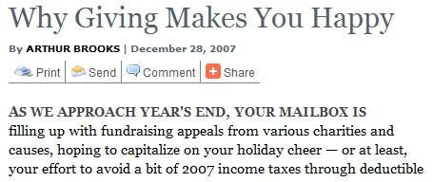
8. Spread some happiness

Slide 14

9. Learn how to help families pass along both value and values

Slide 15

10.
Assist your favorite charities in providing planned giving services to their donors

Slide 16

Help me
HERE
convince my bosses that continuing to build and post these slide sets is not a waste of time. If you work for a nonprofit or advise donors and you reviewed these slides, please let me know by clicking

Slide 17

If you clicked on the link to let me know you reviewed these slides…
Thank You!

Slide 18

For the audio lecture accompanying this
slide set, go to
EncourageGenerosity.com

Slide 19
Why Financial Planners Should Study Charitable Planning
Photos from istockphoto

Slide 20


Graduate Studies in
Charitable Financial Planning
at Texas Tech University
This slide set is from the introductory curriculum for the Graduate Certificate in Charitable Financial Planning at Texas Tech University, home to the nation’s largest graduate program in personal financial planning.
To find out more about the online Graduate Certificate in Charitable Financial Planning go to www.EncourageGenerosity.com
To find out more about the M.S. or Ph.D. in personal financial planning at Texas Tech University, go to www.depts.ttu.edu/pfp/

