Slide 1

Using Life Insurance in Charitable Planning
Russell James, J.D., Ph.D., CFP®, Director of Graduate Studies in Charitable Planning, Texas Tech University

Slide 2

Wealth replacement
Gifting existing policies
Creating new policies for the charity
Common Uses

Slide 3

Using Life Insurance as Wealth Replacement in Charitable Planning

Slide 4

Charitable planning devices such as Charitable Gift Annuities, Gifts of Remainder Interests in Homes and Farms, and Charitable Remainder Trusts produce amazing tax advantages, reducing income taxes, capital gain taxes, and estate taxes

Slide 5

But, they also reduce heirs’ inheritance
Charity
Donor
Heir

Slide 6

Life insurance can diminish this concern
Tax Free Life Insurance

Slide 7


Estate tax law made simple
Anything you own is taxable at death unless it goes to a spouse or charity
2. If your life insurance is owned by another person or an Irrevocable Life Insurance Trust (ILIT) it is not taxable at your death (unless given in prior 3 years).

Slide 8




Because the parent does not own the policy, it is not taxed in his estate
Insurance Inc.
Estate Tax Free Death Benefit
Premium Payments
Policy on Parent’s
Life
Money to Pay Premiums
Parent
Child
Child

Slide 9


Because the parent does not own the policy, it is not taxed in his estate
Insurance Inc.
Estate Tax Free Death Benefit
Premium Payments
Policy on Parent’s
Life
Money to Pay Premiums
Irrevocable Life Insurance Trust (ILIT)
Parent
Child

Slide 10
The parent can use the tax benefit or income from a CGA or CRT to pay for life insurance
Insurance Inc.
Estate Tax Free Death Benefit
Premium Payments
Policy on Parent’s
Life
Money to Pay Premiums
Irrevocable Life Insurance Trust (ILIT)
Parent
Child

Slide 11

Charitable Remainder Trust (CRT)
Insurance Inc.
Estate Tax Free Death Benefit
Lifetime Income
Premium Payments
Policy on Parent’s
Life
Money to Pay Premiums
Irrevocable Life Insurance Trust (ILIT)
Parent
Child

Slide 12
The child gets a tax free inheritance instead of losing up to 55% in estate taxes
Insurance Inc.
Estate Tax Free Death Benefit
Premium Payments
Policy on Parent’s
Life
Money to Pay Premiums
Irrevocable Life Insurance Trust (ILIT)
Parent
Child

Slide 13

We give the taxable inheritance to charity, and create income to purchase the non-taxable inheritance to give to children

Slide 14
Gifts for premiums can be gift tax free if ≤ $13,000 X beneficiaries X donors annually. (E.g., 2 parents to 2 children, spouses, and 4 grandchildren: 2 X 8 X $13,000 = $208,000 per year using “Crummey” powers)
Insurance Inc.
Estate Tax Free Death Benefit
Premium Payments
Policy on Parent’s
Life
Money to Pay Premiums
Irrevocable Life Insurance Trust (ILIT)
Parent
Child

Slide 15

Can it pay to be charitable?
Priscilla wants to sell a $1,000,000 non-income producing zero-basis asset then spend the interest income of 5% while
leaving principal for heirs. Her combined state and federal tax rates are:
capital gains (20%)
income (40%)
estate (55%)

Slide 16
Sale
$1,000,000 asset
-$200,000 capital gains tax
Client uses $40,000/year ($800,000 X 5% return)
Heirs receive $360,000 ($800,000-$440,000 est. tax)
CRUT
$1,000,000 asset
$0 capital gains tax
$1,000,000 in 5% unitrust pays $50,000 annually + a charitable tax deduction of $300,000 worth $120,000
+ ILIT
Client pays $120,000 initially and $10,000 annually for a $400,000 ILIT-owned policy (including post-crummey gift taxes)
Client uses $40,000/year
Charity receives $1,000,000
remainder
Heirs receive $400,000
(tax free from ILIT)

Slide 17

John, age 59, owns $100,000 of farmland which he would like to use for the rest of his life then leave to charity, but he also wants to benefit his heirs. His combined state and federal tax rates are income (40%) and estate (55%).

Slide 18
Giving the remainder interest to charity creates a deduction of $65,553 worth $26,221. This will purchase a paid-up policy of about $50,000. [Using a 2% §7520 rate; the deduction falls as rates rise, but so does the price of the policy]
John keeps lifetime use of farm
Charity gets farm at death
Heirs get $50,000 tax free

Slide 19
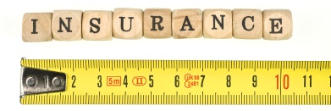
Wealth replacement through ILIT life insurance creates estate tax free inheritance for family members and allows for charitable giving

Slide 20

Part II
Giving Existing Life Insurance Policies to Charity

Slide 21

Bought too much insurance for actual or current needs
Bought for children who are no longer dependent
Bought for an outdated business buy-sell
agreement
Doesn’t need
the cash value

Slide 22

Valuing the gift of a life insurance policy
Lesser of Fair Market Value (≈ Cash Value) or Donor’s Basis (≈ Net Premiums Paid)
Newly issued policy: use first premium paid for
fair market value
Paid-up policy: use replacement policy for
fair market value

Slide 23

Changes in Valuation Approaches
Old rule
Basis is premiums paid – refunds – loans
New addition
Rev. Rul. 2009-13 reduces basis by “the cost of insurance protection that was enjoyed by the policyholder.” E.g., a term policy would have no basis except the unused part of the most recent premium

Slide 24

For universal life policies, “Cost of Insurance” is reported to the policyholder.
For traditional whole life policies, “Cost of Insurance” may not be reported or easily determined.
For term insurance, “Cost of Insurance” is the premium.
Your Cost
of
Insurance

Slide 25

New addition
Some policies can now be sold for more in the life settlement market
Changes in Valuation Approaches
Old rule
FMV (≈ Cash Value) is “Interpolated Terminal Reserve” + Unused Part of Last Premium – Loans

Slide 26

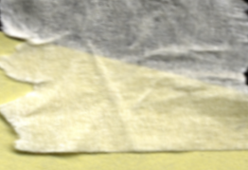

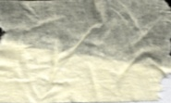
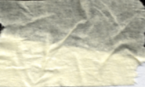
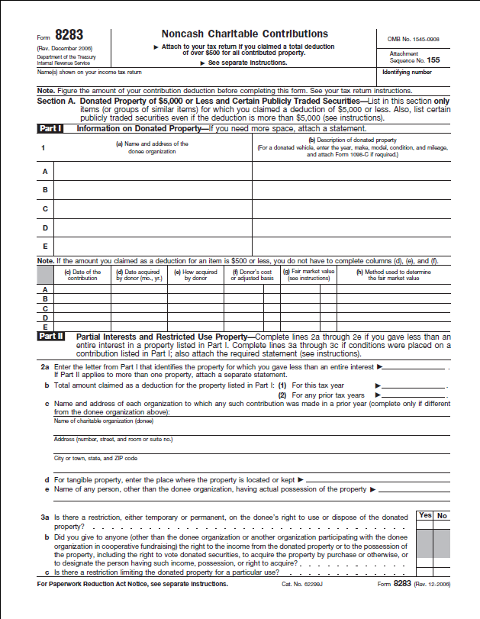
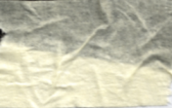

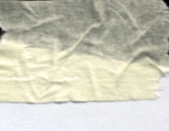

Documenting Property Gifts $5,000+
Note from charity before taxes filed or due
Date, location, and description of property
“No goods or services were provided in exchange for these gifts.” [or describe and value items provided]
Summary of qualified appraisal attached to
tax return
Donor’s reliable records of gift, charity, date, place, FMV (and cost basis if relevant)

Slide 27

Neither the insurance agent who sold the policy nor the insurance company may prepare the appraisal because they are parties to the transaction

Slide 28

Donating a policy with outstanding loans is bad planning!
In a normal bargain sale, the donation FMV is reduced by
the loan amount. But,
under new charitable
split-dollar rules the
deduction (for gift or
future premiums)
will be entirely lost.
Donor is taxed on ordinary income in the amount of loan less the applicable basis, which is loan amount X (policy basis/policy FMV)

Slide 29

Don’t give life insurance with outstanding loans!

Slide 30

After getting a policy the charity may
Ask donor to continue to pay premiums
Surrender it for cash value
Pay premiums from
charity’s funds
Sell in the life
settlement
market

Slide 31

Part III
Creating new policies for the charity

Slide 32





Option 1: Donor makes gifts to be used as premium payments
Insurance Inc.
Premium Payments
Creation or Transfer of New Policy
Death Benefit to Charity
2010
Gifts to be used for premiums
Gifts are deductible if donor keeps no rights in the policy
2011 2012 2013 2014 … Death

Slide 33
Option 2: Donor pays premiums on charity-owned policy
Insurance Inc.
Creation or Transfer of New Policy
Death Benefit to Charity
2010
Premium Payments
Gifts are deductible if donor keeps no rights in the policy
2011 2012 2013 2014 … Death

Slide 34
1. Deductible so long as donor retains no rights in the policy
Insurance Inc.
Premium Payments
Creation or Transfer of New Policy
Death Benefit to Charity
2010
Gifts to be used for premiums
2011 2012 2013 2014 … Death

Slide 35
2. Deductible so long as donor retains no rights in the policy
Insurance Inc.
Creation or Transfer of New Policy
Death Benefit to Charity
2010
Premium Payments
2011 2012 2013 2014 … Death

Slide 36
1. Standard gift receipt
Insurance Inc.
Premium Payments
Creation or Transfer of New Policy
Death Benefit to Charity
2010
Gifts to be used for premiums
2011 2012 2013 2014 … Death

Slide 37
2. Gift receipting practice depends on charity
Insurance Inc.
Creation or Transfer of New Policy
Death Benefit to Charity
2010
Premium Payments
2011 2012 2013 2014 … Death

Slide 38
1. Donor can give appreciated property
Insurance Inc.
Premium Payments
Creation or Transfer of New Policy
Death Benefit to Charity
2010
Gifts to be used for premiums
2011 2012 2013 2014 … Death

Slide 39
2. Donor must give cash
Insurance Inc.
Creation or Transfer of New Policy
Death Benefit to Charity
2010
Premium Payments
2011 2012 2013 2014 … Death

Slide 40
1. Income limitation of 50% for cash gifts
Insurance Inc.
Premium Payments
Creation or Transfer of New Policy
Death Benefit to Charity
2010
Gifts to be used for premiums
2011 2012 2013 2014 … Death

Slide 41
2. Income limitation of 30% “for the use of” charity
Insurance Inc.
Creation or Transfer of New Policy
Death Benefit to Charity
2010
Premium Payments
2011 2012 2013 2014 … Death

Slide 42

Potential Advantages and Problems
for Charities and Donors

Slide 43

Potential Advantages
Donor with small income can fund a large posthumous project

Slide 44

Potential Advantages
Donor receives a bill from the life insurance company instead of ongoing donation requests from charity

Slide 45

Potential Advantages
Insurance agents may help to “sell” the idea instead of requiring charity fundraiser time

Slide 46

Potential Problems
Insurance agents may “oversell” risking long-term donor relationships

Slide 47

Potential Problems
Depending on policy structure, donor may give for years, and charity receives nothing due to later policy lapse

Slide 48

Potential Problems
Some policies may benefit insurance companies and agents more than charity

Slide 49
Potential Problems
Insurable Interest: Does the charity have sufficient financial interest in the donor’s life to allow it to take out a new policy of this size? (Absence may eliminate deductions and death benefit.)
???

Slide 50

Potential Problems
The charity may prefer funds today

Slide 51

Potential Problems
The donor never sees the impact of his gift.

Slide 52

Potential Problems
Donors cannibalize giving to pay premiums
Premium Payments
Regular giving to charity

Slide 53

A charity can prevent problems by refusing to accept policy gifts that don’t meet its guidelines.
Assume cannibalization of gift income and require
  Short-term (e.g., 10 year) to projected paid up status to age 100
  Top companies
  Reasonable interest rate projections

Slide 54

Otherwise, just say “No!”
It isn’t “free” if the donors will be paying premiums instead of giving to your organization

Slide 55
Wealth replacement
Gifting existing policies
Creating new policies for the charity
Common Uses

Slide 56
Using Life Insurance in Charitable Planning
Russell James, J.D., Ph.D., CFP®, Director of Graduate Studies in Charitable Planning, Texas Tech University

Slide 57

Help me
HERE
convince my bosses that continuing to build and post these slide sets is not a waste of time. If you work for a nonprofit or advise donors and you reviewed these slides, please let me know by clicking

Slide 58

If you clicked on the link to let me know you reviewed these slides…
Thank You!

Slide 59

For the audio lecture accompanying this
slide set, go to
EncourageGenerosity.com

Slide 60

Think you understand it?
Prove it!
Click here to go to EncourageGenerosity.com and take the free quiz on this slide set. (Instantly graded with in depth explanations and a certificate of completion score report.)

Slide 61


Graduate Studies in
Charitable Financial Planning
at Texas Tech University
This slide set is from the introductory curriculum for the Graduate Certificate in Charitable Financial Planning at Texas Tech University, home to the nation’s largest graduate program in personal financial planning.
To find out more about the online Graduate Certificate in Charitable Financial Planning go to www.EncourageGenerosity.com
To find out more about the M.S. or Ph.D. in personal financial planning at Texas Tech University, go to www.depts.ttu.edu/pfp/

Slide 62
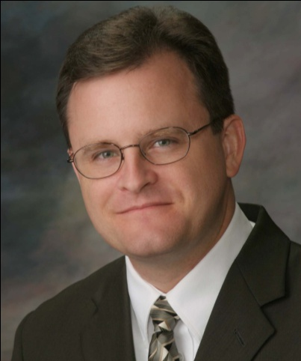
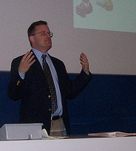
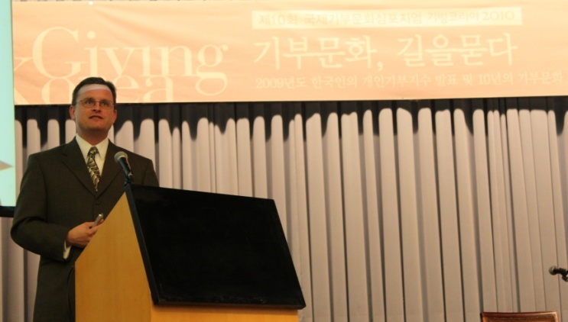
About the Author
Russell James, J.D., Ph.D., CFP® is an Associate
Professor and the Director of Graduate
Studies in Charitable Planning in the Division
of Personal Financial Planning at Texas Tech
University. He graduated, cum laude, from
the University of Missouri School of Law
where he was a member of the Missouri Law
Review. While in law school he received the
United Missouri Bank Award for Most
Outstanding Work in Gift and Estate Taxation
and Planning and the American Jurisprudence
Award for Most Outstanding Work in Federal
Income Taxation. After graduation, he worked
as the Director of Planned Giving for Central
Christian College, Moberly, Missouri for six
years and also built a successful law practice
limited to estate and gift planning. He later
served as president of the college for more
than five years, where he had direct and
supervisory responsibility for all fundraising. Dr. James received his Ph.D. in Consumer & Family Economics from the University of Missouri where his dissertation was on the topic of charitable giving. Dr. James has over 100 publications in print or in press in academic journals, conference proceedings, professional periodicals, and books. He writes regularly for Advancing Philanthropy, the magazine of the Association of Fundraising Professionals. He has presented his research in the U.S. and across the world including as an invited speaker in Ireland, Scotland, England, The Netherlands, Spain, Germany, and South Korea. (click here for complete CV)
Me (about 5 years ago)
Lecturing in Germany. 75 extra students showed up. I thought it was for me until I found out there was free beer afterwards.
At Giving Korea 2010. I didn’t notice until later the projector was shining on my head (inter-cultural height problems).

