Slide 1

Valuing charitable gifts of property:
How much deduction?
Russell James, J.D., Ph.D., CFP®
Director of Graduate Studies in Charitable Planning
Texas Tech University

Slide 2

Giving cash requires no valuation

Slide 3

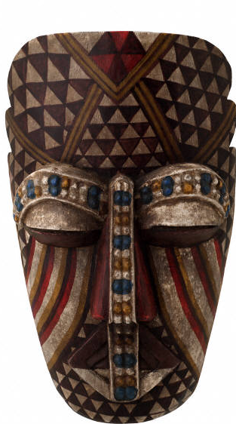
Valuing gifts of property can be more complex

Slide 4

Common valuation options
Current Fair Market Value
$0
Cost Basis (if lower than current value)

Slide 5
What you paid for it less depreciation deductions already taken
Cost Basis

Slide 6
Its value (less any depreciation deductions already taken)
Current Fair Market Value

Slide 7
Which valuation applies?
Current Fair Market Value
$0
Cost Basis (if lower than current value)

Slide 8
Long-term capital gain
FMV, unless…
To a private foundation (except “qualified stock”)
“Special election” (50% income limitation)
Unrelated use tangible personal property
Ordinary income
Cost basis
Short-term capital gain
Inventory or creative works by donor

Slide 9

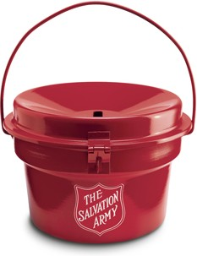
Long-term capital gain
FMV, unless…
To a private foundation (except “qualified stock”)
“Special election” (50% income limitation)
Unrelated use tangible personal property
Current Value: $25
1990 Paid $1
Ordinary income
Cost basis
Short-term capital gain
Inventory or creative works by donor

Slide 10
Long-term capital gain
FMV, unless…
To a private foundation (except “qualified stock”)
“Special election” (50% income limitation)
Unrelated use tangible personal property
Current Value: $25
1990 Paid $1
Ordinary income
Cost basis
Short-term capital gain
Inventory or creative works by donor

Slide 11
Long-term capital gain
FMV, unless…
To a private foundation (except “qualified stock”)
“Special election” (50% income limitation)
Unrelated use tangible personal property
Current Value: $25
1990 Paid $1
Ordinary income
Cost basis
Short-term capital gain
Inventory or creative works by donor

Slide 12
Long-term capital gain
FMV, unless…
To a private foundation (except “qualified stock”)
“Special election” (50% income limitation)
Unrelated use tangible personal property
Current Value: $25
1990 Paid $1
Ordinary income
Cost basis
Short-term capital gain
Inventory or creative works by donor

Slide 13

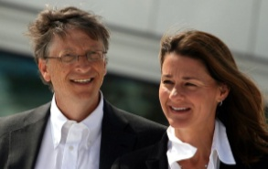

Long-term capital gain
FMV, unless…
To a private foundation (except “qualified stock”)
“Special election” (50% income limitation)
Unrelated use tangible personal property
Current Value: $1800/acre
1990 Paid $600/acre
Ordinary income
Cost basis
Short-term capital gain
Inventory or creative works by donor

Slide 14
Long-term capital gain
FMV, unless…
To a private foundation (except “qualified stock”)
“Special election” (50% income limitation)
Unrelated use tangible personal property
Current Value: $1800/acre
1990 Paid $600/acre
Ordinary income
Cost basis
Short-term capital gain
Inventory or creative works by donor

Slide 15
Long-term capital gain
FMV, unless…
To a private foundation (except “qualified stock”)
“Special election” (50% income limitation)
Unrelated use tangible personal property
Current Value: $1800/acre
1990 Paid $600/acre
Ordinary income
Cost basis
Short-term capital gain
Inventory or creative works by donor

Slide 16
Long-term capital gain
FMV, unless…
To a private foundation (except “qualified stock”)
“Special election” (50% income limitation)
Unrelated use tangible personal property
Current Value: $1800/acre
1990 Paid $600/acre
Ordinary income
Cost basis
Short-term capital gain
Inventory or creative works by donor

Slide 17
Long-term capital gain
FMV, unless…
To a private foundation (except “qualified stock”)
“Special election” (50% income limitation)
Unrelated use tangible personal property
Current Value: $1800/acre
1990 Paid $600/acre
Ordinary income
Cost basis
Short-term capital gain
Inventory or creative works by donor

Slide 18

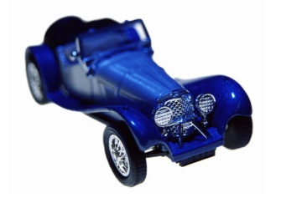

Long-term capital gain
FMV, unless…
To a private foundation (except “qualified stock”)
“Special election” (50% income limitation)
Unrelated use tangible personal property
Current Value: $25
6 Weeks Ago Paid $1
Charity displays toy in collection
Ordinary income
Cost basis
Short-term capital gain
Inventory or creative works by donor

Slide 19
Long-term capital gain
FMV, unless…
To a private foundation (except “qualified stock”)
“Special election” (50% income limitation)
Unrelated use tangible personal property
Current Value: $25
6 Weeks Ago Paid $1
Charity displays toy in collection
Ordinary income
Cost basis
Short-term capital gain
Inventory or creative works by donor

Slide 20
Long-term capital gain
FMV, unless…
To a private foundation (except “qualified stock”)
“Special election” (50% income limitation)
Unrelated use tangible personal property
Current Value: $25
6 Weeks Ago Paid $1
Charity displays toy in collection
Ordinary income
Cost basis
Short-term capital gain
Inventory or creative works by donor

Slide 21
Long-term capital gain
FMV, unless…
To a private foundation (except “qualified stock”)
“Special election” (50% income limitation)
Unrelated use tangible personal property
Current Value: $25
1990 Paid $1
Charity displays toy in collection
Ordinary income
Cost basis
Short-term capital gain
Inventory or creative works by donor

Slide 22
Long-term capital gain
FMV, unless…
To a private foundation (except “qualified stock”)
“Special election” (50% income limitation)
Unrelated use tangible personal property
Current Value: $25
1990 Paid $1
Charity displays toy in collection
Ordinary income
Cost basis
Short-term capital gain
Inventory or creative works by donor

Slide 23
Long-term capital gain
FMV, unless…
To a private foundation (except “qualified stock”)
“Special election” (50% income limitation)
Unrelated use tangible personal property
Current Value: $25
1990 Paid $1
Charity displays toy in collection
Ordinary income
Cost basis
Short-term capital gain
Inventory or creative works by donor

Slide 24
Long-term capital gain
FMV, unless…
To a private foundation (except “qualified stock”)
“Special election” (50% income limitation)
Unrelated use tangible personal property
Current Value: $25
1990 Paid $1
Charity displays toy in collection
Ordinary income
Cost basis
Short-term capital gain
Inventory or creative works by donor

Slide 25
Long-term capital gain
FMV, unless…
To a private foundation (except “qualified stock”)
“Special election” (50% income limitation)
Unrelated use tangible personal property
Current Value: $25
1990 Paid $1
Charity displays toy in collection
Ordinary income
Cost basis
Short-term capital gain
Inventory or creative works by donor

Slide 26
Long-term capital gain
FMV, unless…
Recapture
If charity transfers donor’s “related use” tangible personal property >$5,000 within 3 years, it must certify substantial related use (or that intended use became impossible), otherwise valuation changes to cost basis
Current Value: $25
1990 Paid $1
Charity displays toy in collection
Ordinary income
Cost basis
Short-term capital gain
Inventory or creative works by donor

Slide 27
Long-term capital gain
FMV, unless…
To a private foundation (except “qualified stock”)
“Special election” (50% income limitation)
Unrelated use tangible personal property
Current Value: $25
1990 Paid $1
Charity sells toy at annual benefit auction
Ordinary income
Cost basis
Short-term capital gain
Inventory or creative works by donor

Slide 28
Long-term capital gain
FMV, unless…
To a private foundation (except “qualified stock”)
“Special election” (50% income limitation)
Unrelated use tangible personal property
Current Value: $25
1990 Paid $1
Charity sells toy at annual benefit auction
Ordinary income
Cost basis
Short-term capital gain
Inventory or creative works by donor

Slide 29
Long-term capital gain
FMV, unless…
To a private foundation (except “qualified stock”)
“Special election” (50% income limitation)
Unrelated use tangible personal property
Current Value: $25
1990 Paid $1
Charity sells toy at annual benefit auction
Ordinary income
Cost basis
Short-term capital gain
Inventory or creative works by donor

Slide 30
Long-term capital gain
FMV, unless…
To a private foundation (except “qualified stock”)
“Special election” (50% income limitation)
Unrelated use tangible personal property
Current Value: $25
1990 Paid $1
Charity sells toy at annual benefit auction
Ordinary income
Cost basis
Short-term capital gain
Inventory or creative works by donor

Slide 31
Long-term capital gain
FMV, unless…
To a private foundation (except “qualified stock”)
“Special election” (50% income limitation)
Unrelated use tangible personal property
Current Value: $25
1990 Paid $1
Charity sells toy at annual benefit auction
Ordinary income
Cost basis
Short-term capital gain
Inventory or creative works by donor

Slide 32
Long-term capital gain
FMV, unless…
To a private foundation (except “qualified stock”)
Market quotations available
Not more than 10% of company given to the foundation (counting all family member transfers)

Slide 33
Long-term capital gain
FMV, unless…
To a private foundation (except “qualified stock”)
“Special election” (50% income limitation)
Unrelated use tangible personal property
Current Value: $25
1990 Paid $1
10,000 Shares
Ordinary income
Cost basis
Short-term capital gain
Inventory or creative works by donor

Slide 34
Long-term capital gain
FMV, unless…
To a private foundation (except “qualified stock”)
“Special election” (50% income limitation)
Unrelated use tangible personal property
Current Value: $25
1990 Paid $1
10,000 Shares
Ordinary income
Cost basis
Short-term capital gain
Inventory or creative works by donor

Slide 35
Long-term capital gain
FMV, unless…
To a private foundation (except “qualified stock”)
“Special election” (50% income limitation)
Unrelated use tangible personal property
Current Value: $25
1990 Paid $1
10,000 Shares
Ordinary income
Cost basis
Short-term capital gain
Inventory or creative works by donor

Slide 36
Long-term capital gain
FMV, unless…
To a private foundation (except “qualified stock”)
“Special election” (50% income limitation)
Unrelated use tangible personal property
Current Value: $25
1990 Paid $1
10,000 Shares
Ordinary income
Cost basis
Short-term capital gain
Inventory or creative works by donor

Slide 37
Long-term capital gain
FMV, unless…
To a private foundation (except “qualified stock”)
“Special election” (50% income limitation)
Unrelated use tangible personal property
Current Value: $25
1990 Paid $1
10,000 Shares
Ordinary income
Cost basis
Short-term capital gain
Inventory or creative works by donor

Slide 38
Special asset rules
Clothing or household items
A car, boat, or airplane
Taxidermy
Inventory from your business
A patent or other intellectual property

Slide 39

Why so many special asset rules?
…to prevent abuse

Slide 40

With potential income tax deductions worth nearly half of a gift’s “value”, property with uncertain valuation creates opportunities for abuse
¹ex: 35% Federal
11% Oregon

Slide 41

Don’t throw away those old clothes, give them away and deduct it!

Slide 42
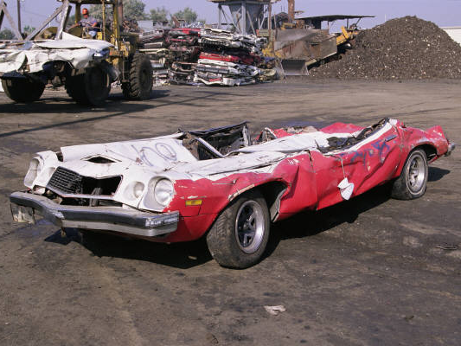
Of course your old junker is worth its blue book value…if you donate it!

Slide 43

Donate the stuffed game to a museum and take the charitable tax deduction for all equipment and travel
Hunt on safari for free!

Slide 44
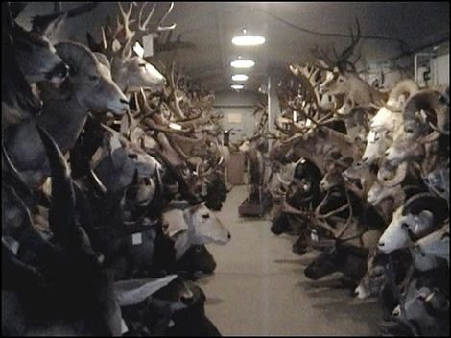
From the Wyobraska Wildlife Museum
in Gering (pop: 7,751) Nebraska (plus four train cars storing another 800 animals each)
Notes:
http://network.bestfriends.org/groups/animalworldusa/news/archive/2006/02/25/biggame-hunting-brings-big-tax-breaks.aspx

Slide 45
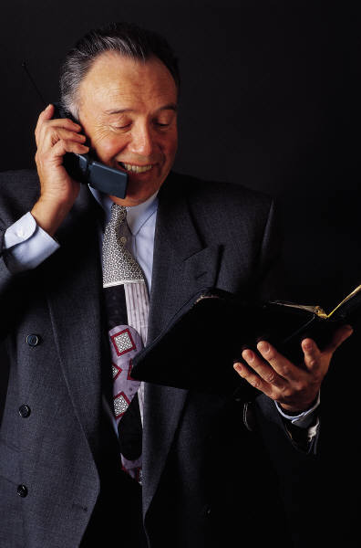
I hereby give you the copyright to my novel. It will be a best seller, I’m sure.
P.S. I’ll be taking a large deduction today for this very valuable gift.

Slide 46
Special asset rules
Clothing or household items
A car, boat, or airplane
Taxidermy
Inventory from your business
A patent or other intellectual property

Slide 47
Don’t throw away those old clothes, give them away and deduct it!
Problem:
Clothing & Household Items

Slide 48
No deduction unless in “good used condition or better” or giving >$500 worth with a qualified appraisal
Solution:
Clothing & Household Items

Slide 49
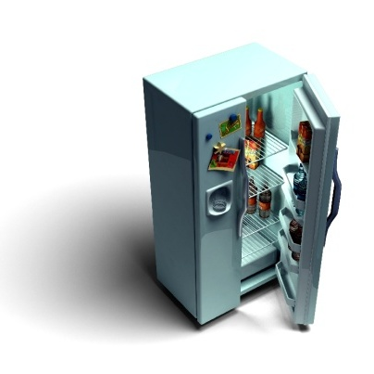


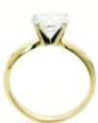
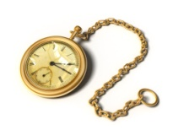


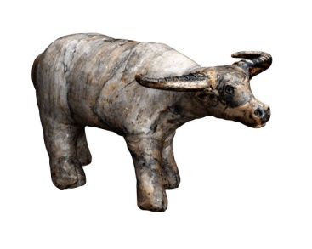

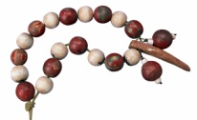



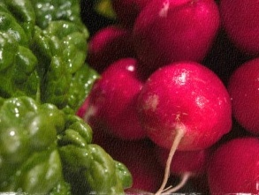
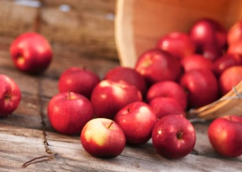
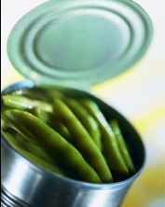
Household items include
Furniture
Electronics
Appliances
Linens
Food
Art
Antiques
Jewelry
Collections

Slide 50
Problem: Donors deduct “Blue Book” value but charity sells for much less

Slide 51
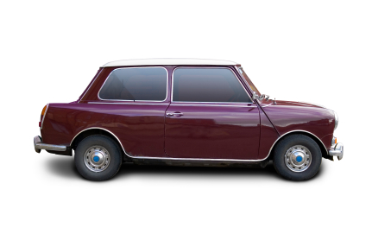
If charity sells, deduct sales price
Current Value $6,000
Charity sells at auction
1990 Paid $5,000
$3,000

Slide 52
If charity sells, deduct sales price
Current Value $6,000
Charity sells at auction
1990 Paid $5,000
$3,000
Deduction

Slide 53
Applies to any car, boat, or plane deduction >$500
Current Value $6,000
Charity sells at auction
1990 Paid $5,000
$3,000
Deduction

Slide 54

Use normal gift valuation if charity certifies (Form 1098-C) it will use the vehicle or give it to a needy person

Slide 55
Problem: Deducting cost of hunting trip when animal given to museum
Notes:
http://network.bestfriends.org/groups/animalworldusa/news/archive/2006/02/25/biggame-hunting-brings-big-tax-breaks.aspx

Slide 56
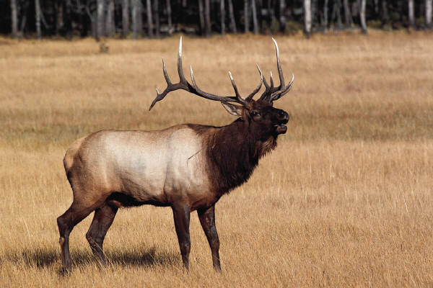
Deduction for taxidermy property is limited to cost of stuffing the animal only

Slide 57
Problem: How to value intellectual property?
“I give you the copyright to my novel that I think will be a best seller”

Slide 58

Year 1 100%
Year 2 100%
Year 3 90%
Year 4 80%
Year 5 70%
Year 6 60%
Year 7 50%
Year 8 40%
Year 9 30%
Year 10 20%
Year 11 10%
Year 12 10%
Deduction for copyrights, patents, and trademarks
=
Cost basis (if < FMV)
+
Share of next 12 years income (n/a private foundations)

Slide 59

Final Exception
C-corporations may deduct average of basis and FMV (not more than 2X basis) for inventory gifts
To public charity for care of ill, needy, or infants
Of qualified research property to a higher education or scientific institution

Slide 60

Some common items can be hard to value
For used cars use “private party” value, not dealer retail
For boats an individual appraisal is required
For used clothing compare with consignment or thrift shops
For large quantities, value as a group, not individual value X number

Slide 61
Penalties for bad valuation are a percentage of the unpaid taxes
More than 1.5X actual value AND
More than $5,000 underpayment of tax
More than 2X actual value
AND more than $5,000 underpayment of tax
Misstatement due to fraud
20% penalty
40% penalty
75% penalty

Slide 62

Can you blame the appraiser and avoid the penalty?

Slide 63
No taxpayer penalty if:
Based on qualified appraisal
Donor made a good faith investigation of value
Valuation <2X actual

Slide 64
If valuation >1.5X actual, appraiser penalty is greater of $1,000 or 10% of tax underpayment, up to 125% of appraisal fee.

Slide 65
Valuing charitable gifts of property:
How much deduction?
Pictures from www.istockphoto.com

Slide 66

Help me
HERE
convince my bosses that continuing to build and post these slide sets is not a waste of time. If you work for a nonprofit or advise donors and you reviewed these slides, please let me know by clicking

Slide 67

If you clicked on the link to let me know you reviewed these slides…
Thank You!

Slide 68

For the audio lecture accompanying this
slide set, go to
EncourageGenerosity.com

Slide 69

Think you understand it?
Prove it!
Click here to go to EncourageGenerosity.com and take the free quiz on this slide set. (Instantly graded with in depth explanations and a certificate of completion score report.)

Slide 70


Graduate Studies in
Charitable Financial Planning
at Texas Tech University
This slide set is from the introductory curriculum for the Graduate Certificate in Charitable Financial Planning at Texas Tech University, home to the nation’s largest graduate program in personal financial planning.
To find out more about the online Graduate Certificate in Charitable Financial Planning go to www.EncourageGenerosity.com
To find out more about the M.S. or Ph.D. in personal financial planning at Texas Tech University, go to www.depts.ttu.edu/pfp/

Slide 71
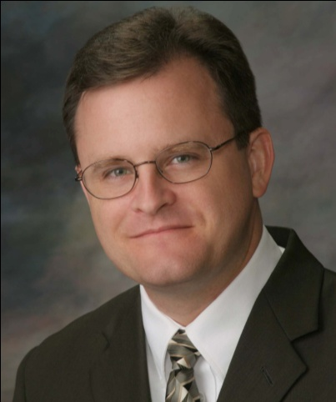
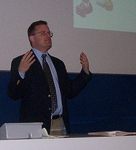
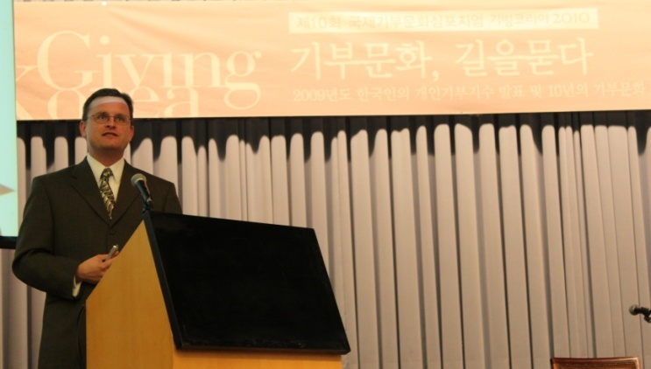
About the Author
Russell James, J.D., Ph.D., CFP® is an Associate
Professor and the Director of Graduate
Studies in Charitable Planning in the Division
of Personal Financial Planning at Texas Tech
University. He graduated, cum laude, from
the University of Missouri School of Law
where he was a member of the Missouri Law
Review. While in law school he received the
United Missouri Bank Award for Most
Outstanding Work in Gift and Estate Taxation
and Planning and the American Jurisprudence
Award for Most Outstanding Work in Federal
Income Taxation. After graduation, he worked
as the Director of Planned Giving for Central
Christian College, Moberly, Missouri for six
years and also built a successful law practice
limited to estate and gift planning. He later
served as president of the college for more
than five years, where he had direct and
supervisory responsibility for all fundraising. Dr. James received his Ph.D. in Consumer & Family Economics from the University of Missouri where his dissertation was on the topic of charitable giving. Dr. James has over 100 publications in print or in press in academic journals, conference proceedings, professional periodicals, and books. He writes regularly for Advancing Philanthropy, the magazine of the Association of Fundraising Professionals. He has presented his research in the U.S. and across the world including as an invited speaker in Ireland, Scotland, England, The Netherlands, Spain, Germany, and South Korea. (click here for complete CV)
Me (about 5 years ago)
Lecturing in Germany. 75 extra students showed up. I thought it was for me until I found out there was free beer afterwards.
At Giving Korea 2010. I didn’t notice until later the projector was shining on my head (inter-cultural height problems).

