Slide 1

Income Limits on Charitable Deductions
Russell James, J.D., Ph.D., CFP®
Director of Graduate Studies in Charitable Planning
Texas Tech University

Slide 2

We pay taxes on income.

Slide 3
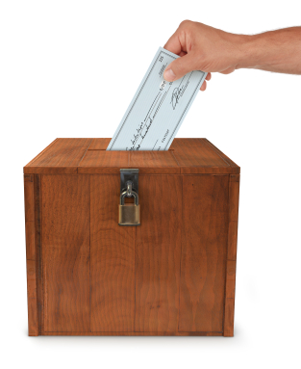
Charitable gifts can sometimes be deducted from taxable income, thereby reducing taxes owed.

Slide 4
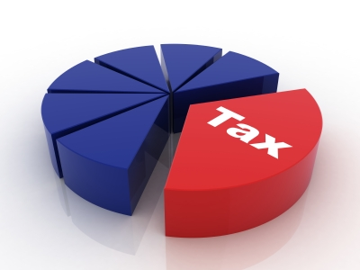
Charitable deductions are limited to
20%, 30%, or 50% of income
depending on the gift and recipient.

Slide 5

Why should we limit charitable deductions?

Slide 6

Encouraging giving is good, but at least some revenue should go to the government.
Need $ for roads, bridges, schools, and national defense

Slide 7
0.00
Wealthy with high incomes could pay zero taxes by annually transferring assets to charity.

Slide 8
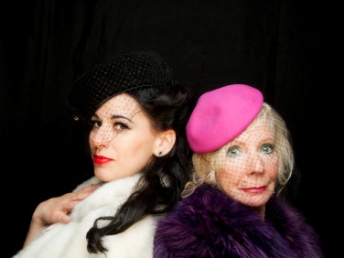
Taxes? Oh, no, we don’t pay taxes.

Slide 9

Why are people making such large donations, anyway?

Slide 10
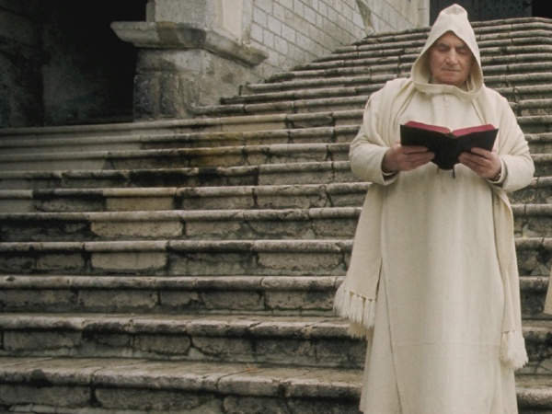
Are people taking vows of poverty and giving away everything they earn?

Slide 11
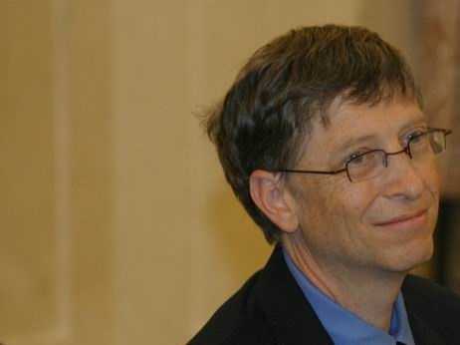
Actually, the limits are an issue with gifts from assets, where wealth is far greater than annual income.
Notes:
http://commons.wikimedia.org/wiki/File:Bill_Gates_in_Poland.jpg

Slide 12
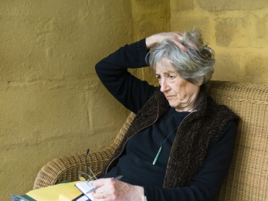
Can be an issue with wealthy retiree donors who have limited income but large assets
Notes:
http://commons.wikimedia.org/wiki/File:Bill_Gates_in_Poland.jpg

Slide 13

Some gifts may be deducted up to 50% of income if given to a public charity, government, or an operating private foundation

Slide 14
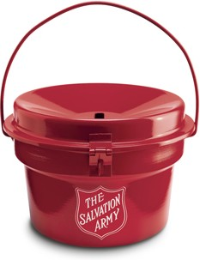

50% limit
$
Money
(given or spent performing services for the charity)
Public Charity

Slide 15
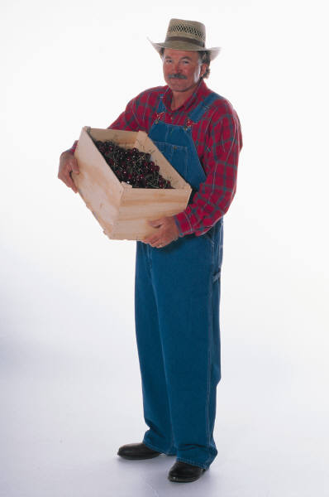
50% limit
Ordinary Income Property
Public Charity

Slide 16
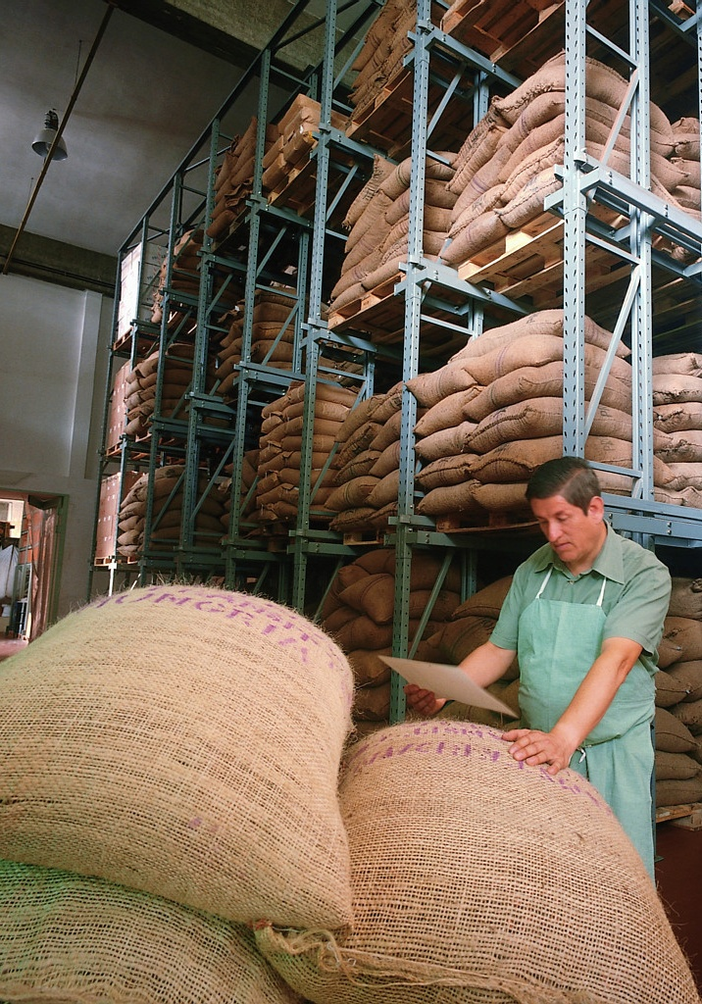
50% limit
Public Charity
Inventory

Slide 17

50% limit
Short-Term (≤1 year) Capital Gain Property
Public Charity

Slide 18

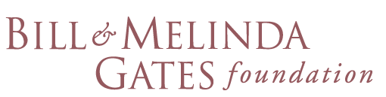



For all other charitable organizations, such as private (non-operating) foundations, the maximum deduction is 30% or less.

Slide 19
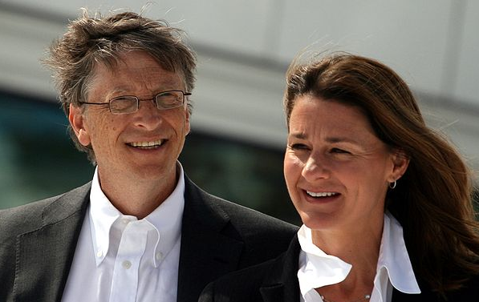
30% limit
$
Money
(given or spent performing services for the charity)
Private Foundation (non-operating)
Notes:
http://commons.wikimedia.org/wiki/File:Bill_og_Melinda_Gates_2009-06-03_(bilde_01).JPG

Slide 20
30% limit
Ordinary Income Property
Private Foundation (non-operating)

Slide 21
30% limit
Private Foundation (non-operating)
Inventory

Slide 22
30% limit
Short-Term (≤1 year) Capital Gain Property
Private Foundation (non-operating)

Slide 23

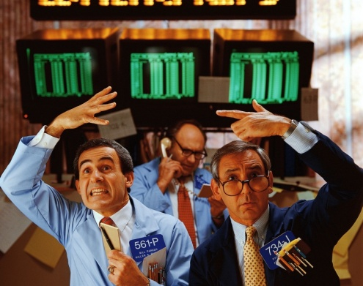
All ordinary income property is usually treated the same

Slide 24
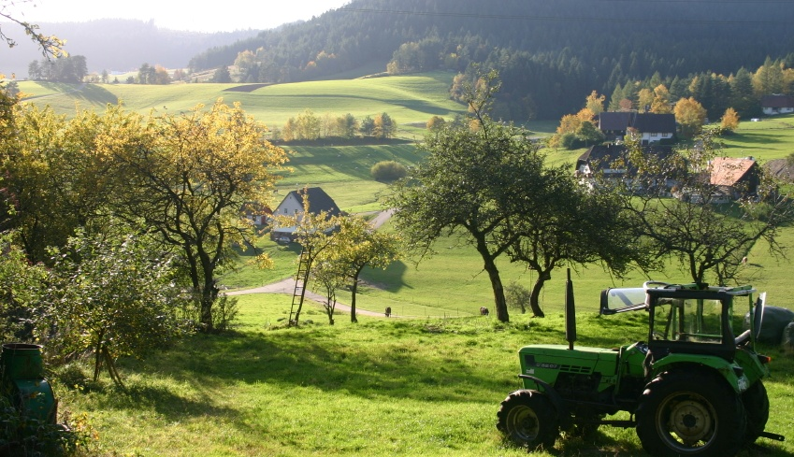
Long-term (>1 year) capital gain property is treated differently
Current Value: $1,800/acre
1990 Paid $600 acre

Slide 25

Long-term capital gain property
Current Value: $25
1990 Paid $1
(split adjusted)

Slide 26
30% Limit
Current Value: $25
1990 Paid $1
Public Charity

Slide 27
50% limit with “special election”
Deduct cost basis instead of value (if lower)
Covers all long-term capital gain gifts for the year
Current Value: $25
Public Charity
1990 Paid $1

Slide 28
20% limit
Current Value: $25
1990 Paid $1
Private Foundation (non-operating)

Slide 29
30% limit if “for the use of” charity
Means money given “in trust” to another entity but charity gets current benefit
  Ex: paying premiums to a life insurance company for a charity-owned policy
  Ex: money in a trust where charity gets income for a time (Charitable Lead Trust)
“in trust”

Slide 30

So, that covers gifts of cash, capital assets, and ordinary income property.
What’s left?

Slide 31

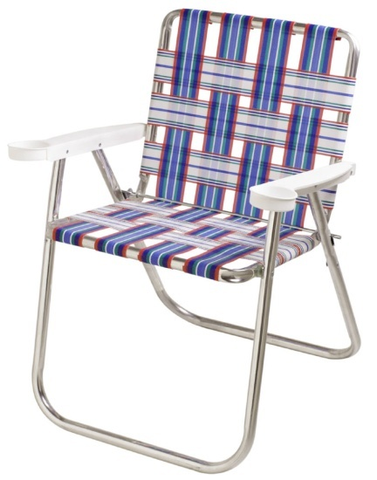
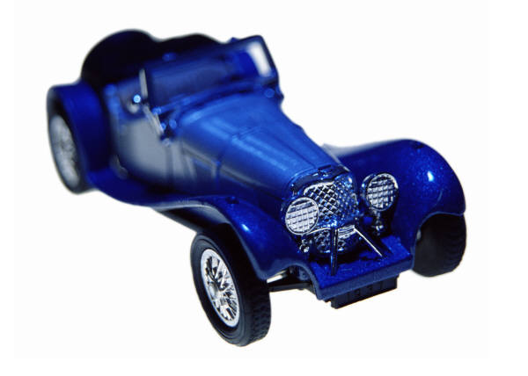

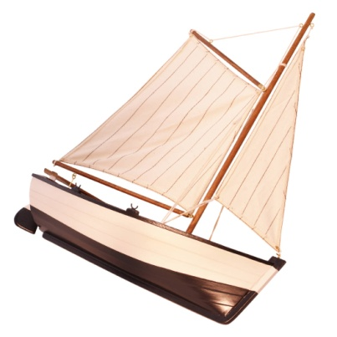
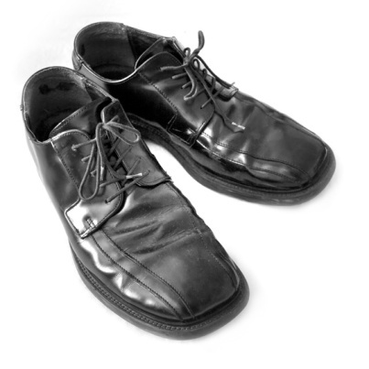
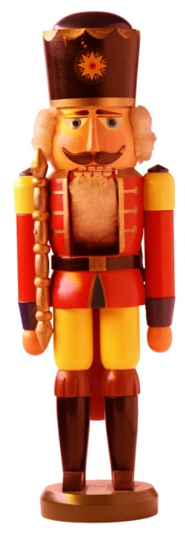
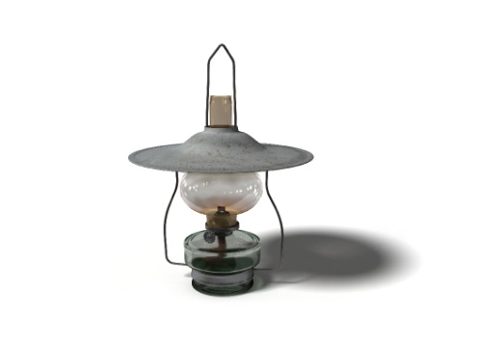
All the stuff in your garage (tangible personal property)

Slide 32
50% when valued at lower of cost basis or current value
Current Value: $25
1970 Paid $1
Public Charity

Slide 33
50% when valued at lower of cost basis or current value
Current Value: $1
1970 Paid $25
Public Charity

Slide 34


30% when valued at current value due to “related use” by a public charity
Current Value: $25
1970 Paid $1
Public Charity

Slide 35
20% when given to a private non-operating foundation
Current Value: $25
1970 Paid $1

Slide 36

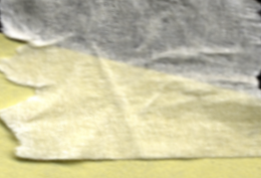

CORPORATIONS
C-corps limited to 10% of taxable income with 5-year carryforward.
S-corps pass through all deductions to shareholders.

Slide 37





Ordinary income property
Cash
Inventory
Short-term capital gain
Public Charity
50% Gifts
Current Value: $25
1990 Paid $1
Long-term capital gain (special election)
Tangible personal property (“unrelated” use)
Public Charity

Slide 38
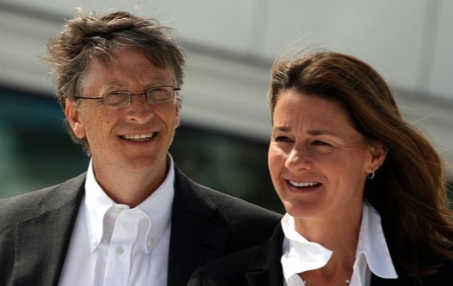
Ordinary income property
Cash
Inventory
Short-term capital gain
Private Foundation (non-operating)
30% Gifts
Current Value: $25
1990 Paid $1
Long-term capital gain
(no special election)
Tangible personal property (“related” use)
Public Charity

Slide 39
Current Value: $25
1990 Paid $1
Tangible personal property
(“related” or “unrelated” use)
Private Foundation (non-operating)
20% Gifts
Current Value: $25
1990 Paid $1
Long-term capital gain
(any)
Private Foundation (non-operating)

Slide 40

What happens if you give more than the limit?

Slide 41

The excess deduction may be used later (as soon as charitable deductions do not exceed the maximum limit), but within five years.

Slide 42
Unused charitable deductions may be carried over for up to 5 years
Charitable Deduction Maximum for Each Year
Not Deductible in Year 1 (over limit)
Deductible in Year 1 (under limit)
Deductible Carryover
Deductible Carryover
Deductible Gifts Made in Year 2
Deductible Gifts Made in Year 3
Deductible Gifts Made in Year 4
Year 1
Year 2
Year 3
Year 4

Slide 43
Oldest carryover deductions are used first
Charitable Deduction Maximum for Each Year
Not Deductible in Year 1 (over limit)
Deductible in Year 1 (under limit)
Not Deductible in Year 2 (over limit)
Deductible Carryover
Deductible Carryover
Deductible in Year 2 (under limit)
Deductible Gifts Made in Year 3
Deductible Gifts Made in Year 4
Deductible Gifts Made in Year 5
Year 1
Year 2
Year 3
Year 4
Year 5

Slide 44

What happens to a carryover deduction if I don’t itemize (i.e., just take the standard deduction)?

Slide 45
The carryover is reduced as if you took the largest possible charitable deduction
Charitable Deduction Maximum for Each Year
In year 2 no gifts were deducted because the standard deduction was used
Not Deductible in Year 1 (over limit)
Deductible in Year 1 (under limit)
Carryover Eliminated
Deductible Carryover
(potentially)Deductible Gifts Made in Year 2
Deductible Gifts Made in Year 3
Deductible Gifts Made in Year 4
Year 1
Year 2
Year 3
Year 4

Slide 46

What happens to a carryover deduction if the donor dies?

Slide 47
The carryover deduction is lost at death. For joint returns, the carryover that would have been claimed by the decedent if the couple had filed separately is lost.

Slide 48

How do the different limits work together?

Slide 49
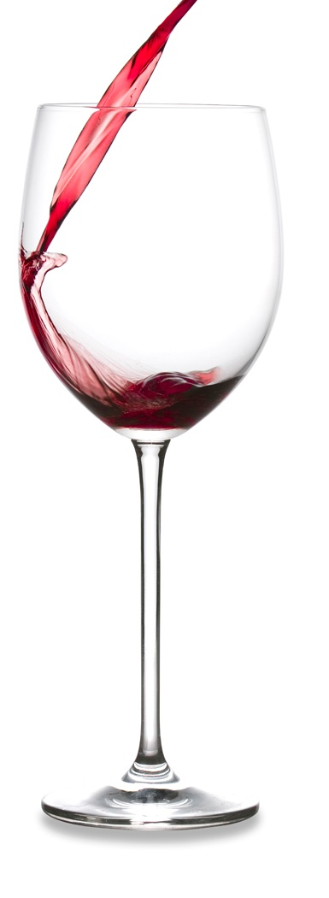
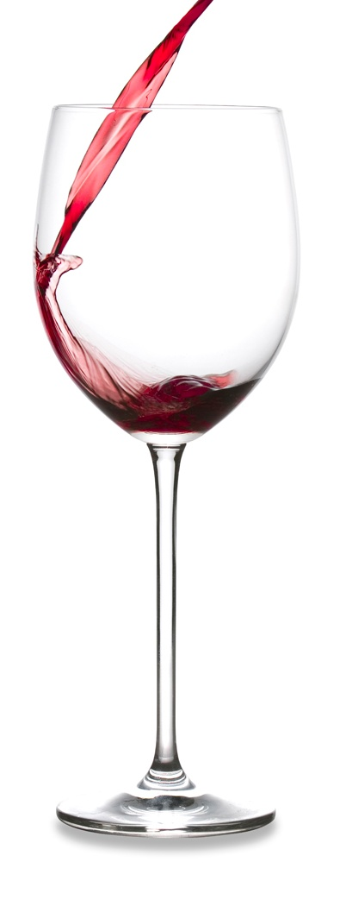
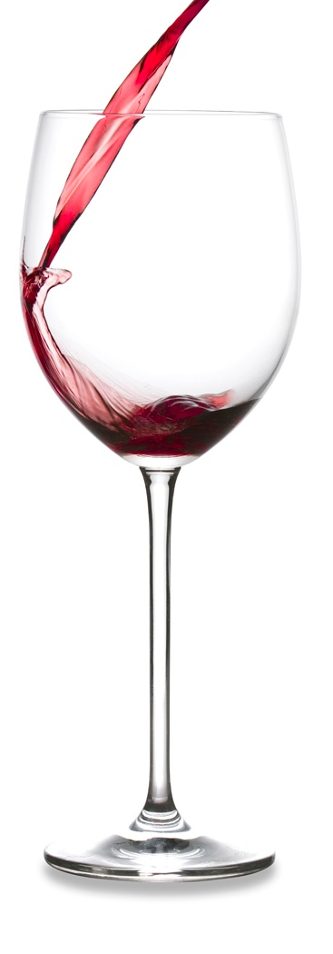
Any overflow is carried over
Holds 50% of Income
Holds 30% of Income
Holds 30% of Income
Holds 20%
of Income
All gifts
All capital gain property except “special election”
All gifts to
private foundations
or “for the use of” public charities
Capital gain property to private foundations
Notes:
All gifts to private foundations should also include any gifts “for the use of” public charities

Slide 50

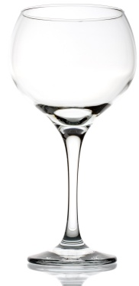
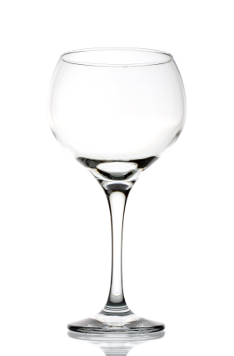
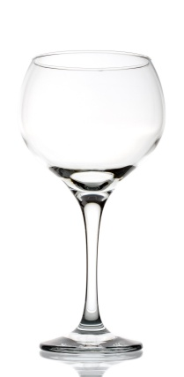
$100,000 income
$30,000 FMV capital gain property to public charity
$20,000 cash to private foundation
Holds 50% of Income
Holds 30% of Income
Holds 30% of Income
Holds 20%
of Income
All gifts
All capital gain property except “special election”
All gifts to private foundations
Capital gain property to private foundations

Slide 51
$100,000 income
$30,000 FMV capital gain property to public charity
$20,000 cash to private foundation
Holds 50% of Income
Holds 30% of Income
Holds 30% of Income
Holds 20%
of Income
✓
$50,000
✓
$30,000
✓
$20,000
✓
$0
All gifts
All capital gain property except “special election”
All gifts to private foundations
Capital gain property to private foundations

Slide 52
No Carryover. All deductions allowed.
Holds 50% of Income
Holds 30% of Income
Holds 30% of Income
Holds 20%
of Income
✓
$50,000
✓
$30,000
✓
$20,000
✓
$0
All gifts
All capital gain property except “special election”
All gifts to private foundations
Capital gain property to private foundations

Slide 53

Which gifts get counted first if the total is too great?

Slide 54





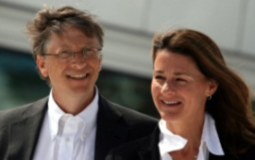
50% Gifts
1st
Current Value: $25
1990 Paid: $1
30% Gifts
2nd
Current Value: $25
1990 Paid: $1
3rd
20% Gifts
4th

Slide 55
$100,000 income
$30,000 cash to public charity
$30,000 FMV capital gain property to public charity
Holds 50% of Income
Holds 30% of Income
Holds 30% of Income
Holds 20%
of Income
All gifts
All capital gain property except “special election”
All gifts to private foundations
Capital gain property to private foundations

Slide 56

$100,000 income
$30,000 cash to public charity
$30,000 FMV capital gain property to public charity
Holds 50% of Income
Holds 30% of Income
Holds 30% of Income
Holds 20%
of Income
X
$60,000
✓
$30,000
✓
$0
✓
$0
All gifts
All capital gain property except “special election”
All gifts to private foundations
Capital gain property to private foundations

Slide 57
$100,000 income
$30,000 cash to public charity
$30,000 FMV capital gain property to public charity
Holds 50% of Income
Holds 30% of Income
Holds 30% of Income
Holds 20%
of Income
$10k FMV capital gain property
✓
$20k FMV capital gain property
$30,000
✓
$0
$30k cash
✓
$0
All gifts
All capital gain property except “special election”
All gifts to private foundations
Capital gain property to private foundations

Slide 58
$10,000 carryover
Holds 50% of Income
Holds 30% of Income
Holds 30% of Income
Holds 20%
of Income
$10k FMV capital gain property
✓
$20k FMV capital gain property
$30,000
✓
$0
$30k cash
✓
$0
All gifts
All capital gain property except “special election”
All gifts to private foundations
Capital gain property to private foundations

Slide 59
$100,000 income
$2,000 cash to public charity
$56,000 FMV capital gain property to public charity
$5,000 cash to private foundation
Holds 50% of Income
Holds 30% of Income
Holds 30% of Income
Holds 20%
of Income
All gifts
All capital gain property except “special election”
All gifts to private foundations
Capital gain property to private foundations

Slide 60

$100,000 income
$2,000 cash to public charity
$56,000 FMV capital gain property to public charity
$5,000 cash to private foundation
Holds 50% of Income
Holds 30% of Income
Holds 30% of Income
Holds 20%
of Income
X
$73,000
X
$56,000
✓
$5,000
✓
$0
All gifts
All capital gain property except “special election”
All gifts to private foundations
Capital gain property to private foundations

Slide 61
$100,000 income
$2,000 cash to public charity
$56,000 FMV capital gain property to public charity
$5,000 cash to private foundation
Holds 50% of Income
Holds 30% of Income
Holds 30% of Income
$5k cash to private foundation
Holds 20%
of Income
$8k FMV capital gain property
$26k FMV capital gain property
✓
$48k FMV capital gain property
$5,000
✓
$0
$2k cash to public charity
$30k FMV capital gain property
All gifts
All capital gain property except “special election”
All gifts to private foundations
Capital gain property to private foundations

Slide 62
$5,000 carryover of cash to private foundations
$26,000 carryover of FMV capital gain property
Holds 50% of Income
Holds 30% of Income
Holds 30% of Income
$5k cash to private foundation
Holds 20%
of Income
$8k FMV capital gain property
$26k FMV capital gain property
✓
$48k FMV capital gain property
$5,000
✓
$0
$2k cash to public charity
$30k FMV capital gain property
All gifts
All capital gain property except “special election”
All gifts to private foundations
Capital gain property to private foundations

Slide 63
$5,000 carryover of cash to private foundations
$26,000 carryover of FMV capital gain property
$5,000 cash to private foundation: Deduct $0
$2,000 cash to public charity: Deduct $2,000
$56,000 FMV capital gain property to public charity:
Deduct $30,000

Slide 64
$100,000 income
$20,000 FMV capital gain property to public charity
$20,000 capital gain property to private foundation
Holds 50% of Income
Holds 30% of Income
Holds 30% of Income
Holds 20%
of Income
All gifts
All capital gain property except “special election”
All gifts to private foundations
Capital gain property to private foundations

Slide 65
$100,000 income
$20,000 FMV capital gain property to public charity
$20,000 capital gain property to private foundation
Holds 50% of Income
Holds 30% of Income
Holds 30% of Income
Holds 20%
of Income
✓
$40,000
X
$40,000
✓
$20,000
✓
$20,000
All gifts
All capital gain property except “special election”
All gifts to private foundations
Capital gain property to private foundations

Slide 66
$100,000 income
$20,000 FMV capital gain property to public charity
$20,000 capital gain property to private foundation
Holds 50% of Income
Holds 30% of Income
Holds 30% of Income
Holds 20%
of Income
✓
$40,000
$10k cap gain to private foundation
✓
$10k cap gain to private foundation
$20,000
✓
$20,000
$20k FMV cap gain to public charity
All gifts
All capital gain property except “special election”
All gifts to private foundations
Capital gain property to private foundations

Slide 67
$10,000 carryover of capital gain property given to a private foundation
Holds 50% of Income
Holds 30% of Income
Holds 30% of Income
Holds 20%
of Income
✓
$40,000
$10k cap gain to private foundation
✓
$10k cap gain to private foundation
$20,000
✓
$20,000
$20k FMV cap gain to public charity
All gifts
All capital gain property except “special election”
All gifts to private foundations
Capital gain property to private foundations

Slide 68
Income Limits on Charitable Deductions
All pictures are from www.istockphoto.com

Slide 69

Help me
HERE
convince my bosses that continuing to build and post these slide sets is not a waste of time. If you work for a nonprofit or advise donors and you reviewed these slides, please let me know by clicking

Slide 70

If you clicked on the link to let me know you reviewed these slides…
Thank You!

Slide 71

For the audio lecture accompanying this
slide set, go to
EncourageGenerosity.com

Slide 72

Think you understand it?
Prove it!
Click here to go to EncourageGenerosity.com and take the free quiz on this slide set. (Instantly graded with in depth explanations and a certificate of completion score report.)

Slide 73
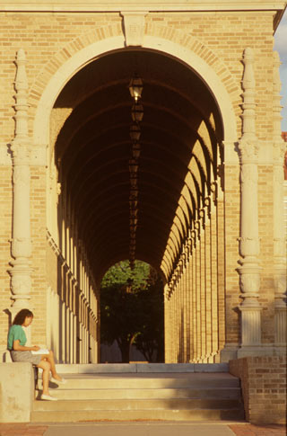

Graduate Studies in
Charitable Financial Planning
at Texas Tech University
This slide set is from the introductory curriculum for the Graduate Certificate in Charitable Financial Planning at Texas Tech University, home to the nation’s largest graduate program in personal financial planning.
To find out more about the online Graduate Certificate in Charitable Financial Planning go to www.EncourageGenerosity.com
To find out more about the M.S. or Ph.D. in personal financial planning at Texas Tech University, go to www.depts.ttu.edu/pfp/

Slide 74
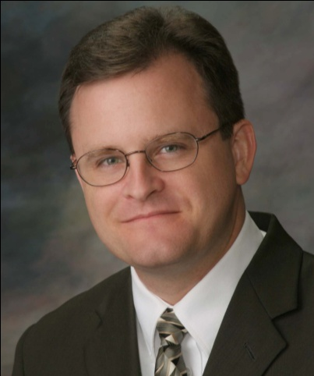
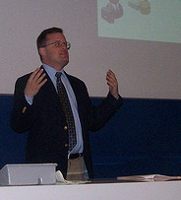
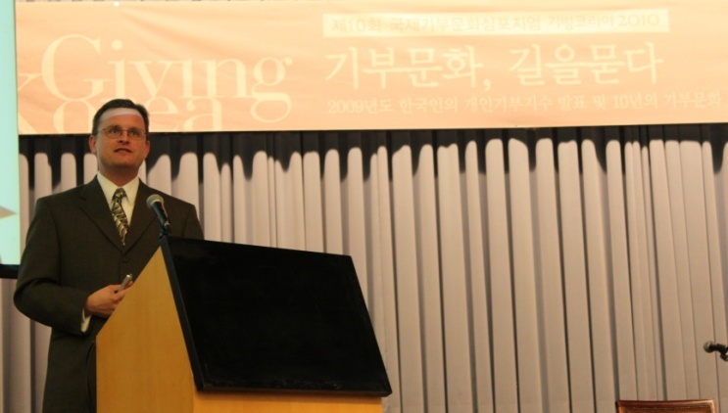
About the Author
Russell James, J.D., Ph.D., CFP® is an Associate
Professor and the Director of Graduate
Studies in Charitable Planning in the Division
of Personal Financial Planning at Texas Tech
University. He graduated, cum laude, from
the University of Missouri School of Law
where he was a member of the Missouri Law
Review. While in law school he received the
United Missouri Bank Award for Most
Outstanding Work in Gift and Estate Taxation
and Planning and the American Jurisprudence
Award for Most Outstanding Work in Federal
Income Taxation. After graduation, he worked
as the Director of Planned Giving for Central
Christian College, Moberly, Missouri for six
years and also built a successful law practice
limited to estate and gift planning. He later
served as president of the college for more
than five years, where he had direct and
supervisory responsibility for all fundraising. Dr. James received his Ph.D. in Consumer & Family Economics from the University of Missouri where his dissertation was on the topic of charitable giving. Dr. James has over 100 publications in print or in press in academic journals, conference proceedings, professional periodicals, and books. He writes regularly for Advancing Philanthropy, the magazine of the Association of Fundraising Professionals. He has presented his research in the U.S. and across the world including as an invited speaker in Ireland, Scotland, England, The Netherlands, Spain, Germany, and South Korea. (click here for complete CV)
Me (about 5 years ago)
Lecturing in Germany. 75 extra students showed up. I thought it was for me until I found out there was free beer afterwards.
At Giving Korea 2010. I didn’t notice until later the projector was shining on my head (inter-cultural height problems).

