Slide 1

Charitable gifts of remainder interests in homes and farms
Russell James, J.D., Ph.D., CFP®, Director of Graduate Studies in Charitable Planning, Texas Tech University

Slide 2
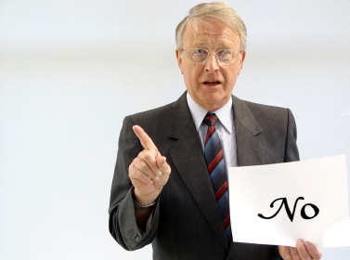
General rule: you can’t deduct a partial interest gift

Slide 3

A partial interest gift occurs when a donor gives some rights to property but keeps others

Slide 4
General rule: you can’t deduct a partial interest gift

Slide 5


But, you can deduct a remainder interest in a home or farm
Other Exceptions
Giving all or an “undivided portion” of a property interest
Charitable remainder/ lead trust or pooled income fund
Qualified conservation easement

Slide 6

A remainder interest gives the right to own the property after a set time or after the death of a person
OK,
you can have my stuff now.
Charles A. Donor

Slide 7

Unlike a will, a remainder interest is not revocable, and can even be sold
Remainder
Interest

Slide 8

A deductible remainder interest in farmland or a home must be transferred by deed, not by trust or contract

Slide 9
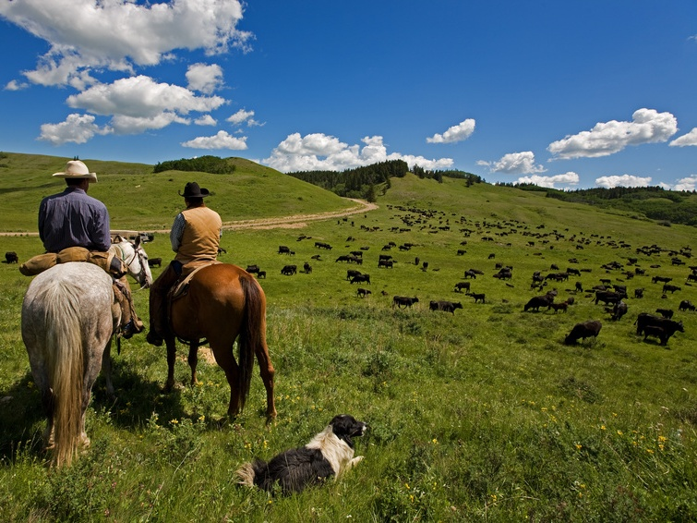
A farm is any land and improvements used
(even by a tenant)
to raise crops or livestock

Slide 10
A remainder interest in any part of a farm may be gifted
(Rev. Rul. 78-303)

Slide 11
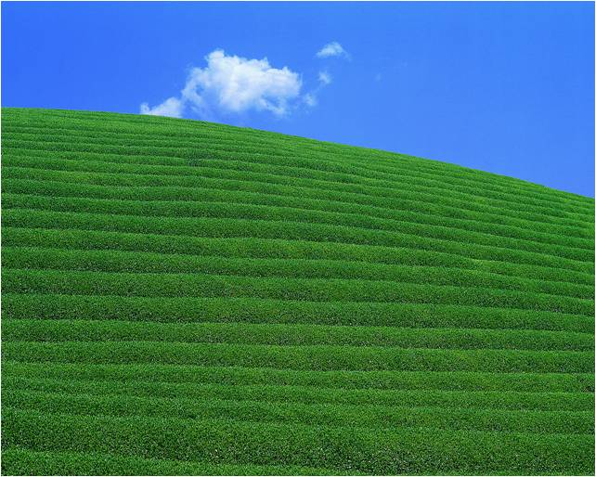
Can I give a remainder interest of an undivided share in farmland?
12.5%
25%

Slide 12
Yes, donor may deduct a remainder interest shared by charity and others as tenants in common (Rev. Rule 87-37)
12.5%
25%

Slide 13
However, IRS may deduct cost of partitioning (of forcing a sale or division)
12.5%
25%

Slide 14
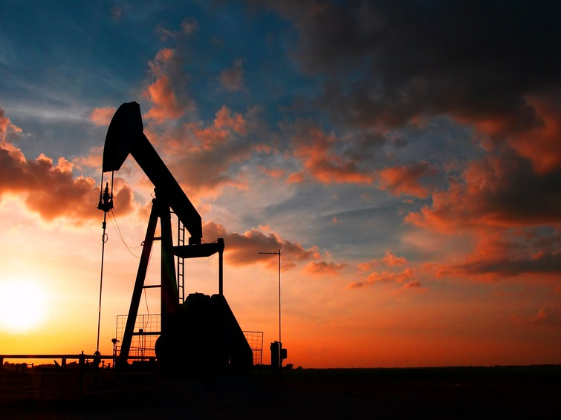
mineral rights
No deduction for remainder just in mineral rights because it is not a “farm” Reg. 1.170A-7(b)(4)
Can gift remainder in entire “fee simple” farm (even if land and mineral rights go to separate charities) PLR 8316037
Can gift remainder in farm without mineral rights if you don’t owned them

Slide 15

How do you calculate the deduction for a remainder interest in farmland?
Find the §7520 interest rate (http://www.irs.gov/businesses/small/article/0,,id=112482,00.html)
Multiply value of land by remainder percentage in IRS Pub. 1457 (one or two lives or specific term) (http://www.irs.gov/retirement/article/0,,id=206601,00.html)

Slide 16
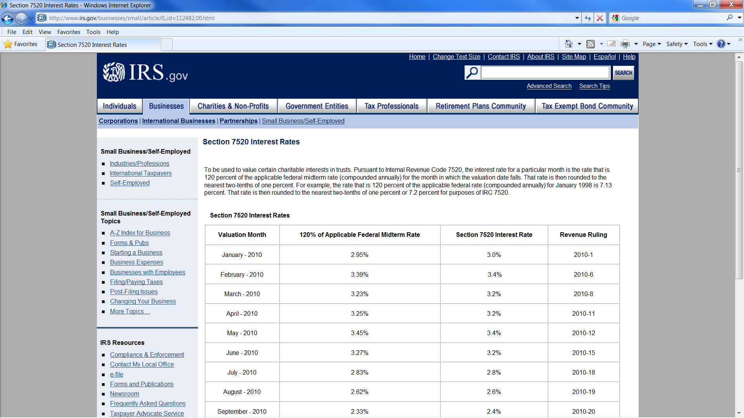
Ex: A remainder interest in $100,000 of farmland given by a 59 year old donor on 9/6/10
Find the §7520 interest rate (http://www.irs.gov/businesses/small/article/0,,id=112482,00.html)
Use remainder value in IRS Pub. 1457 for one or two lives or specific term (http://www.irs.gov/retirement/article/0,,id=206601,00.html)
Multiply remainder value by value of the farmland
2.4%

Slide 17
Ex: A remainder interest in $100,000 of farmland given by a 59 year old donor on 9/6/10
Find the §7520 interest rate (http://www.irs.gov/businesses/small/article/0,,id=112482,00.html)
Multiply value of land by remainder percentage in IRS Pub. 1457 (one or two lives or specific term) (http://www.irs.gov/retirement/article/0,,id=206601,00.html)
2.4%
$100,000
X 0.60589
= $60,589
Section 1 | Table S - Based on Life Table 2000CM
 | Interest at 2.4 Percent
 |  | Life |  |  |  | Life
Age | Annuity | Estate | Remainder | Age | Annuity | Estate | Remainder
0 | 34.2376 | 0.82170 | 0.17830 | 55 | 18.1993 | 0.43678 | 0.56322
1 | 34.3011 | 0.82323 | 0.17677 | 56 | 17.7570 | 0.42617 | 0.57383
2 | 34.1418 | 0.81940 | 0.18060 | 57 | 17.3129 | 0.41551 | 0.58449
3 | 33.9727 | 0.81534 | 0.18466 | 58 | 16.8678 | 0.40483 | 0.59517
4 | 33.7967 | 0.81112 | 0.18888 | 59 | 16.4213 | 0.39411 | 0.60589

Slide 18
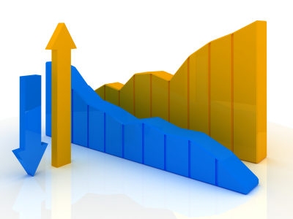
Charitable Deduction
Interest Rates

Slide 19

Deduction for remainder interest in $100,000 farm by age 59 donor
11.6% (May 89) $15,684
2.0% (Oct 10) $65,553

Slide 20

Leaving land to charity
by will
Revocable
$0 income tax deduction
Impacts charity after death
Leaving land to charity
by remainder interest
Irrevocable
$60,589 immediate income tax deduction
Impacts charity after death or immediately if charity sells remainder interest

Slide 21
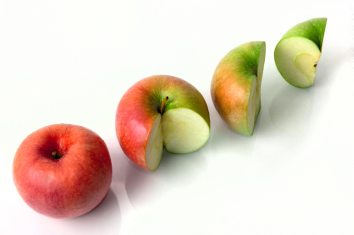
Because farmland can be gifted in parts, a donor could annually give remainder interests up to income limits or desired
marginal tax rate
Allows for increasing valuation each year
Avoids risk of losing carryover deduction at death
Could use value of annual deductions to pay for ILIT life insurance passing tax free to heirs

Slide 22

Donor can use money from remainder tax deduction to buy tax free life insurance (ILIT) for children’s inheritance
IRS
Cash Back
Tax Free From ILIT

Slide 23
Age 59 wealthy donor with $100,000 farmland on 9/1/10
remainder interest in farmland given to charity
will divides farmland 10% to charity 90% to children
$60,589 tax deduction x 41% combined tax rate = $24,841
$24,841 buys est. $70,000 paid up ILIT life insurance
farmland worth $125,000 at death
charity receives $125,000 farmland
children receive $70,000
(tax free from ILIT)
children receive $50,625
(90% x 125,000 = 112,500, less 55% for estate taxes)
charity receives $12,500
(10% x $125,000)

Slide 24
Gifts of remainder interests in personal residences can also be deducted
Remainder
Interest

Slide 25
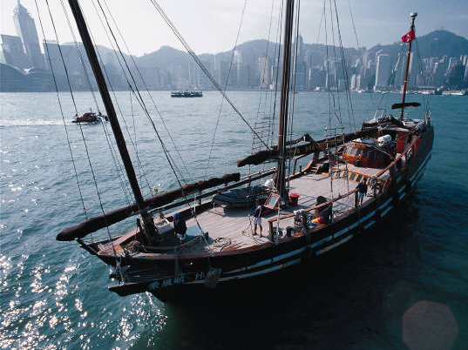
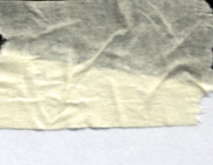

Includes second homes, vacation homes, even a boat with bathroom, cooking, and sleeping facilities, if used by the donor as a residence

Slide 26
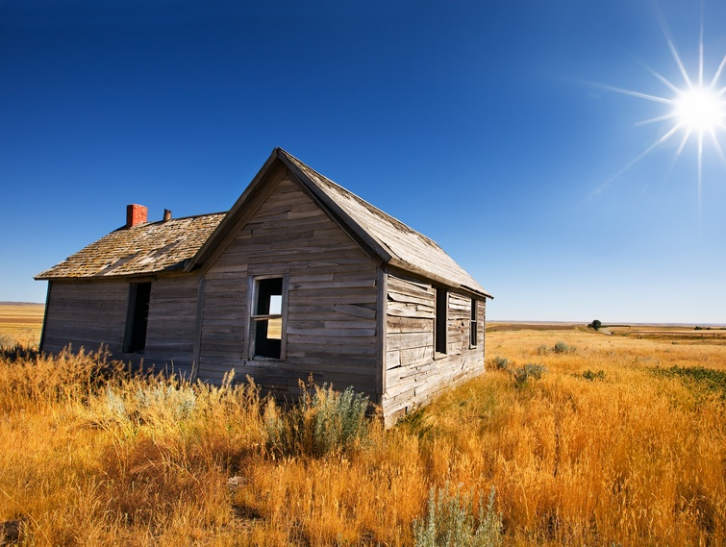
Deduction for a house is reduced because, unlike land, it is depreciable (it wears out)
Rules in IRS Pub. 1459 http://www.irs.gov/pub/irs-pdf/p1459.pdf

Slide 27


59 year old donor giving on 9/6/10
Remainder interest in $100,000 farm
.60589 x $100,000
$60,589 Deduction
Remainder interest in $100,000 home
.60589 x $20,000 (land)
.60589 x $10,000 (salvage)
.33768* x $70,000
$41,814 Deduction
*.60589 less .26821 depreciation
reduction
calculated
on next
slide

Slide 28
Depreciation reduction factor
R factor age now – R factor age after useful life of house
D factor age now X Useful life of house
Appraiser can estimate. IRS examples use 45 years.
Table C(2.4)
Factors for Reducing Assurances - Based on Table 2000CM
Interest at 2.4 Percent
Age |  | Remainder |  | R-Factors |  | D-Factors |  | Age |  | Remainder |  | R-Factors |  | D-Factors
x |  | Factors |  | R_{x}-0.5M_{x} |  | D_{x} |  | x |  | Factors |  | R_{x}-0.5M_{x} |  | D_{x}
0 |  | .17830 |  | 1202916 |  | 100000.0 |  | 55 |  | .56322 |  | 317860.0 |  | 24748.54
1 |  | .17677 |  | 1185429 |  | 96977.54 |  | 56 |  | .57383 |  | 304002.2 |  | 24008.45
2 |  | .18060 |  | 1168311 |  | 94656.94 |  | 57 |  | .58449 |  | 290311.8 |  | 23274.97
3 |  | .18466 |  | 1151231 |  | 92407.69 |  | 58 |  | .59517 |  | 276800.1 |  | 22547.02
4 |  | .18888 |  | 1134179 |  | 90219.15 |  | 59 |  | .60589 |  | 263478.6 |  | 21825.10
… | … | … | … | … | … | … | … | … | … | … | … | … | … | …
48 |  | .49158 |  | 418809.2 |  | 30218.64 |  | 103 |  | .95802 |  | 60.91156 |  | 35.63595
49 |  | .50143 |  | 404011.4 |  | 29397.77 |  | 104 |  | .96077 |  | 33.72948 |  | 21.05020
263478.6-60.91156
21825.1-45
=.26821
Table C at http://www.irs.gov/retirement/article/0,,id=206601,00.html

Slide 29

What if the donor leaves?

Slide 30
What if the donor leaves?
Give life estate to charity
Agree with the charity to a joint sale and divide proceeds
Give life estate to charity in exchange for a gift annuity
Rent property
Sell life estate

Slide 31
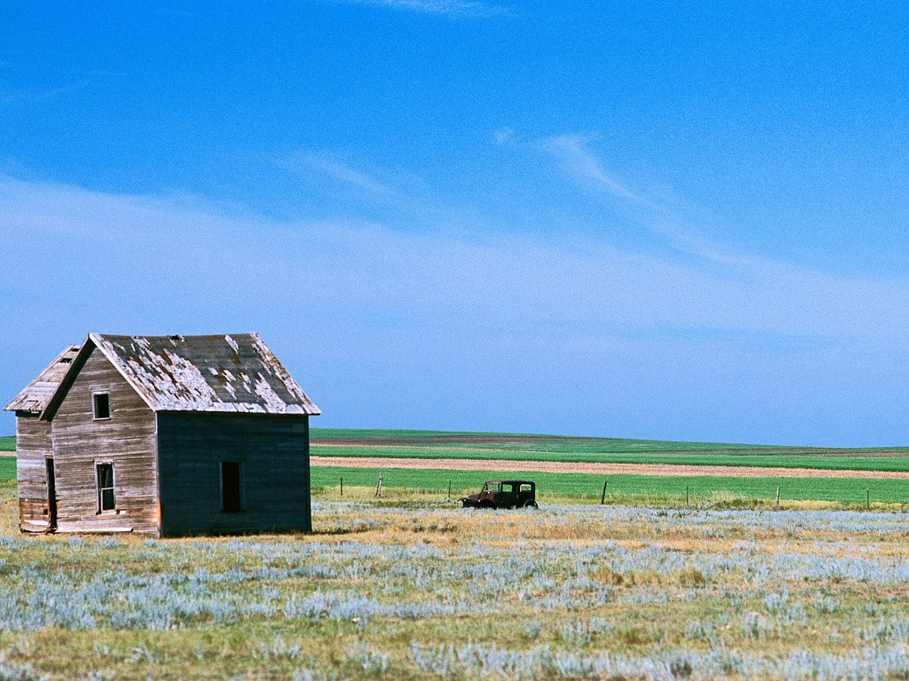
Will the donor maintain the property?

Slide 32
Will the donor maintain the property?
Common law requires the “life tenant” to Maintain, Insure, and pay Taxes on the property
Some charities also require a written MIT contract

Slide 33

What if I make improvements to the property after giving a remainder interest?

Slide 34


You can deduct the remainder value of major improvements as additional gifts
PLR 9329017; PLR 8529014
$8,000 for new HVAC

Slide 35
Charitable gifts of remainder interests in homes and farms
Photos from www.istockphoto.com

Slide 36

Help me
HERE
convince my bosses that continuing to build and post these slide sets is not a waste of time. If you work for a nonprofit or advise donors and you reviewed these slides, please let me know by clicking

Slide 37

If you clicked on the link to let me know you reviewed these slides…
Thank You!

Slide 38

For the audio lecture accompanying this
slide set, go to
EncourageGenerosity.com

Slide 39

Think you understand it?
Prove it!
Click here to go to EncourageGenerosity.com and take the free quiz on this slide set. (Instantly graded with in depth explanations and a certificate of completion score report.)

Slide 40
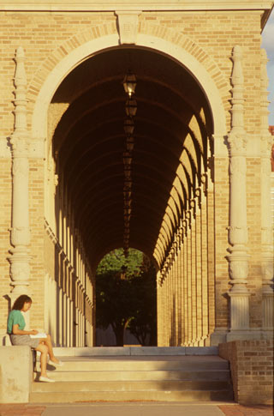

Graduate Studies in
Charitable Financial Planning
at Texas Tech University
This slide set is from the introductory curriculum for the Graduate Certificate in Charitable Financial Planning at Texas Tech University, home to the nation’s largest graduate program in personal financial planning.
To find out more about the online Graduate Certificate in Charitable Financial Planning go to www.EncourageGenerosity.com
To find out more about the M.S. or Ph.D. in personal financial planning at Texas Tech University, go to www.depts.ttu.edu/pfp/

Slide 41
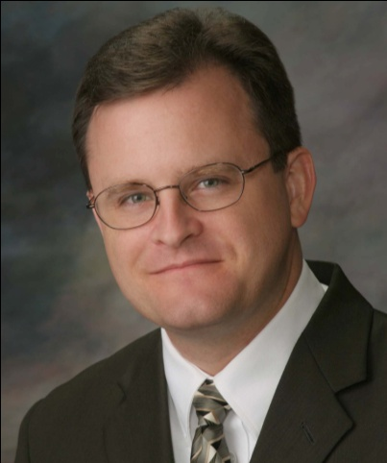
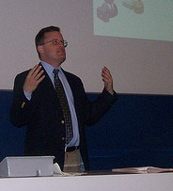
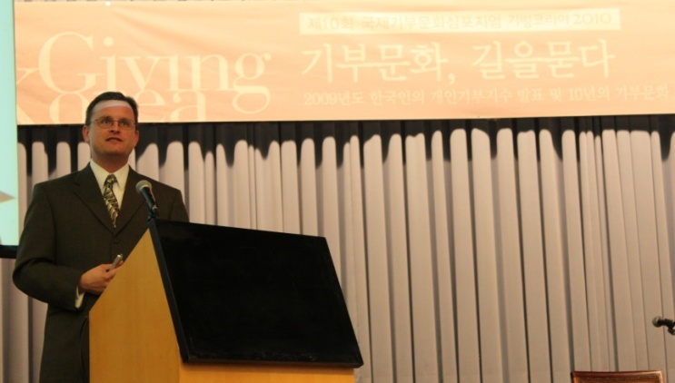
About the Author
Russell James, J.D., Ph.D., CFP® is an Associate
Professor and the Director of Graduate
Studies in Charitable Planning in the Division
of Personal Financial Planning at Texas Tech
University. He graduated, cum laude, from
the University of Missouri School of Law
where he was a member of the Missouri Law
Review. While in law school he received the
United Missouri Bank Award for Most
Outstanding Work in Gift and Estate Taxation
and Planning and the American Jurisprudence
Award for Most Outstanding Work in Federal
Income Taxation. After graduation, he worked
as the Director of Planned Giving for Central
Christian College, Moberly, Missouri for six
years and also built a successful law practice
limited to estate and gift planning. He later
served as president of the college for more
than five years, where he had direct and
supervisory responsibility for all fundraising. Dr. James received his Ph.D. in Consumer & Family Economics from the University of Missouri where his dissertation was on the topic of charitable giving. Dr. James has over 100 publications in print or in press in academic journals, conference proceedings, professional periodicals, and books. He writes regularly for Advancing Philanthropy, the magazine of the Association of Fundraising Professionals. He has presented his research in the U.S. and across the world including as an invited speaker in Ireland, Scotland, England, The Netherlands, Spain, Germany, and South Korea. (click here for complete CV)
Me (about 5 years ago)
Lecturing in Germany. 75 extra students showed up. I thought it was for me until I found out there was free beer afterwards.
At Giving Korea 2010. I didn’t notice until later the projector was shining on my head (inter-cultural height problems).

