Slide 1

Charitable gifts of partial interests in property
Russell James, J.D., Ph.D., CFP® Director of Graduate Studies in Charitable Planning, Texas Tech University

Slide 2

What is it?
When a donor gives some rights to property but keeps others

Slide 3

Charity, I give you my plant, but I keep the right to harvest it when it is grown

Slide 4

I can’t seem to rent out this office space that I own, so I’ll donate the use of it to a charity

Slide 5

I give the charity this land, but I keep all mineral rights

Slide 6

Charity, I hereby give you my car but I keep the right to drive it for the next 10 years

Slide 7
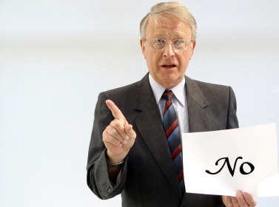
General rule: you can’t deduct a partial interest gift

Slide 8
Charity, I give you my plant, but I keep the right to harvest it when it is grown
NO Income Tax Deduction

Slide 9
I can’t seem to rent out this office space that I own, so I’ll donate the use of it to a charity
NO Income Tax Deduction

Slide 10
I give the charity this land, but I keep all mineral rights
NO Income Tax Deduction

Slide 11
Charity, I hereby give you my car but I keep the right to drive it for the next 10 years
NO Income Tax Deduction

Slide 12
General rule: you can’t deduct a partial interest gift

Slide 13

Why do we have this rule?

Slide 14

If I give part and keep part, after the deduction I can manipulate the property to get more value for my share and less for the charity

Slide 15

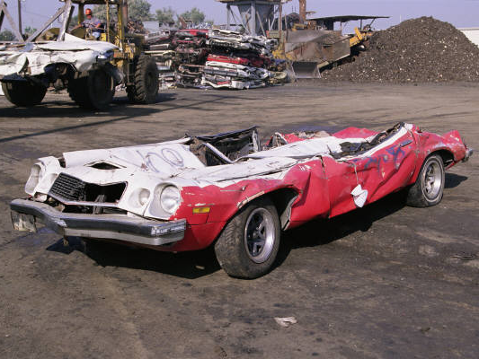
Charity I give you this car, but retain the right to use for 1 year
[Now, I want to deduct current value less 1 year of depreciation]
I take the deduction and deliver the car in 1 year

Slide 16
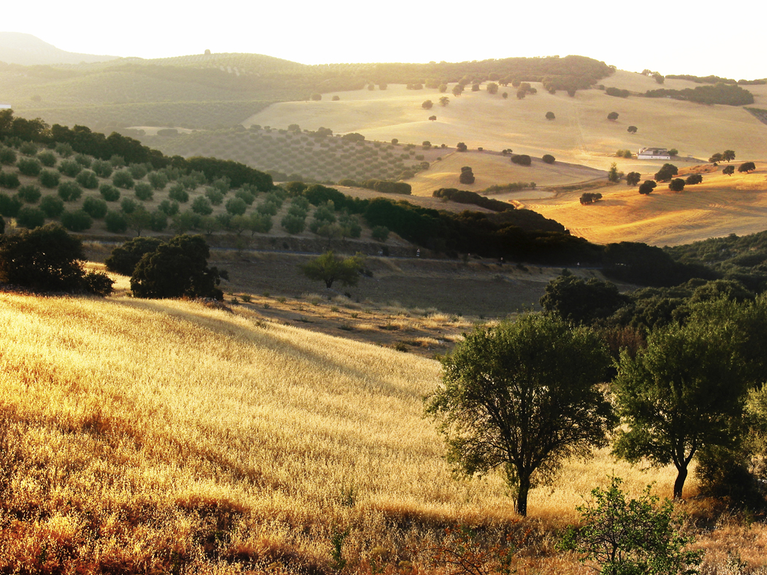


I give charity the right to use the newly planted acres of my olive tree orchard for 7 years [Now, I want to deduct the rental value of the land]
Olive trees don’t produce for the first seven years

Slide 17
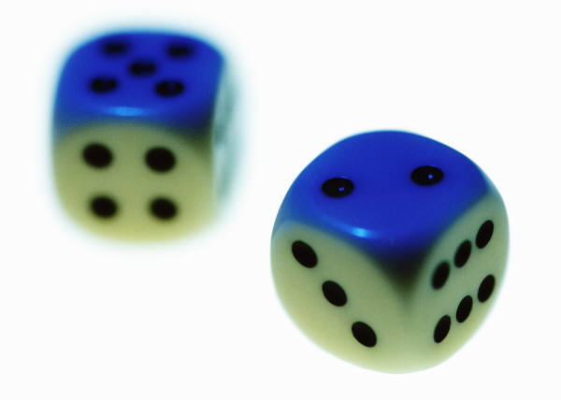
Charity I give you my $2,000,000 company, but keep the right to buy it back in 3 years for $2,000,000 [Now, I want to deduct $2,000,000]
Our only product is a risky new cancer drug that will be approved or rejected by the FDA in 3 years

Slide 18
General rule: you can’t deduct a partial interest gift

Slide 19


The donor can deduct if he gives all or an “undivided portion” of his interest
Other Exceptions
Remainder interest in a home or farm
Charitable remainder/ lead trust or pooled income fund
Qualified conservation easement

Slide 20
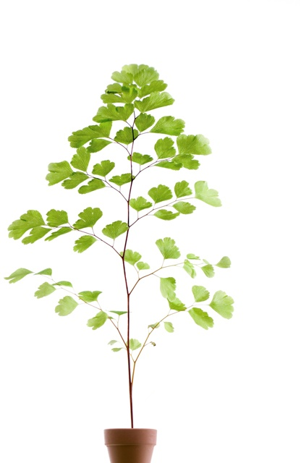

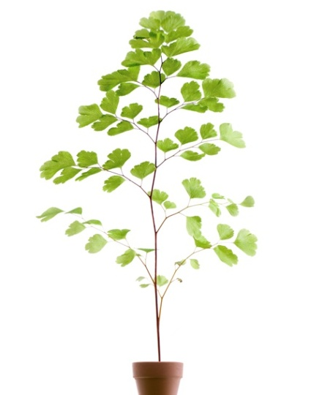
Divided share v. undivided share
My Ownership Rights My Gift
Divided Share
A leaf from the tree
Undivided Share
A 15% ownership interest in the whole tree

Slide 21
An divided share is not deductible
My Ownership Rights My Gift
Not Deductible
Divided Share
A leaf from the tree
Undivided Share
A 15% ownership interest in the whole tree

Slide 22
An undivided share of property is deductible
My Ownership Rights My Gift
Not Deductible
Divided Share
A leaf from the tree
✓
Undivided Share
A 15% ownership interest in the whole tree

Slide 23

I donate a West Texas cotton farm, but keep all the mineral rights
Divided Share
A leaf from the tree
Undivided Share
A 15% ownership interest in the whole tree

Slide 24
I donate a West Texas cotton farm, but keep all the mineral rights
Not Deductible
Divided Share
A leaf from the tree
Undivided Share
A 15% ownership interest in the whole tree

Slide 25
I donate a 5% interest as tenants in common in a West Texas cotton farm including all the mineral rights
Divided Share
A leaf from the tree
Undivided Share
A 15% ownership interest in the whole tree

Slide 26
I donate a 5% interest as tenants in common in a West Texas cotton farm including all the mineral rights
Divided Share
A leaf from the tree
✓
Undivided Share
Deductible
A 15% ownership interest in the whole tree

Slide 27


I donate a painting, but keep all digital and reproduction rights
Divided Share
A leaf from the tree
Undivided Share
A 15% ownership interest in the whole tree

Slide 28
I donate a painting, but keep all digital and reproduction rights
Not Deductible
Divided Share
A leaf from the tree
Undivided Share
A 15% ownership interest in the whole tree

Slide 29
I donate a 1/12 ownership interest in a painting including the right to possess 1 month of every year
Divided Share
A leaf from the tree
Undivided Share
A 15% ownership interest in the whole tree

Slide 30
I donate a 1/12 ownership interest in a painting including the right to possess 1 month of every year
Divided Share
A leaf from the tree
Undivided Share
Deductible, if…
A 15% ownership interest in the whole tree

Slide 31

Fractional shares in tangible personal property
Deduction is lesser of value during first or later transfers
All of donor’s rights must be given to charity within 10 years (or at donor’s death if earlier)

Slide 32

What happens if I don’t transfer the rest of it to charity within 10 years?

Slide 33
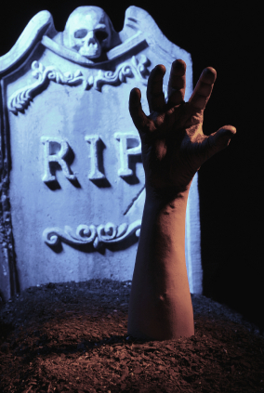
Recapture
Previous deductions are counted as ordinary income, plus interest, plus a 10% penalty

Slide 34
When can I deduct a gift of a partial ownership right?
My Ownership Rights My Gift
Not Deductible
Divided Share
A leaf from the tree
✓
Undivided Share
A 15% ownership interest in the whole tree

Slide 35

If a donor owns only a partial interest, she can deduct a gift of all or an undivided share of it

Slide 36
I can deduct a gift of all or an undivided share of all my rights even if I own only a partial interest
My Ownership Rights My Gift
All of donor’s interests
A leaf from the tree
A leaf from the tree
Undivided share of donor’s interests
15% ownership in my interests

Slide 37

I give my land to a charity although I never owned the mineral rights

Slide 38
I can deduct a gift of all or an undivided share of all of my interests in the property
✓
My Ownership Rights My Gift
All of donor’s interests
Land without mineral rights
Land without mineral rights
Undivided share of donor’s interests
15% ownership in my interests

Slide 39
If a donor owns only a partial interest, she can deduct a gift of all or an undivided share of it

Slide 40
An undivided share in all interests of the donor
I donate a 5% interest as tenants in common in a West Texas cotton farm although I never owned the mineral rights

Slide 41
I can deduct a gift of all or an undivided share of all of my interests in the property
My Ownership Rights My Gift
All of donor’s interests
✓
Land without mineral rights
Land without mineral rights
Undivided share of donor’s interests
5% ownership of what I own

Slide 42

I give charity the right to own my vacation home after I die by a remainder deed
Next I give 11/12 interest in my life estate, keeping the right to use every September
Deductible as gift of remainder interest in home
Deductible as an undivided share of all the interests owned by the donor
Rev. Rul. 75-420; 1975-2 C.B. 78

Slide 43
I can deduct a gift of all or an undivided share of all of my interests in the property
My Ownership Rights My Gift
All of donor’s interests
✓
Land without mineral rights
A life estate
Undivided share of donor’s interests
11/12 ownership in my life estate

Slide 44

If all interests are given to charity, each divided portion is deductible
To:
The Red Cross
To: The
Salvation Army
To:
Texas Tech University

Slide 45
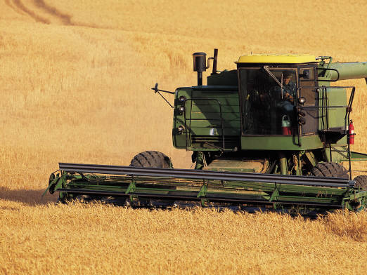
I give ownership of the land to the Red Cross, the mineral rights to the Salvation Army, and rent free use for 10 years to my local church
Deduct as if all rights were given to one charity

Slide 46

Summary
If you don’t give or share all of your rights,
you get no deduction
(unless it is a designated exception)

Slide 47
Charitable gifts of partial interests in property
All slides from www.istockphoto.com

Slide 48

Help me
HERE
convince my bosses that continuing to build and post these slide sets is not a waste of time. If you work for a nonprofit or advise donors and you reviewed these slides, please let me know by clicking

Slide 49

If you clicked on the link to let me know you reviewed these slides…
Thank You!

Slide 50

For the audio lecture accompanying this
slide set, go to
EncourageGenerosity.com

Slide 51

Think you understand it?
Prove it!
Click here to go to EncourageGenerosity.com and take the free quiz on this slide set. (Instantly graded with in depth explanations and a certificate of completion score report.)

Slide 52


Graduate Studies in
Charitable Financial Planning
at Texas Tech University
This slide set is from the introductory curriculum for the Graduate Certificate in Charitable Financial Planning at Texas Tech University, home to the nation’s largest graduate program in personal financial planning.
To find out more about the online Graduate Certificate in Charitable Financial Planning go to www.EncourageGenerosity.com
To find out more about the M.S. or Ph.D. in personal financial planning at Texas Tech University, go to www.depts.ttu.edu/pfp/

Slide 53
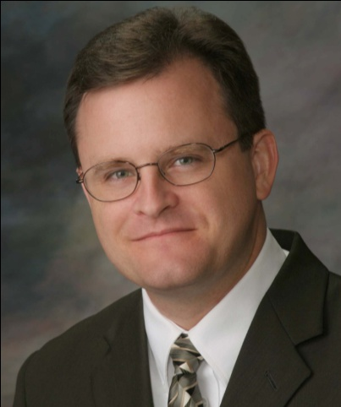
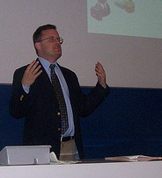
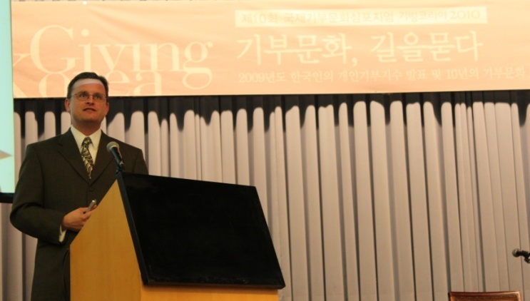
About the Author
Russell James, J.D., Ph.D., CFP® is an Associate
Professor and the Director of Graduate
Studies in Charitable Planning in the Division
of Personal Financial Planning at Texas Tech
University. He graduated, cum laude, from
the University of Missouri School of Law
where he was a member of the Missouri Law
Review. While in law school he received the
United Missouri Bank Award for Most
Outstanding Work in Gift and Estate Taxation
and Planning and the American Jurisprudence
Award for Most Outstanding Work in Federal
Income Taxation. After graduation, he worked
as the Director of Planned Giving for Central
Christian College, Moberly, Missouri for six
years and also built a successful law practice
limited to estate and gift planning. He later
served as president of the college for more
than five years, where he had direct and
supervisory responsibility for all fundraising. Dr. James received his Ph.D. in Consumer & Family Economics from the University of Missouri where his dissertation was on the topic of charitable giving. Dr. James has over 100 publications in print or in press in academic journals, conference proceedings, professional periodicals, and books. He writes regularly for Advancing Philanthropy, the magazine of the Association of Fundraising Professionals. He has presented his research in the U.S. and across the world including as an invited speaker in Ireland, Scotland, England, The Netherlands, Spain, Germany, and South Korea. (click here for complete CV)
Me (about 5 years ago)
Lecturing in Germany. 75 extra students showed up. I thought it was for me until I found out there was free beer afterwards.
At Giving Korea 2010. I didn’t notice until later the projector was shining on my head (inter-cultural height problems).

