Slide 1


Timing
Elements
and
of a
Charitable Gift
Dr. Russell James
Texas Tech University

Slide 2



Completed Gift
Donor
Delivers money or property
To a charity or agent of the charity

Slide 3

Not Completed
Until Actually Given
Donor
Promises to deliver money or property in the future
To a charity or agent of the charity

Slide 4



Not Completed
Until Delivered to
Charity/Charity’s Agent
Donor
Gives money or property to donor’s agent with instructions to deliver
To a charity or agent of the charity

Slide 5

Not Completed
Until Retained Interests
Are Transferred
Donor
Delivers money or property with retained interests
To a charity or agent of the charity

Slide 6


Not a
Charitable Gift
Donor
Delivers money or property
To a charity for a
specific person

Slide 7

When is it a completed gift?
Day 1: I put a cash gift addressed to a charity in the U.S. mail
Day 2: It arrives safely at the charity

Slide 8
Completed Gift
Completed Gift
Donor
Delivers money or property
Post office is treated as the charity’s agent
To a charity or agent of the charity

Slide 9
When is it a completed gift?
Day 1: I put a cash gift addressed to a charity in the U.S. mail
Day 2: It arrives safely at the charity

Slide 10

When is the gift completed?
Day 1: I write a check to a charity
Day 2: I put the check in the post office mailbox
Day 3: The charity receives the check
Day 4: The charity deposits the check
Day 5: The charity’s bank receives the funds and the charity is credited with the funds

Slide 11
Completed Gift
Donor
A valid check is a valuable negotiable instrument
Delivers money or property
Post office is treated as the charity’s agent
To a charity or agent of the charity

Slide 12
When is the gift completed?
Day 1: I write a check to a charity
Day 2: I put the check in the post office mailbox
Day 3: The charity receives the check
Day 4: The charity deposits the check
Day 5: The charity’s bank receives the funds and the charity is credited with the funds

Slide 13

Who cares which day the gift is considered completed?

Slide 14

The deduction comes one year sooner
Dec 30: I write a check to a charity
Dec 31: I put the check in the post office mailbox
Jan 3: The charity receives the check
Jan 4: The charity deposits the check
Jan 5: The charity’s bank receives the funds and the charity is credited with the funds

Slide 15

Or on a different kind of tax return
Dec 23: I write a check to a charity
Dec 24: I put the check in the post office mailbox
Dec 25: I die
Jan 2: The charity receives the check
Jan 3: The charity deposits the check
Jan 3: The charity’s bank receives the funds and the charity is credited with the funds

Slide 16

What if the check bounces?
Dec 30: I write a check to a charity
Dec 31: I put the check in the post office mailbox
Jan 3: The charity receives the check
Jan 4: The charity deposits the check
Jan 5: The charity’s bank receives notice of insufficient funds

Slide 17
No Gift
No Gift
Donor
An invalid check was never money or valuable property
X
Delivers money or property
To a charity or agent of the charity

Slide 18
What if the check bounces?
Dec 30: I write a check to a charity
Dec 31: I put the check in the post office mailbox
Jan 3: The charity receives the check
Jan 4: The charity deposits the check
Jan 5: The charity’s bank receives notice of insufficient funds
No Gift

Slide 19

What about a post-dated check?
Dec 25: I write a check to a charity dated Jan 1
Dec 26: I put the check in the post office mailbox
Dec 31: The charity receives the check
Jan 1: Nothing happens
Jan 2: The charity deposits the check
Jan 3: The charity’s bank receives the funds and the charity is credited with the funds

Slide 20
Not Completed
Until Actually Given
Donor
Promises to deliver money or property in the future
A post-dated check is a promise to pay money in the future
To a charity or agent of the charity

Slide 21
What about a post-dated check?
Dec 25: I write a check to a charity dated Jan 1
Dec 26: I put the check in the post office mailbox
Dec 31: The charity receives the check
Jan 1: Nothing happens
Jan 2: The charity deposits the check
Jan 3: The charity’s bank receives the funds and the charity is credited with the funds

Slide 22

What about a credit card gift?
Dec 31: I make a donation by credit card and the charity is credited with the funds
Jan 20: I receive a credit card statement noting the donation
Jan 30: I pay my credit card bill in full

Slide 23
Completed Gift
Donor
Delivers money or property
Regardless of how I got it in the first place (e.g., borrowed)
To a charity or agent of the charity

Slide 24
What about a credit card gift?
Dec 31: I make a donation by credit card and the charity is credited with the funds
Jan 20: I receive a credit card statement noting the donation
Jan 30: I pay my credit card bill in full

Slide 25

What about credit card rebates?
Day 1: I earn $20 in rebates from my credit card company
Day 2: I click online to donate those rebates to a charity
Day 9: The credit card company mails a check to the charity
Day 10: The charity receives a check from the credit card company
Day 11: The charity deposits the check
Day 12: The charity’s bank receives the funds and the charity is credited with the funds

Slide 26
Not Completed
Until Delivered to
Charity/Charity’s Agent
Donor
Gives money or property to donor’s agent with instructions to deliver
By clicking, I instruct my agent (credit card company) to give
To a charity or agent of the charity

Slide 27
What about credit card rebates?
Day 1: I earn $20 in rebates from my credit card company
Day 2: I click online to donate those rebates to a charity
Day 9: The credit card company mails a check to the charity
Day 10: The charity receives a check from the credit card company
Day 11: The charity deposits the check
Day 12: The charity’s bank receives the funds and the charity is credited with the funds

Slide 28

What about a legally enforceable contract?
Dec. 1: I sign a legally enforceable contract (a pledge) to give $100,000 to the charity on August 1
Dec. 5: The charity books this as an asset in their general ledger
Dec. 10: The charity sells the rights to this pledge to an accounts receivable purchasing agency for $90,000
Dec. 11: The charity spends the $90,000
Aug. 1: I pay the $100,000 pledge
to the charity

Slide 29
Not Completed
Until Actually Given
Donor
Promises to deliver money or property in the future
A legally enforceable contract is still a promise to pay
To a charity or agent of the charity

Slide 30
What about a legally enforceable contract?
Dec. 1: I sign a legally enforceable contract (a pledge) to give $100,000 to the charity on August 1.
Dec. 5: The charity books this as an asset in their general ledger
Dec. 10: The charity sells the rights to this pledge to an accounts receivable purchasing agency for $90,000
Dec. 11: The charity spends the $90,000
Aug. 1: I pay the $100,000 pledge
to the charity

Slide 31

I give land worth $2 million to charity and retain a two year option to repurchase the land for $500,000. How much can I deduct?
$0
$500,000
$1.5 Million
$2 Million
Only the rental value

Slide 32
Not Completed
Until Retained Interests
Are Transferred
Donor
Delivers money or property with retained interests
To a charity or agent of the charity

Slide 33
I give land worth $2 million to charity and retain a two year option to repurchase the land for $500,000. How much can I deduct?
$0
$500,000
$1.5 Million
$2 Million
Only the rental value

Slide 34
I give land worth $2 million and retain a two year option to repurchase for $500,000. After the option expires, how much can I deduct?
$0
$500,000
$1.5 Million
$2 Million
Only the rental value

Slide 35
I give land worth $2 million and retain a two year option to repurchase for $500,000. After the option expires, how much can I deduct?
$0
$500,000
$1.5 Million
$2 Million
Only the rental value

Slide 36






Retained interests are allowed if…
Chance of interfering with charity ownership is negligible, or
Restricting use for a specific charitable purpose (or return funds)

Slide 37

Donor gives money to a university and directs that the funds must be spent on athletic scholarships or returned.
Is it deductible?

Slide 38
Retained interests are allowed if…
Restricting use for a specific charitable purpose (or return funds)

Slide 39

Donor gives money to a university and directs that the funds must be spent on a scholarship for Sarah A. Student
You
College
Me

Slide 40
Not a
Charitable Gift
Donor
Delivers money or property
To a charity for a
specific person

Slide 41
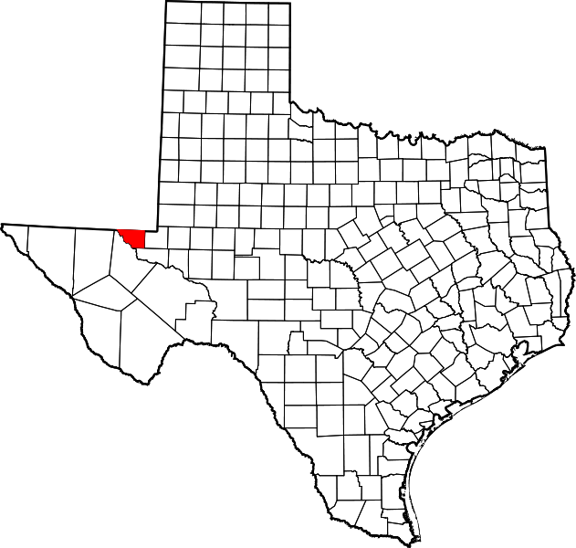
Donor gives money to Texas Tech University and directs that the funds must be spent on a scholarship for students from Loving County, Texas or returned

Slide 42
Retained interests are allowed if…
Restricting use for a specific charitable purpose (or return funds)

Slide 43
Donor gives money to Texas Tech University and directs that the funds must be spent on a scholarship for students from Loving County, Texas or returned
Limiting to a class of people is acceptable, limiting to a person is not

Slide 44


“I am aware that a donation to a scholarship fund is only deductible if it is unspecified, however, if in your opinion and that of the authorities, it could be applied to the advantage of [student], I think it would be constructive”
The college applies the money to the student’s account. Charitable gift?

Slide 45
“I am aware that a donation to a scholarship fund is only deductible if it is unspecified, however, if in your opinion and that of the authorities, it could be applied to the advantage of [student], I think it would be constructive”
No Deduction
The college applies the money to the student’s account. Charitable gift?

Slide 46

A special exception for timing of gifts from C-Corporations

Slide 47

A C-Corporation using accrual accounting may deduct contributions made within 2 ½ months after the tax year if board authorized giving during the tax year

Slide 48

Why?
Because corporations wanting to make the maximum gift (10% of net income) often couldn’t figure out their net income by the end of the year.

Slide 49
Timing
Elements
and
of a
Charitable Gift
Photos from istockphoto

Slide 50

Help me
HERE
convince my bosses that continuing to build and post these slide sets is not a waste of time. If you work for a nonprofit or advise donors and you reviewed these slides, please let me know by clicking

Slide 51

If you clicked on the link to let me know you reviewed these slides…
Thank You!

Slide 52

For the audio lecture accompanying this
slide set, go to
EncourageGenerosity.com

Slide 53

Think you understand it?
Prove it!
Click here to go to EncourageGenerosity.com and take the free quiz on this slide set. (Instantly graded with in depth explanations and a certificate of completion score report.)

Slide 54


Graduate Studies in
Charitable Financial Planning
at Texas Tech University
This slide set is from the introductory curriculum for the Graduate Certificate in Charitable Financial Planning at Texas Tech University, home to the nation’s largest graduate program in personal financial planning.
To find out more about the online Graduate Certificate in Charitable Financial Planning go to www.EncourageGenerosity.com
To find out more about the M.S. or Ph.D. in personal financial planning at Texas Tech University, go to www.depts.ttu.edu/pfp/

Slide 55
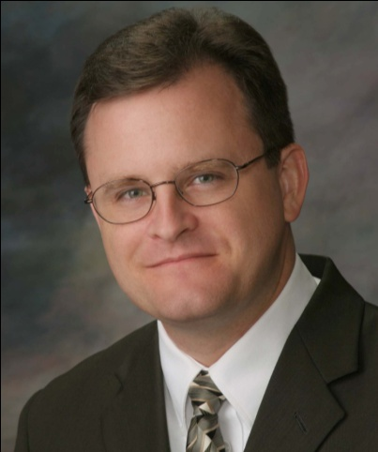
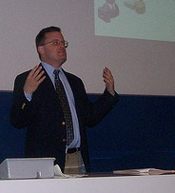
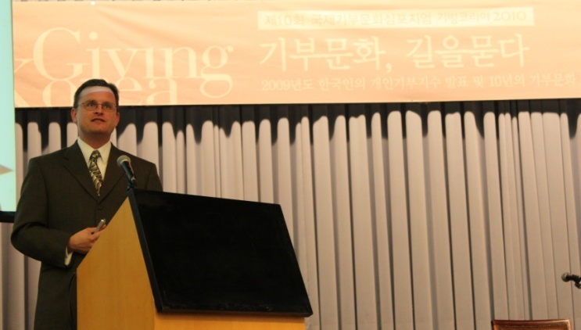
About the Author
Russell James, J.D., Ph.D., CFP® is an Associate
Professor and the Director of Graduate
Studies in Charitable Planning in the Division
of Personal Financial Planning at Texas Tech
University. He graduated, cum laude, from
the University of Missouri School of Law
where he was a member of the Missouri Law
Review. While in law school he received the
United Missouri Bank Award for Most
Outstanding Work in Gift and Estate Taxation
and Planning and the American Jurisprudence
Award for Most Outstanding Work in Federal
Income Taxation. After graduation, he worked
as the Director of Planned Giving for Central
Christian College, Moberly, Missouri for six
years and also built a successful law practice
limited to estate and gift planning. He later
served as president of the college for more
than five years, where he had direct and
supervisory responsibility for all fundraising. Dr. James received his Ph.D. in Consumer & Family Economics from the University of Missouri where his dissertation was on the topic of charitable giving. Dr. James has over 100 publications in print or in press in academic journals, conference proceedings, professional periodicals, and books. He writes regularly for Advancing Philanthropy, the magazine of the Association of Fundraising Professionals. He has presented his research in the U.S. and across the world including as an invited speaker in Ireland, Scotland, England, The Netherlands, Spain, Germany, and South Korea. (click here for complete CV)
Me (about 5 years ago)
Lecturing in Germany. 75 extra students showed up. I thought it was for me until I found out there was free beer afterwards.
At Giving Korea 2010. I didn’t notice until later the projector was shining on my head (inter-cultural height problems).

