Slide 1


Donating Retirement Assets
Dr. Russell James
Texas Tech University

Slide 2

Why are retirement assets a big deal?

Slide 3

Because that’s where the money is!
36% of all household financial assets ($16.5 trillion) were retirement assets
Source: Investment Company Institute (2010) Research Fundamentals, 19, 3-Q1.

Slide 4
Part I:
Giving During Life

Slide 5



Life stages of a retirement account
Early distribution (before 59 ½)
Regular distribution (59 ½ to 70 ½)
Required minimum distribution (after 70 ½)

Slide 6


Giving before 59 ½
Normally, withdrawing retirement plan assets before age 59 ½ creates taxable income plus a 10% penalty
$10,000
$10,000
IRA
$10,000 income
+$1,000 penalty
$10,000 deduction

Slide 7
Giving before 59 ½
A charitable gift deduction may offset up to 100% of the taxable income from the withdraw, but will not offset the penalty
$10,000
$10,000
IRA
$10,000 income
+$1,000 penalty
$10,000 deduction

Slide 8
Giving before 59 ½
A charitable gift deduction may offset up to 100% of the taxable income from the withdraw, but will not offset the penalty
$10,000
$10,000
IRA
$10,000 income
+$1,000 penalty
$10,000 deduction
Bad Idea!

Slide 9
Giving 59 ½ to 70 ½
After 59 ½ withdraws are taxable, but create no penalty.
$10,000
$10,000
IRA
$10,000 income
$10,000 deduction

Slide 10
Giving 59 ½ to 70 ½
If donor is already itemizing and stays under the relevant income giving limitations, the income can be completely offset by the deduction
$10,000
$10,000
IRA
$10,000 income
$10,000 deduction

Slide 11
Giving after 70 ½
After age 70 ½ participants must take required minimum distributions (account balance / remaining life expectancy) or pay 50% penalty
$10,000
IRA
$10,000 income

Slide 12
Giving after 70 ½
If the income is not needed, a charitable gift deduction may offset the income (if itemizing and no income giving limitations exceeded)
$10,000
$10,000
IRA
$10,000 income
$10,000 deduction

Slide 13

Giving after 70 ½
In some years, congress has allowed a Qualified Charitable Distribution (QCD), eliminating both the income and deduction
$0 income
$0 deduction
IRA
$10,000

Slide 14
Qualified Charitable Distribution (QCD)
No private foundations, donor advised funds, charitable trusts, or charitable gift annuities
IRAs or IRA rollovers only; no 401(k), 403(b), SEP, SIMPLE, pension or profit sharing plans
Participant 70 ½ or older
$0 income
$0 deduction
IRA
$100,000 per person maximum
$10,000

Slide 15

Distributions from Roth IRAs are generally not taxed
$10,000
$10,000
Roth
IRA
$0 income
$10,000 deduction

Slide 16
Part II:
Giving After Death

Slide 17

Retirement plan assets inherited by non-charitable beneficiaries are reduced by both estate tax and income tax

Slide 18

A top tax rate donor with a $1MM IRA and a $1MM house wants to leave one to her child and one to charity
Does it matter which goes where?

Slide 19

IRA(child); House(charity)
$1,000,000 House
$1,000,000 to charity
$1,000,000 IRA
-$550,000 (55% estate tax)
$450,000
-$180,000 (40% income tax)
$270,000 to child
IRA(charity); House(child)
$1,000,000 IRA
$1,000,000 to charity
$1,000,000 House
-$550,000 (55% estate tax)
$450,000 to child

Slide 20

Good retirement plan death beneficiaries
A public charity
A private family foundation
A charitable remainder trust

Slide 21

Bad retirement plan death beneficiaries
Avoid naming other types of charitable trusts (e.g., Charitable Lead Trust, Pooled Income Funds)
Avoid naming estate as beneficiary with instructions in estate documents (estate may have to pay income taxes)
Avoid specific dollar charitable gifts instead of percentages

Slide 22

The plan must actually have a residual death benefit to pass to charity, rather than just a lifetime income right

Slide 23

Participant’s spouse must approve beneficiary for ERISA accounts, e.g., 401(k), but not for non-ERISA accounts, e.g., IRA

Slide 24



Primary Beneficiary: Spouse
Alternate: Charity
100% flexibility to spouse, including rollover into spouse’s own account
No estate tax if surviving spouse retains charity as beneficiary
Transfer at Death
Anything
Left Over
?
?
Donor’s Retirement Assets after Death
Surviving Spouse

Slide 25

Beneficiary: CRT with payments to spouse
Spouse cannot alter payout
Charitable beneficiary selection could be irrevocable
No estate tax (but, adding a non-spouse beneficiary destroys any marital deduction)
Charitable Remainder Trust
Transfer
at Death
Anything
Left Over
Donor’s Retirement Assets after Death
Payments for Life
Surviving Spouse

Slide 26

Beneficiary: CRT with payments to children
Payments likely ordinary income, but spread out
Income tax deduction for estate taxes paid on retirement assets likely won’t be used, as all ordinary income is paid out of CRT before tax-free property
Charitable Remainder Trust
Transfer
at Death
Anything
Left Over
Donor’s Retirement Assets after Death
Payments for Life
Children

Slide 27

A retirement account with charitable beneficiary can act like a mini-CRT
IRA + Charitable Beneficiary
Remainder to charity at death
Income to donor after
59 ½ (unrestricted)
Deduction for entire
value placed into IRA
Minor administration
costs
Cash
transfers
only
Limited size
Charitable Remainder Trust
Remainder to charity at death
Income to donor for life (fixed)
Deduction for value of charitable remainder
Significant administration costs
Cash or property transfers
Unlimited size

Slide 28

Roth conversions and charitable planning can work together to match
Income
Deductions

Slide 29


Roth Conversion
Tax Free
Taxable
$1MM in standard IRA (withdraws are taxable)
$1MM in Roth IRA (withdraws are tax free)
Conversion creates $1MM in immediate taxable income

Slide 30

Where can I find offsetting deductions?

Slide 31

Where can I find offsetting deductions?
Put money into a
Charitable remainder trust
Charitable lead trust (grantor)
Charitable gift annuity
Donor advised fund
Private foundation
Or give a remainder interest in a residence or farmland to a charity

Slide 32

Charitable deductions may be limited (with five year carryover) to 20%, 30%, or 50% of income depending on gift and recipient

Slide 33

If I have unused deductions, how can I pull future income into current year?

Slide 34
If I have unused deductions, how can I pull future income into current year?
With a Roth conversion

Slide 35
Roth Conversion
Tax Free
Taxable
$1MM in standard IRA (withdraws are taxable)
$1MM in Roth IRA (withdraws are tax free)
Conversion creates $1MM in immediate taxable income

Slide 36
Roth conversions and charitable planning can work together to match
Income
Deductions

Slide 37
Donating Retirement Assets
Photos from www.istockphoto.com

Slide 38

Help me
HERE
convince my bosses that continuing to build and post these slide sets is not a waste of time. If you work for a nonprofit or advise donors and you reviewed these slides, please let me know by clicking

Slide 39

If you clicked on the link to let me know you reviewed these slides…
Thank You!

Slide 40

For the audio lecture accompanying this
slide set, go to
EncourageGenerosity.com

Slide 41

Think you understand it?
Prove it!
Click here to go to EncourageGenerosity.com and take the free quiz on this slide set. (Instantly graded with in depth explanations and a certificate of completion score report.)

Slide 42


Graduate Studies in
Charitable Financial Planning
at Texas Tech University
This slide set is from the introductory curriculum for the Graduate Certificate in Charitable Financial Planning at Texas Tech University, home to the nation’s largest graduate program in personal financial planning.
To find out more about the online Graduate Certificate in Charitable Financial Planning go to www.EncourageGenerosity.com
To find out more about the M.S. or Ph.D. in personal financial planning at Texas Tech University, go to www.depts.ttu.edu/pfp/

Slide 43
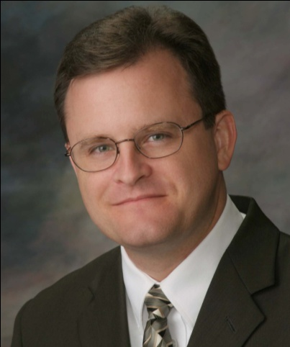
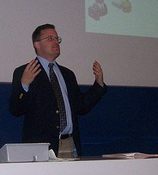
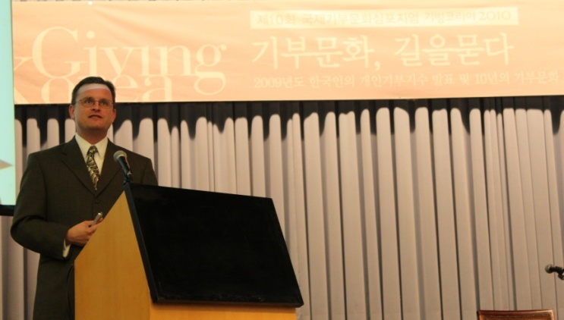
About the Author
Russell James, J.D., Ph.D., CFP® is an Associate
Professor and the Director of Graduate
Studies in Charitable Planning in the Division
of Personal Financial Planning at Texas Tech
University. He graduated, cum laude, from
the University of Missouri School of Law
where he was a member of the Missouri Law
Review. While in law school he received the
United Missouri Bank Award for Most
Outstanding Work in Gift and Estate Taxation
and Planning and the American Jurisprudence
Award for Most Outstanding Work in Federal
Income Taxation. After graduation, he worked
as the Director of Planned Giving for Central
Christian College, Moberly, Missouri for six
years and also built a successful law practice
limited to estate and gift planning. He later
served as president of the college for more
than five years, where he had direct and
supervisory responsibility for all fundraising. Dr. James received his Ph.D. in Consumer & Family Economics from the University of Missouri where his dissertation was on the topic of charitable giving. Dr. James has over 100 publications in print or in press in academic journals, conference proceedings, professional periodicals, and books. He writes regularly for Advancing Philanthropy, the magazine of the Association of Fundraising Professionals. He has presented his research in the U.S. and across the world including as an invited speaker in Ireland, Scotland, England, The Netherlands, Spain, Germany, and South Korea. (click here for complete CV)
Me (about 5 years ago)
Lecturing in Germany. 75 extra students showed up. I thought it was for me until I found out there was free beer afterwards.
At Giving Korea 2010. I didn’t notice until later the projector was shining on my head (inter-cultural height problems).

