Slide 1

How to Document Charitable Contributions
Russell James, J.D., Ph.D., CFP®
Director of Graduate Studies in Charitable Planning
Texas Tech University

Slide 2

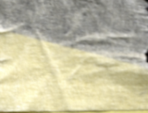
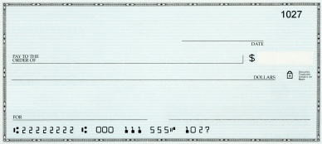




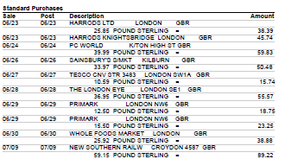
Cash <$250 any of these
Charity
P A I D
December 2010
Bank of America
210.00
Two Hundred and No/100
Gift
A. Donor
Note from charity before taxes filed or due
Amount(s), date(s) & donor
Credit Card Statement

Slide 3
Cash $250+
Note from charity before taxes filed or due
Amount(s), date(s) & donor
“No goods or services were provided in exchange for these gifts.” [or describe and value items provided]

Slide 4
Based on individual gift amounts
✓
Charity
210.00
P A I D
December 2010
Bank of America
Two Hundred Ten and No/100
Gift
A. Donor
Charity
240.00
P A I D
December 2010
Bank of America
Two Hundred Forty and No/100
Gift
A. Donor
Charity
230.00
P A I D
December 2010
Bank of America
Two Hundred Thirty and No/100
Gift
A. Donor

Slide 5
Based on individual gift amounts
X
Charity
260.00
P A I D
December 2010
Bank of America
Two Hundred Sixty and No/100
Gift
A. Donor

Slide 6
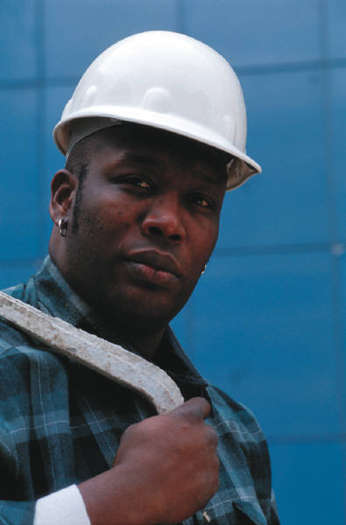
I give through payroll deduction at work to a united appeal, so, there isn’t a specific charity to get a receipt from.
How do I substantiate?

Slide 7
If any single gift is $250+, use a pledge card indicating no goods or services are given in exchange, and the W-2 or paystub.

Slide 8

What about documenting gifts of property?

Slide 9
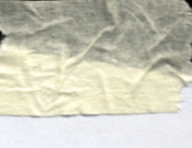

Property Gift Both
Note from charity before taxes filed or due
Donor and date, location & description of property
“No goods or services were provided in exchange for these gifts.” [or describe and value items provided] *
*Part (2) not required for gifts <$250
Donor’s reliable records of gift, charity, date, place, FMV (and cost basis if relevant)

Slide 10


So then, how exactly would this work?

Slide 11
For property gifts under $250, a receipt is not required where it is impractical

Slide 12
Property
<$250 where receipt is impractical
X
Note from charity before taxes filed or due
Donor and date, location & description of property
“No goods or services were provided in exchange for these gifts.” [or describe and value items provided] *
*Part (2) not required for gifts <$250
Donor’s reliable records of gift, charity, date, place, FMV (and cost basis if relevant)

Slide 13
Otherwise,
Property Gift Both
Note from charity before taxes filed or due
Donor and date, location & description of property
“No goods or services were provided in exchange for these gifts.” [or describe and value items provided] *
*Part (2) not required for gifts <$250
Donor’s reliable records of gift, charity, date, place, FMV (and cost basis if relevant)

Slide 14


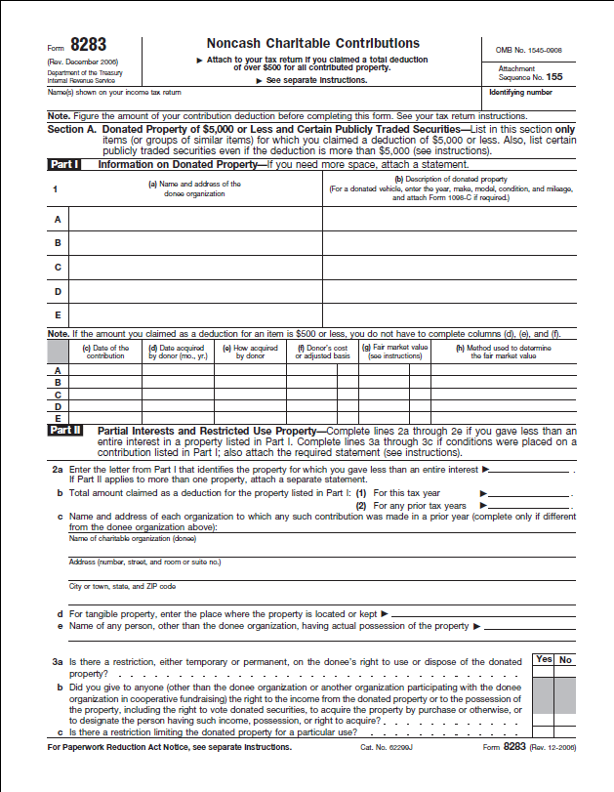
Property >$500
Note from charity before taxes filed or due
Date, location, and description of property
“No goods or services were provided in exchange for these gifts.” [or describe and value items provided]
Donor’s reliable records of gift, charity, date, place, FMV (and cost basis if relevant)

Slide 15

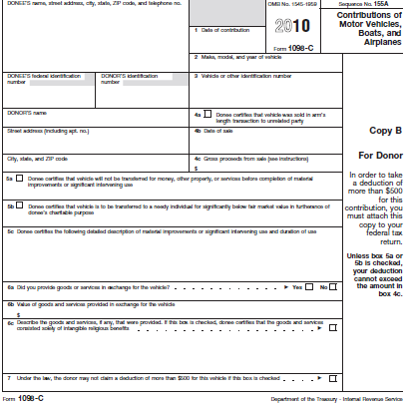
Car/Plane/Boat >$500
Note from charity before taxes filed or due
Date, location, and description of property
“No goods or services were provided in exchange for these gifts.” [or describe and value items provided]
1098-C from charity 30 days after gift or sale
Donor’s reliable records of gift, charity, date, place, FMV (and cost basis if relevant)

Slide 16


Property $5,000+
Note from charity before taxes filed or due
Date, location, and description of property
“No goods or services were provided in exchange for these gifts.” [or describe and value items provided]
Summary of qualified appraisal attached to
tax return
Donor’s reliable records of gift, charity, date, place, FMV (and cost basis if relevant)

Slide 17

Property
>$500,000 or Artwork >$20,000
Note from charity before taxes filed or due
Date, location, and description of property
“No goods or services were provided in exchange for these gifts.” [or describe and value items provided]
Qualified Appraisal
(attach the entire appraisal report to the tax return)
Donor’s reliable records of gift, charity, date, place, FMV (and cost basis if relevant)

Slide 18
No appraisal for any publicly traded securities
Note from charity before taxes filed or due
Date, location, and description of property
“No goods or services were provided in exchange for these gifts.” [or describe and value items provided]
Donor’s reliable records of gift, charity, date, place, FMV (and cost basis if relevant)

Slide 19



Note from charity before taxes filed or due
Date, location, and description of property
“No goods or services were provided in exchange for these gifts.” [or describe and value items provided]
Don’t report small benefits
≤2% of the donation ($96* max benefit)
≤$9.60* if gift $48*+
Member events (≤$9.60*), shop discounts, or entry to facilities and ongoing events given to members where membership ≤$75
*2010 numbers

Slide 20

If I hit the target and actually deduct the right amount, is documentation really a big deal?

Slide 21

Donor gives $80,000 of non-publicly traded stock ($3,700 basis) to charity. No qualified appraisal is completed, but the valuation is correct.
Result?

Slide 22

Donor gives $80,000 of non-publicly traded stock ($3,700 basis) to charity. No qualified appraisal is completed, but the valuation is correct.
Result?
Deduction reduced to
$3,700
See Hewitt v. Commissioner, 109 T.C. 258 (1997)

Slide 23

Donor gives $435,000 of equipment to public charity, but appraisal reports and receipts omit required information. Later, to prepare for the audit, donor gets qualified appraisals. Result?

Slide 24

Donor gives $435,000 of equipment to public charity, but appraisal reports and receipts omit required information. Later, to prepare for the audit, donor gets qualified appraisals. Result?
No deduction
+ 20% penalty for underpayment
of taxes
See Friedman v. Commissioner, T.C. Memo 2010-45

Slide 25
How to Document Charitable Contributions
Pictures from www.istockphoto.com

Slide 26

Help me
HERE
convince my bosses that continuing to build and post these slide sets is not a waste of time. If you work for a nonprofit or advise donors and you reviewed these slides, please let me know by clicking

Slide 27

If you clicked on the link to let me know you reviewed these slides…
Thank You!

Slide 28

For the audio lecture accompanying this
slide set, go to
EncourageGenerosity.com

Slide 29

Think you understand it?
Prove it!
Click here to go to EncourageGenerosity.com and take the free quiz on this slide set. (Instantly graded with in depth explanations and a certificate of completion score report.)

Slide 30


Graduate Studies in
Charitable Financial Planning
at Texas Tech University
This slide set is from the introductory curriculum for the Graduate Certificate in Charitable Financial Planning at Texas Tech University, home to the nation’s largest graduate program in personal financial planning.
To find out more about the online Graduate Certificate in Charitable Financial Planning go to www.EncourageGenerosity.com
To find out more about the M.S. or Ph.D. in personal financial planning at Texas Tech University, go to www.depts.ttu.edu/pfp/

Slide 31
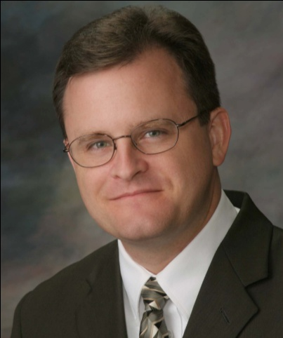
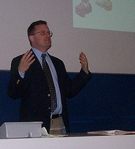
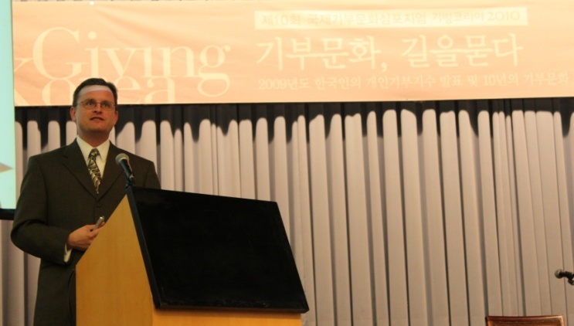
About the Author
Russell James, J.D., Ph.D., CFP® is an Associate
Professor and the Director of Graduate
Studies in Charitable Planning in the Division
of Personal Financial Planning at Texas Tech
University. He graduated, cum laude, from
the University of Missouri School of Law
where he was a member of the Missouri Law
Review. While in law school he received the
United Missouri Bank Award for Most
Outstanding Work in Gift and Estate Taxation
and Planning and the American Jurisprudence
Award for Most Outstanding Work in Federal
Income Taxation. After graduation, he worked
as the Director of Planned Giving for Central
Christian College, Moberly, Missouri for six
years and also built a successful law practice
limited to estate and gift planning. He later
served as president of the college for more
than five years, where he had direct and
supervisory responsibility for all fundraising. Dr. James received his Ph.D. in Consumer & Family Economics from the University of Missouri where his dissertation was on the topic of charitable giving. Dr. James has over 100 publications in print or in press in academic journals, conference proceedings, professional periodicals, and books. He writes regularly for Advancing Philanthropy, the magazine of the Association of Fundraising Professionals. He has presented his research in the U.S. and across the world including as an invited speaker in Ireland, Scotland, England, The Netherlands, Spain, Germany, and South Korea. (click here for complete CV)
Me (about 5 years ago)
Lecturing in Germany. 75 extra students showed up. I thought it was for me until I found out there was free beer afterwards.
At Giving Korea 2010. I didn’t notice until later the projector was shining on my head (inter-cultural height problems).

