Slide 1



Charitable Remainder Trusts
Initial Transfer
Anything Left at Death
Donor
CRT
Charity
Payments During Life
Dr. Russell James
Texas Tech University

Slide 2
The donor sets aside money from which he takes payments, with any remaining amount going to charity
Initial Transfer
Anything Left at Death
Donor
CRT
Charity
Payments During Life

Slide 3

Payments can go to the donor, other people, or other people and charity
Initial Transfer
Anything Left at Death
Donor
CRT
Charity
5% of trust assets

Slide 4
Payments can be for donor’s life or for as many lives as desired or…
Initial Transfer
Anything Left at Death
Donor
CRT
Charity
Payments during life or lives

Slide 5
Payments can be for a period of 20 or fewer years
Initial Transfer
Anything Left at Death
Donor
CRT
Charity
Payments for 20 years

Slide 6
Payments can be a fixed dollar amount: Charitable Remainder Annuity Trust (CRAT)
Initial Transfer
Anything Left at Death
Donor
CRT
Charity
$1,000 Per Year for Life

Slide 7
Payments can be a fixed percentage (5%-50%) of all trust assets: Charitable Remainder UniTrust (CRUT)
Initial Transfer
Anything Left at Death
Donor
CRT
Charity
5% of trust assets

Slide 8
The donor can give cash or property (usually appreciated securities)
Initial Transfer
Anything Left at Death
Donor
CRT
Charity
5% of trust assets

Slide 9


The donor creates the rules in a Charitable Remainder Trust, but once created it is irrevocable

Slide 10
The rules of a Charitable Remainder Trust cannot be changed
Initial Transfer
Anything Left at Death
Donor
CRT
Charity
5% of trust assets

Slide 11


The donor may act as CRT trustee and manage the assets

Slide 12

The donor may choose himself, the charity, a trust company, or anyone else as CRT trustee
Initial Transfer
Anything Left at Death
Donor
CRT
Charity
5% of trust assets

Slide 13

The donor may keep the right to change which charity receives money

Slide 14
The trust must require the remainder to go to some charity, but the named charity can be changed
?
Initial Transfer
Anything Left at Death
Donor
CRT
Charity
5% of trust assets

Slide 15
When might a donor wish to use a charitable remainder trust? Discuss.
Initial Transfer
Anything Left at Death
Donor
CRT
Charity
Payments During Life

Slide 16

I would like to use $50,000 per year from my assets.
The rest, I want to go to my favorite charity.

Slide 17
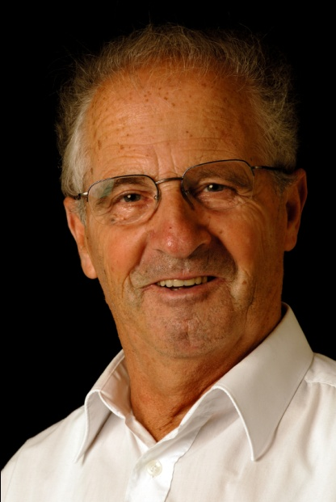
I want to control my own investments and spend about 5% of my assets each year.
After death I want it all to go to charity.

Slide 18

I want to retire today, but my pension doesn’t start paying for 9 more years. I want to give assets to charity, but I still need $65,000 per year for the next 9 years.

Slide 19

However, the biggest reason for donors to use charitable remainder trusts is…

Slide 20

Tax Benefits

Slide 21
The donor receives an immediate tax deduction for the present value of the amount that may go to charity
Initial Transfer
Anything Left at Death
Donor
CRT
Charity
Payments During Life

Slide 22

With a charitable gift in a will, there is no income tax deduction

Slide 23


There are no capital gains taxes when the donor makes a transfer to the CRT.

Slide 24

A CRT is itself a nonprofit entity and pays no capital gains tax when it sells appreciated property

Slide 25
Why is it a big deal that the transfer and sale of appreciated property occurs without capital gains tax?
Initial Transfer
Anything Left at Death
Donor
CRT
Charity
Payments During Life

Slide 26

A client holds a large, highly appreciated asset that generates little income (like developable land or non-dividend paying stock). How can she convert it to income generating property?

Slide 27

Option 1: Sell it. Pay the capital gains tax. Invest the remaining amount.
$1,000,000 stock
$900,000 gain (if $100,000 cost)
$180,000 tax (15% fed + 5% state)
$820,000 left to invest

Slide 28

Option 2: Transfer to a CRT
$1,000,000 stock
$900,000 gain (if $100,000 cost)
_____$0 tax (CRT pays no tax)
$1,000,000 left to invest

Slide 29

Other charitable remainder trust combinations

Slide 30
A Net Income CRUT (NICRUT) will pay only if enough income is available (no payments from principal)
Initial Transfer
Anything Left at Death
Donor
CRT
Charity
Lesser of trust income or 5% of trust assets

Slide 31

When would you want this limitation?

Slide 32


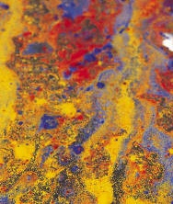
Suppose you want the trust to hold a non-income producing asset
A normal payout requirement could force a sale
land, art, non-dividend or closely-held stock

Slide 33
A Net Income Makeup CRUT (NIMCRUT) only postpones the payment if it is greater than income
Initial Transfer
Anything Left at Death
Donor
CRT
Charity
Lesser of trust income or 5% of trust assets

Slide 34

Past payments are made up whenever net income is sufficient
I.O.U.
from C.R.T

Slide 35

NIMCRUTs may be problematic when later returns are consistently less than payout rates.
There isn’t enough income to make normal payouts, much less make-up past deficiencies.

Slide 36
“Flip CRUT”: A NICRUT/NIMCRUT that converts to a CRUT at a trigger event
Net Income CRUT
Standard CRUT
Trigger Event

Slide 37

Common trigger events can be the sale of the non-income producing property or reaching retirement age

Slide 38


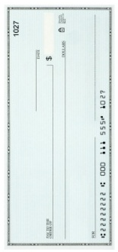
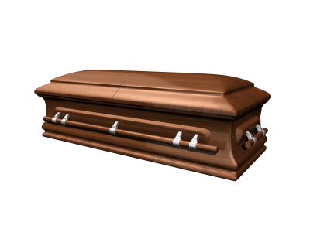
Initial Transfer
Anything Remaining
at Death
Charitable Remainder Trust
2010
Income up to 5%
Income up to 5%
Income up to 5%
5%
5%
Trigger Event
2011 2012 2013 2014 2015 … Death

Slide 39
Initial Transfer
Anything Remaining
at Death
Charitable Remainder Trust
2010
Ex: Trigger is sale of $1,000,000 of non-income land funding CRT
$0.00
$0.00
$0.00
Trigger Event
$50,000
$51,000
2011 2012 2013 2014 2015 … Death

Slide 40
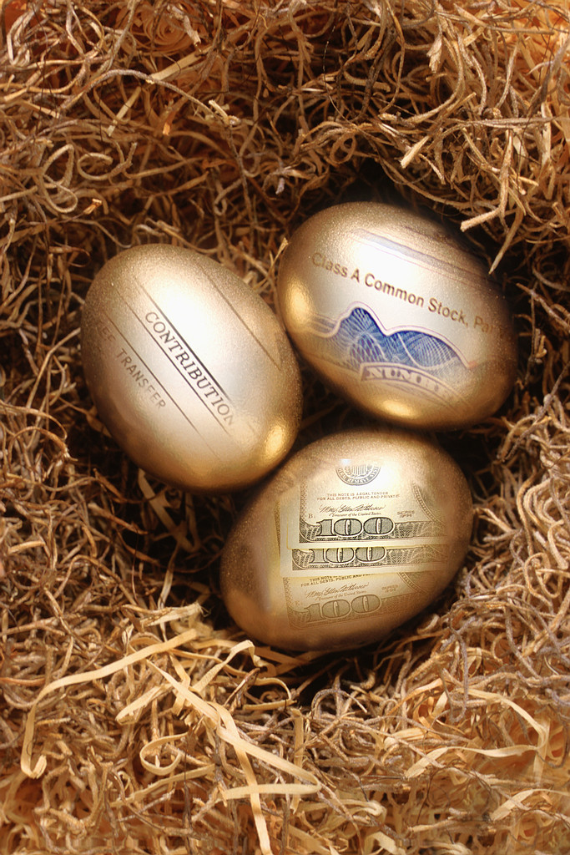
The CRT trustee could invest in non-income producing property (such as non-dividend paying growth stocks) until a retirement date trigger to maximize post retirement distributions

Slide 41


Charitable
Gift Annuity
Simple & Cheap
CGAs from a charity are usually identical except for the dollar amount
Charitable Remainder Trust
Flexible & Expensive
CRTs are individually created according to the specific desires of each client

Slide 42
The flexibility of CRTs
Unlimited number of income beneficiaries
Special restrictions on income beneficiaries allowed (where violation gives income to alternate beneficiary)
  Spendthrift trusts
  Match earned income to prevent “trust fund” kids
  Require random drug tests
Unlimited number of public charity or private foundation beneficiaries (income limitations pass through)
Open choice on payout years and amounts

Slide 43
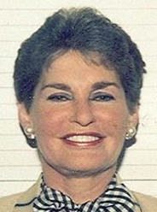
Leona Helmsley’s Charitable Remainder Unitrust created in her will includes
“Notwithstanding any provision of this Will to the contrary, my grandchildren DAVID PANZIRER and WALTER PANZIRER shall not be entitled to any distributions from any trust established for such beneficiary's benefit under this Will unless such beneficiary visits the grave of my late son JAY PANZIRER, at least once each calendar year, preferably on the anniversary of my said son's death (March 31, 1982) (except that this provision shall not apply during any period that the beneficiary is unable to comply therewith by reason of physical or mental disability as determined by my Trustees in their sole and absolute discretion).”
Notes:
Creative commons picture from http://commons.wikimedia.org/wiki/File:Leona_Helmsley.jpg

Slide 44

CRT Advantages
Immediate income tax deduction
No capital gains tax on transfer to CRT
No capital gains tax when CRT sells
Lifetime income
CRT Concern?
Remainder goes to charity not to family
How can we address this limitation?

Slide 45
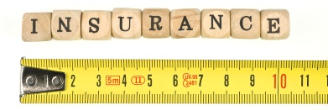
Wealth replacement may come through ILIT life insurance, creating estate tax free inheritance for family members

Slide 46

Special tax rules for CRTs

Slide 47
The present value of the projected amount going to charity (i.e., the tax deduction) must be at least 10% of the transfer
Initial Transfer
Anything Left at Death
Donor
CRT
Charity
Payments During Life

Slide 48
Does this qualify under the 10% rule (if the applicable interest rate is 5%)?
Projected Remainder After 20 years
Initial Transfer
$100,000
$15,000
Donor
CRT
Charity
Payments For 20 years

Slide 49
What is the present value of $15,000 going to charity after 20 years using a 5% interest rate?
Projected Remainder After 20 years
Initial Transfer
$100,000
$15,000
Donor
CRT
Charity
Payments For 20 years

Slide 50
Future Value ___
(1+interest rate)^{periods}
Present Value=
Projected Remainder After 20 years
Initial Transfer
$100,000
$15,000
Donor
CRT
Charity
Payments For 20 years

Slide 51
Future Value ___
(1+interest rate)^{periods}
Present Value=
$15,000_
(1+.05)²⁰
Present Value=
= $5,653.34
Projected Remainder After 20 years
Initial Transfer
$100,000
$15,000
Donor
CRT
Charity
Payments For 20 years

Slide 52
$15,000_
(1+.05)²⁰
Present Value=
= $5,653.34
This does not qualify as a CRT because the projected gift to charity has a present value <10%
Projected Remainder After 20 years
Initial Transfer
$100,000
$15,000
Donor
CRT
Charity
Payments For 20 years

Slide 53
At current interest rates, when will the CRAT exhaust?
Is there >5% chance the donor will live to that age? Yes = Disqualified
Initial Transfer
Anything Left at Death
Donor
CRT
Charity
Why don’t CRUTs require this?
Payments During Life

Slide 54

So what happens if it doesn’t qualify as a CRT?

Slide 55

No deduction
It is a retained interest gift, which are not deductible unless falling into one of the exceptions such as charitable
remainder trusts

Slide 56

How are distributions from a CRT taxed?

Slide 57

Return of Principal
Exempt Income
Capital Gain
Ordinary Income
When the trust makes a payment, it opens the spigot.
Ordinary income is paid first, then capital gain and so forth.

Slide 58
Return of Principal
Exempt Income
Capital Gain
Ordinary Income
Donor gives $100,000 of stock ($10,000 basis) to CRT. The CRT sells the stock, buys corporate bonds generating $3,000 of income and municipal bonds generating $2,000 of tax exempt income.

Slide 59
Return of Principal
Exempt Income
Capital Gain
Ordinary Income
$10,000
$2,000
$90,000
$3,000
Donor gives $100,000 of stock ($10,000 basis) to CRT. The CRT sells the stock, buys corporate bonds generating $3,000 of income and municipal bonds generating $2,000 of tax exempt income.

Slide 60
Return of Principal
Exempt Income
Capital Gain
Ordinary Income
$10,000
$2,000
$90,000
$3,000
What is the tax treatment of a $2,000 distribution?

Slide 61
Return of Principal
Exempt Income
Capital Gain
Ordinary Income
$10,000
$2,000
$90,000
$3,000
What is the tax treatment of a $2,000 distribution?
Recipient pays taxes on:
$2,000 of ordinary income

Slide 62
Return of Principal
Exempt Income
Capital Gain
Ordinary Income
$10,000
$2,000
$90,000
$3,000
What is the tax treatment of a $5,000 distribution?

Slide 63
Return of Principal
Exempt Income
Capital Gain
Ordinary Income
$10,000
$2,000
$90,000
$3,000
What is the tax treatment of a $5,000 distribution?
Recipient pays taxes on:
$3,000 of ordinary income
$2,000 of capital gain

Slide 64
Return of Principal
Exempt Income
Capital Gain
Ordinary Income
$10,000
$2,000
$90,000
$3,000
What is the tax treatment of a $10,000 distribution?

Slide 65
Return of Principal
Exempt Income
Capital Gain
Ordinary Income
$10,000
$2,000
$90,000
$3,000
What is the tax treatment of a $10,000 distribution?
Recipient pays taxes on:
$3,000 of ordinary income
$7,000 of capital gain

Slide 66
Return of Principal
Exempt Income
Capital Gain
Ordinary Income
If CRT ordinary income earnings are always higher than distributions, no capital gain tax will ever be paid.

Slide 67

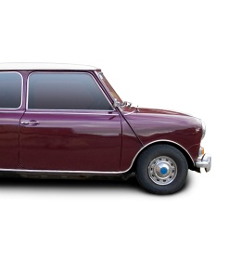
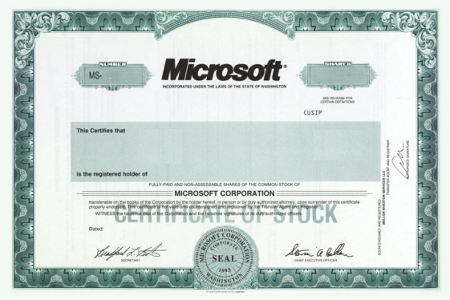


What kind of property can a CRT hold?

Slide 68
Subchapter S corporation rules do not allow CRT shareholders
S

Slide 69


100% excise tax on Unrelated Business Taxable Income (UBTI), where CRT is running a business (e.g., owning as a sole proprietor or partner) instead of being a passive investor

Slide 70
Not UBTI
Dividends, interest, annuities, royalties, rents from real estate, and capital gains, so long as none of them involve debt-financing
UBTI
Net income from running a hotel, parking lot, convenience store, coin operated laundry
or
Debt financed net income

Slide 71

Ex: CRT receives a $1,000,000 home ($100,000 basis). Trustee makes improvements using a $100,000 mortgage (acquisition indebtedness) and sells for $1,200,000.
Result?

Slide 72
Ex: CRT receives a $1,000,000 home ($100,000 basis). Trustee makes improvements using a $100,000 mortgage (acquisition indebtedness) and sells for $1,200,000.
Due to debt financing $1,000,000 capital gain is UBTI, taxed at 100%, and lost.

Slide 73

Self-Dealing
CRT can’t sell, lease, loan, or allow use of assets by CRT creator, contributor, trustee, or their ancestors, descendents, or spouses

Slide 74

If all parties agree can a CRT be broken and distributed?

Slide 75
If all parties agree can a CRT be broken and distributed?
IRS has allowed termination & distribution of present value of all interests
PLR 200208039

Slide 76
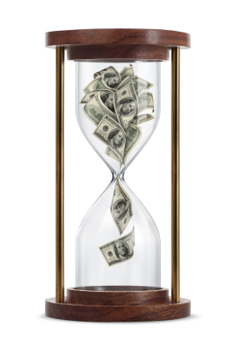
Donor plans to create CRT with remainder value sufficient to build a building, but charity needs building now. Solutions?

Slide 77
Donor plans to create CRT with remainder value sufficient to build a building, but charity needs building now. Solutions?
CRT may segregate and pledge funds as collateral for a loan taken out by the charity. (Charity can pay off loan with remainder at death.)
PLR 8807082

Slide 78
Charitable Remainder Trusts
Initial Transfer
Anything Left at Death
Donor
CRT
Charity
Payments During Life
Photos from www.istockphoto.com

Slide 79

Help me
HERE
convince my bosses that continuing to build and post these slide sets is not a waste of time. If you work for a nonprofit or advise donors and you reviewed these slides, please let me know by clicking

Slide 80

If you clicked on the link to let me know you reviewed these slides…
Thank You!

Slide 81

For the audio lecture accompanying this
slide set, go to
EncourageGenerosity.com

Slide 82

Think you understand it?
Prove it!
Click here to go to EncourageGenerosity.com and take the free quiz on this slide set. (Instantly graded with in depth explanations and a certificate of completion score report.)

Slide 83
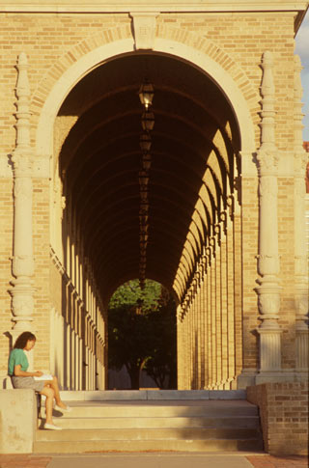

Graduate Studies in
Charitable Financial Planning
at Texas Tech University
This slide set is from the introductory curriculum for the Graduate Certificate in Charitable Financial Planning at Texas Tech University, home to the nation’s largest graduate program in personal financial planning.
To find out more about the online Graduate Certificate in Charitable Financial Planning go to www.EncourageGenerosity.com
To find out more about the M.S. or Ph.D. in personal financial planning at Texas Tech University, go to www.depts.ttu.edu/pfp/

Slide 84
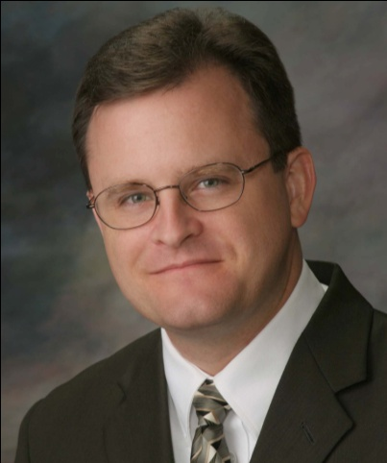
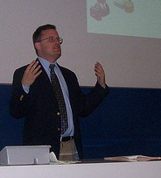
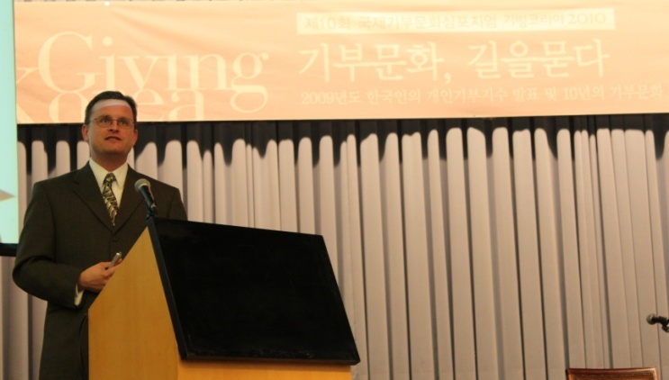
About the Author
Russell James, J.D., Ph.D., CFP® is an Associate
Professor and the Director of Graduate
Studies in Charitable Planning in the Division
of Personal Financial Planning at Texas Tech
University. He graduated, cum laude, from
the University of Missouri School of Law
where he was a member of the Missouri Law
Review. While in law school he received the
United Missouri Bank Award for Most
Outstanding Work in Gift and Estate Taxation
and Planning and the American Jurisprudence
Award for Most Outstanding Work in Federal
Income Taxation. After graduation, he worked
as the Director of Planned Giving for Central
Christian College, Moberly, Missouri for six
years and also built a successful law practice
limited to estate and gift planning. He later
served as president of the college for more
than five years, where he had direct and
supervisory responsibility for all fundraising. Dr. James received his Ph.D. in Consumer & Family Economics from the University of Missouri where his dissertation was on the topic of charitable giving. Dr. James has over 100 publications in print or in press in academic journals, conference proceedings, professional periodicals, and books. He writes regularly for Advancing Philanthropy, the magazine of the Association of Fundraising Professionals. He has presented his research in the U.S. and across the world including as an invited speaker in Ireland, Scotland, England, The Netherlands, Spain, Germany, and South Korea. (click here for complete CV)
Me (about 5 years ago)
Lecturing in Germany. 75 extra students showed up. I thought it was for me until I found out there was free beer afterwards.
At Giving Korea 2010. I didn’t notice until later the projector was shining on my head (inter-cultural height problems).

