Slide 1

Charitable Bequest Demographics
Dr. Russell James
Texas Tech University

Slide 2

What do we know about who makes charitable plans and charitable bequests?
Dr. Russell James
Texas Tech University

Slide 3

Previous studies
One time survey
Non-response bias if the whole survey was about charitable giving
After death distributions
Only for taxable estates
Rare single county probate studies

Slide 4

Current study
Longitudinal
Same people asked every two years
Distributions
After death nearest relatives are asked about final distributions

Slide 5
New Questions
Changes
Not just who has charitable plans but
when do they add and drop them
Intentions v. Outcomes
Did during life plans result in after death distributions

Slide 6
Details
Nationally representative of over 50 population since 1998.
Over 20,000 people per survey.
In person interviews, some follow up by phone.
Started in 1992
Questions within larger Health & Retirement Study
Respondents paid

Slide 7

What share of people over 50 in the U.S. have “made provisions for any charities in [their] will or trust?”

Slide 8
U.S. Over 50 Population
* Weighted nationally representative 2006 sample

Slide 9
U.S. Over 50 Population
* Weighted nationally representative 2006 sample

Slide 10

What share of over-50 charitable donors giving over $500 per year indicate that they have a charitable estate plan?

Slide 11
* Donors giving $500+ per year, weighted nationally representative 2006 sample

Slide 12

Can that be right?
Maybe a lot of donors will eventually get around to making a charitable plan?
Will donors ever get around to making a charitable plan?

Slide 13

Projecting based on age, gender and mortality or tracking actual post-death distributions
88%-90% of donors ($500+/year) over age 50 will die with no charitable estate plan.

Slide 14
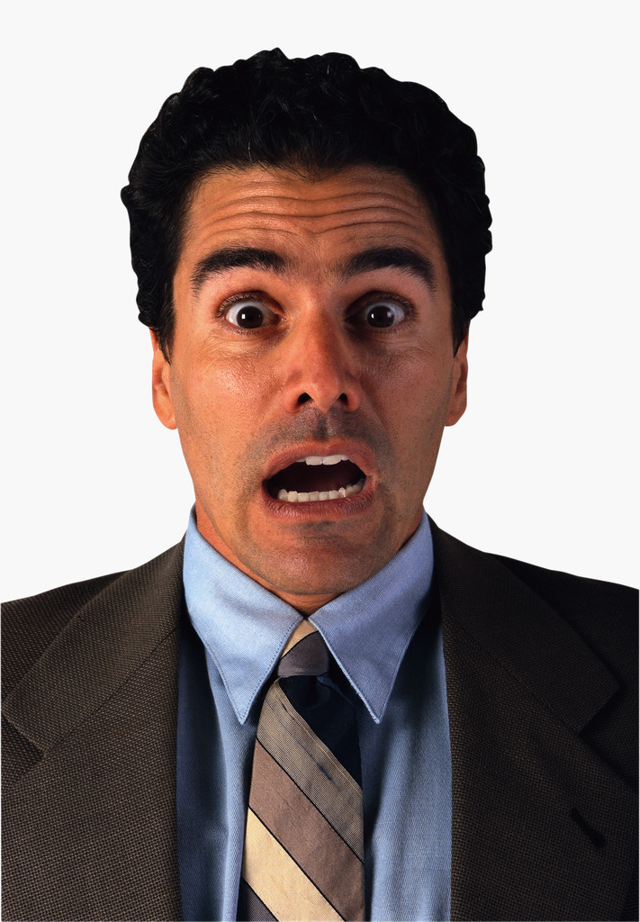

You mean 90% of our donors will die without leaving a gift?
You mean we could generate 9 times more estate gifts from our current donors?

Slide 15

Among donors ($500+) over 50 with an estate plan, what is the single most significant factor associated with having a charitable estate plan?
Age? Education? Wealth? Income?

Slide 16
Among Donors ($500+) with an Estate Plan
Family Status | % indicating a charitable estate plan
No Offspring | 50.0%
Children Only | 17.1%
Grandchildren | 9.8%

Slide 17

Regression: Compare only otherwise identical people
Example: The effect of differences in education among those making the same income, with the same wealth, same family structure, etc.

Slide 18
Likelihood of having a charitable plan
(comparing otherwise identical individuals)
Graduate degree (v. high school) +4.2 % points
Gives $500+ per year to charity +3.1 % points
Volunteers regularly +2.0 % points
College degree (v. high school) +1.7 % points
Has been diagnosed with a stroke +1.7 % points
Is ten years older +1.2 % points
Has been diagnosed with cancer +0.8 % points
Is married (v. unmarried) +0.7 % points
Diagnosed with a heart condition +0.4 % points
Attends church 1+ times per month +0.2 % points
Has $1,000,000 more in assets +0.1 % points
Has $100,000 per year more income not significant
Is male (v. female) not significant
Has only children (v. no offspring) -2.8 % points
Has grandchildren (v. no offspring) -10.5 % points

Slide 19
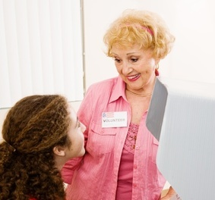
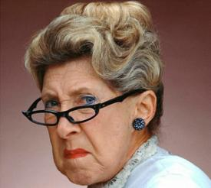
Find your estate donor…
A makes substantial charitable gifts, volunteers regularly, and has grandchildren |  | B doesn’t give to charity, doesn’t volunteer, and has no children

Slide 20

From an Australian study by Christopher
Baker including 1729 wills:
“Australian will-makers without surviving children are ten times more likely to make a charitable gift from their estate”

Slide 21
How did giving during life compare with post death transfers?
$
$
$
$

Slide 22
Estate giving and annual giving for 6,342 deceased panel members
Offspring | Last Annual Volunteer Hours | Average Annual Giving | Average Estate Giving | Estate Gift Multiple
No Children | 32.6 (6.6) | $3,576 | $44,849 | 12.6
Children Only | 25.4 (7.1) | $1,316 | $6,147 | 4.7
Grandchildren | 23.2 (2.1) | $1,497 | $4,320 | 2.9
Total | 24.3 (1.8) | $1,691 | $8,582 | 5.1

Slide 23

When did people drop charitable plans?

Slide 24
Yes!
Yes!
No.
What happened here?

Slide 25
Factors that triggered dropping the charitable plan
  1. Becoming a grandparent 0.7226* (0.2997)
  2. Becoming a parent 0.6111† (0.3200)
  3. Stopping current charitable giving 0.1198* (0.0934)
  4. A drop in self-rated health 0.0768† (0.0461)
Some factors that didn’t seem to matter:
  Change in income
  Change in assets
  Change in marital status
*Fixed effects analysis including 1,306 people who reported a charitable plan and later reported no charitable plan. Coefficients show relative magnitude of factors.

Slide 26

When did people add charitable plans?

Slide 27
Factors that triggered adding a new charitable plan
Starting to make charitable gifts .1531† (.0882)
An improvement in self-reported health .0927* (0.0446)
A $100k increase in assets .0061** (.0023)
One factor dramatically reduced the likelihood that a new charitable plan would be added:
The addition of the first grandchild -.4641† (.2732)

Slide 28
How often did planned bequests produce a post-death gift?
Yes!
Yes!
Yes!
No.

Slide 29
How often did planned bequests produce a post-death gift?
Yes!
40.9%
59.1%
Yes!
No.

Slide 30
How often did planned bequests produce a post-death gift?
71.5%
surviving spouse
No.
Yes!
No surviving spouse
49.4%
Yes!
No.

Slide 31

What’s the problem?

Slide 32

Are mischievous heirs stealing the documents?

Slide 34
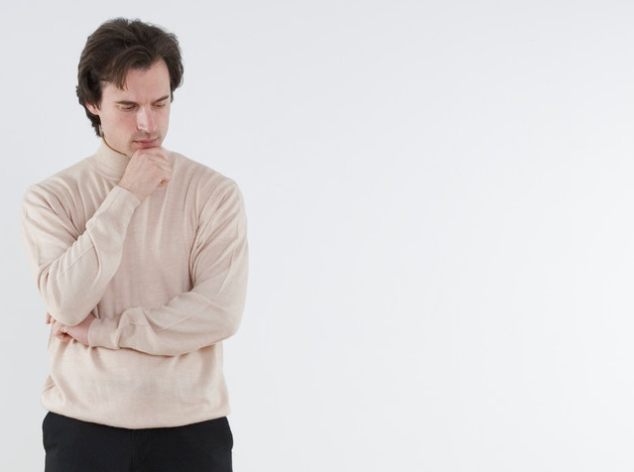
Does choice of planning document matter?

Slide 36
Does document choice really matter or is it just the people who are different?
Variable | Decedent had reported a funded inter vivos trust | Decedent had reported only a will
Charitable estate distribution | 56% | 35%**
Household assets prior to death | $1,120,591 | $378,361**
Household income prior to death | $78,496 | $51,326
Married | 47.5% | 46.3%*
Had child(ren) and grandchild(ren) | 58.8% | 55.5%
Had child(ren) only | 7.5% | 9.6%
Age | 83.2 | 80.6 *
Male | 37.5% | 40.6%
No estate documents found | 3.7% | 9.2%†
n | 80 | 218

Slide 37
Regression: Compare only otherwise identical people
Example: The effect of differences in trusts among those with same education, income, wealth, family structure, etc.

Slide 38
Trust increases likelihood of charitable transfer by 14-15 % points
Independent Variables | Linear Probability Model | Linear Probability Model
Intercept | 0.3532 (0.0328)** | -0.1882 (0.2913)
I.V. Trust (Funded) | 0.2093 (0.0633)** | 0.1461 (0.0629)*
Wealth (100k) |  | 0.0037 (0.0022) †
Self-reported Health |  | -0.0174 (0.0241)
Income (100k) |  | 0.0435 (0.0198)*
Married |  | -0.1632 (0.0644)*
Children and Grandchildren |  | -0.1172 (0.0600) †
Children Only |  | -0.2012 (0.1027) †
White |  | 0.0429 (0.168)
Black |  | -0.1111 (0.2113)
Age |  | 0.0084 (0.0029)**
Male |  | -0.0405 (0.0599)

Slide 39
Why are trusts more effective?
Will probated
60%
40%
Charitable plan and only will
Will not probated

Slide 40

Consider using a phrase such as “a dollar amount equal to 10% of my gross estate for federal estate tax purposes”

Slide 41

  Do the estates of people who make charitable estate plans grow differently than the general population?

Slide 42
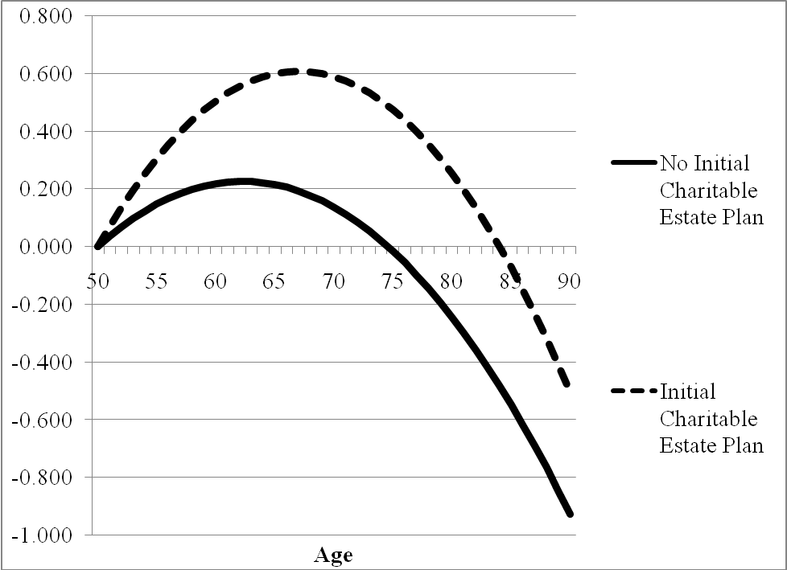
After making their plan, charitable estate donors grew their estates 50%-100% faster than did others with same initial wealth

Slide 43
Using Demographics to Make Future Projections
Dr. Russell James
Texas Tech University

Slide 44
The Fall and Rise in Live Births - US

Slide 45
Dramatic increases on the horizon
Temporary drop in key demographic population

Slide 46
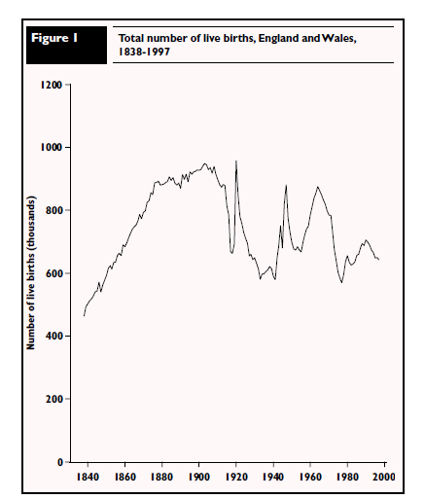
The fall and rise in live births - UK
Notes:
http://www.statistics.gov.uk/CCI/article.asp?ID=618&Pos=3&ColRank=2&Rank=176

Slide 47
Persons alive in the UK, 2008-2030
Notes:
http://www.statistics.gov.uk/downloads/theme_population/NPP2008/NatPopProj2008.pdf

Slide 48
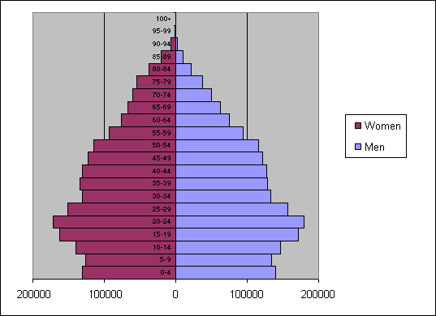
Ireland population pyramid, 2001
Without the large post-war baby boom, expect less rapid growth in older ages
Growth will come primarily due to improved longevity

Slide 49
Projecting future bequest giving
Frequency of future bequest gifts
Change in population
Change in tendency to make bequest gifts

Slide 50
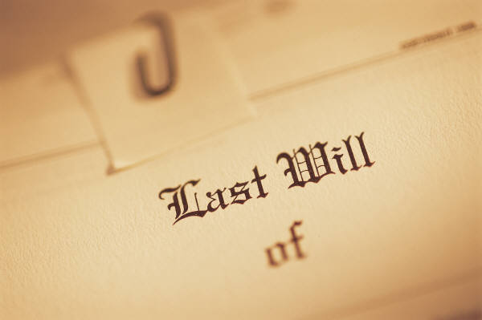
Do the boomers give differently?
After controlling for wealth and income, the baby boom cohort gave at a significantly lower rate during middle age than the pre-war cohort did (Wilhelm, Rooney, and Tempel, 2008).
Will boomers also be less charitable in estate giving?

Slide 51

Data
1996-2006 Health and Retirement Study (HRS), a nationally representative, biennial, longitudinal study.
Analysis weighted to project to national means and adjusted for complex sample selection process

Slide 52
Charitable Estate Planning among US Adults Aged 55-65

Slide 53
What is driving this trend?

Slide 54
Weighted descriptive statistics of adults aged 55-65 (‘96 & ‘06 HRS)
Variable | 1996 | 2006 | Δ%
Charitable estate plan | 3.81% | 5.43%* | 42.5%
Will or trust executed | 51.72% | 43.63%* | -15.6%
Funded trust | 4.53% | 6.60%* | 45.7%
<High School | 24.57% | 14.76%* | -39.9%
High school graduate | 36.22% | 30.73%* | -15.2%
Some college | 19.37% | 24.77%* | 27.9%
College graduate | 8.82% | 13.53%* | 53.4%
Graduate education | 10.82% | 15.55%* | 43.7%
Household assets (2006$) | $384,419 (771,398) [$15,092] | 686,258 (3,421,725) [$69,935]* | 78.5%
Household income (2006$) | $76,372 (99,274) [$2,287] | 100,865 (530,858) [$12,037]* | 32.1%
Charitable giving >$650 | 33.85% | 36.27%* | 7.1%
Number of children | 3.30 (2.17) [0.03] | 2.83* (2.01) [0.03] | -14.2%
Number of grandchildren | 4.48 (5.10) [0.10] | 3.79* [4.94] (0.08) | -15.5%
No children | 6.83% | 8.34%* | 22.1%
No grandchildren | 21.03% | 29.1%* | 38.4%

Slide 55
Charitable estate planning among adults aged 55-65

Slide 56
Increases in charitable planning are driven by increases in childlessness and education
Time trend disappears when including childlessness and education
Time trend exists
Variable | Estimate (s.e.) | p-value | Estimate (s.e.) | p-value | Estimate (s.e.) | p-value
Year | 0.0138 (0.0032) | <.0001 | 0.0033 (0.0034) | 0.3298 | 0.0015 (0.0036) | 0.664
Any children |  |  | -0.6251 (0.0345) | <.0001 | -0.6224 (0.0479) | <.0001
Years of Education |  |  | 0.1412 (0.0048) | <.0001 | …. full set of | ….
 |  |  |  |  | control variables
Probit analysis of all respondents age 55-65 in 1996-2006 HRS. Outcome variable is the presence of charitable estate planning.

Slide 57


Basic relationship
This suggests that the overall trend of increased charitable estate planning may have been driven, in large part, by changes in childlessness and education.
Such a relationship has important implications for predicting charitable estate planning levels in the future.

Slide 58
Upcoming cohorts and childlessness
Childlessness among women who will be entering the 55-65 age group over the next decade will be substantially higher than those in the 55-65 age group during 2006 (the year of the latest HRS survey).
Women in the 56-61 age group during 2006 reported a childlessness rate of 16.0% in 1990 when they were aged 40-44 (Dye, 2005). In comparison, women in the 40-44 age range in 2004 (i.e., those who will begin entering the 55-65 near retirement age group in 2015) reported a childlessness rate of 19.3% (Dye, 2005).

Slide 59
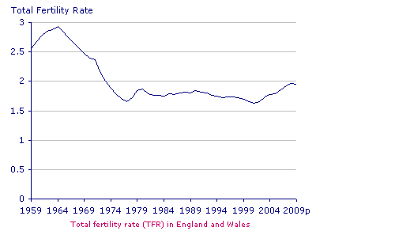
Similar trends in U.K.
Source: http://www.statistics.gov.uk/cci/nugget.asp?id=369

Slide 60
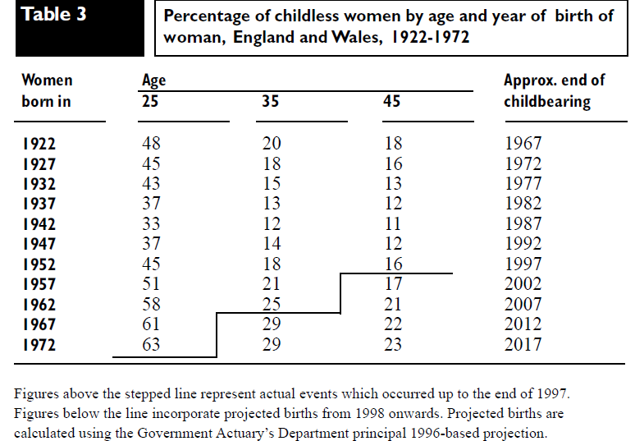
http://www.statistics.gov.uk/articles/population_trends/birthstats_pt94.pdf

Slide 61
Upcoming cohorts and education
Similarly, a college education is much more common among the upcoming cohorts of individuals nearing retirement age than among the current 55-65 group (Stoops, 2004).
In 1996, less than 27% of those in the 35-54 age group had at least a bachelor’s degree.
By 2007, over 31% of those in the 35-54 age group had at least a bachelor’s degree (Current Population Survey, 2007).
Thus, one can expect the upcoming cohorts of individuals nearing retirement to be more educated than individuals currently in the 55-65 age group.

Slide 62
Growth trends in charitable estate planning
Overall graying of the population
Increased childlessness of upcoming and future cohorts
Increased education of upcoming and future cohorts
The financial planner without a basic understanding of planned giving options may leave greater and greater numbers of clients underserved.

Slide 63
Photos from www.istockphoto.com
Charitable Bequest Demographics

Slide 64

Help me
HERE
convince my bosses that continuing to build and post these slide sets is not a waste of time. If you work for a nonprofit or advise donors and you reviewed these slides, please let me know by clicking

Slide 65
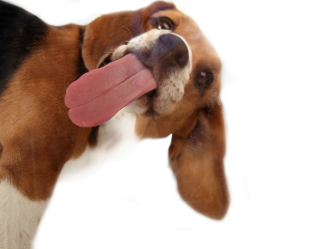
If you clicked on the link to let me know you reviewed these slides…
Thank You!

Slide 66

For the audio lecture accompanying this
slide set, go to
EncourageGenerosity.com

Slide 67

Think you understand it?
Prove it!
Click here to go to EncourageGenerosity.com and take the free quiz on this slide set. (Instantly graded with in depth explanations and a certificate of completion score report.)

Slide 68
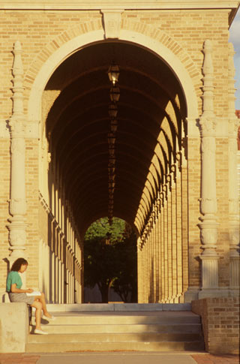

Graduate Studies in
Charitable Financial Planning
at Texas Tech University
This slide set is from the introductory curriculum for the Graduate Certificate in Charitable Financial Planning at Texas Tech University, home to the nation’s largest graduate program in personal financial planning.
To find out more about the online Graduate Certificate in Charitable Financial Planning go to www.EncourageGenerosity.com
To find out more about the M.S. or Ph.D. in personal financial planning at Texas Tech University, go to www.depts.ttu.edu/pfp/

Slide 69
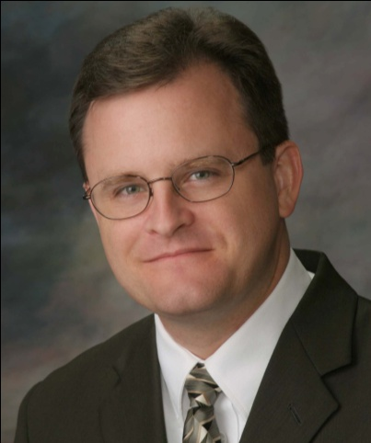
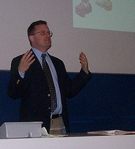
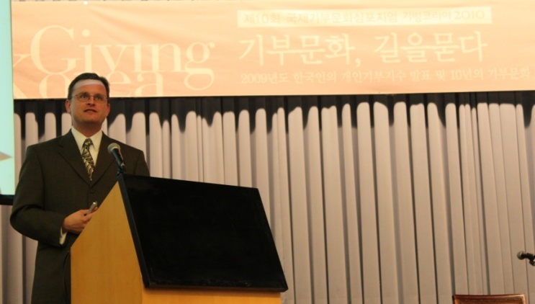
About the Author
Russell James, J.D., Ph.D., CFP® is an Associate
Professor and the Director of Graduate
Studies in Charitable Planning in the Division
of Personal Financial Planning at Texas Tech
University. He graduated, cum laude, from
the University of Missouri School of Law
where he was a member of the Missouri Law
Review. While in law school he received the
United Missouri Bank Award for Most
Outstanding Work in Gift and Estate Taxation
and Planning and the American Jurisprudence
Award for Most Outstanding Work in Federal
Income Taxation. After graduation, he worked
as the Director of Planned Giving for Central
Christian College, Moberly, Missouri for six
years and also built a successful law practice
limited to estate and gift planning. He later
served as president of the college for more
than five years, where he had direct and
supervisory responsibility for all fundraising. Dr. James received his Ph.D. in Consumer & Family Economics from the University of Missouri where his dissertation was on the topic of charitable giving. Dr. James has over 100 publications in print or in press in academic journals, conference proceedings, professional periodicals, and books. He writes regularly for Advancing Philanthropy, the magazine of the Association of Fundraising Professionals. He has presented his research in the U.S. and across the world including as an invited speaker in Ireland, Scotland, England, The Netherlands, Spain, Germany, and South Korea. (click here for complete CV)
Me (about 5 years ago)
Lecturing in Germany. 75 extra students showed up. I thought it was for me until I found out there was free beer afterwards.
At Giving Korea 2010. I didn’t notice until later the projector was shining on my head (inter-cultural height problems).

