Slide 1

Bargain Sale
Charitable Gifts
Russell James, J.D., Ph.D., CFP®, Director of Graduate Studies in Charitable Planning, Texas Tech University

Slide 2

What is a bargain sale?

Slide 3

Bargain sale: The sale of an asset to a charity at less than fair market value

Slide 4

Deduct the value of what you give less the value of what you get

Slide 5

Charity wants land worth $1,000,000
Donor gives it to charity for $400,000

Slide 6
Charity wants land worth $1,000,000
Donor gives it to charity for $400,000
Deduction = $600,000

Slide 7

I give $300,000 house with $100,000 mortgage

Slide 8
I give $300,000 house with $100,000 mortgage
Deduction = $200,000

Slide 9



I give $100,000 in stock
Stock
Annuity
Charity pays $3,000 per year for life

Slide 10
I give $100,000 in stock
Stock
Deduction = $100,000 - Value of annuity
Annuity
Charity pays $3,000 per year for life

Slide 11

The rules for calculating capital gain (taxable) add complications

Slide 12
$500,000
$1,000,000
$500,000
I paid for it
I sell it for
fair market
value of
I have a
capital
gain of

Slide 13
$500,000
$500,000
$0
I paid for it
I sell it for
fair market
value of
I have a
capital
gain of

Slide 14
$500,000
$800,000
$1,000,000
???
I paid for it
I sell it to
charity for
It has a fair
market
value of
I have a
capital
gain of

Slide 15
Step 1: Divide property value
Original cost
$500,000
Value
$1,000,000
Gave to charity for $800,000

Slide 16
$800,000 of sale income
Original cost
$500,000
Value
$1,000,000
Gave to charity for $800,000

Slide 17
Step 2: Divide cost basis
Original cost
$500,000
Value
$1,000,000
Gave to charity for $800,000

Slide 18
Sale part: $400,000 of cost basis
Original cost
$500,000
Value
$1,000,000
Gave to charity for $800,000

Slide 19
Gain is sale income less sale basis
Original cost
$500,000
Value
$1,000,000
Gave to charity for $800,000

Slide 20
Gain is sale income less sale basis
Sale part
$800,000 of income
$400,000 of cost basis
$400,000 gain
Original cost
$500,000
Value
$1,000,000
Gave to charity for $800,000

Slide 21
% of the property value sold
% of cost basis allocated to sale
=

Slide 22

Tax benefits of bargain sales

Slide 23


Bargain Sale
$500,000 Original cost
$1,000,000 Value
$800,000 Charity pays
$800,000 Donor keeps
$200,000 Charity gets
$400,000 Capital gain
(taxable)
Sale + Gift
$500,000 Original cost
$1,000,000 Value/Sale
$200,000 Gift after sale
$800,000 Donor keeps
$200,000 Charity gets
$500,000 Capital gain
(taxable)

Slide 24

Bargain sales cannot generate tax losses, so loss property should be sold not gifted

Slide 25

Debt on gifted property is sale income. Consider shifting debt to other assets.

Slide 26

Giving property with debt
Lot A
$100,000 value
$50,000 cost
$50,000 debt
Lot B
$100,000 value
$50,000 cost
$50,000 debt
Lot C
$100,000 value
$50,000 cost
$50,000 debt
Charity
$100,000 net gift
Donor
$100,000 deduction
$100,000 sale (from debt)
$50,000 capital gain
$50,000 remaining equity

Slide 27
Shifting to give debt-free property
Lot A
$100,000 value
$50,000 cost
$50,000 debt
Lot B
$100,000 value
$50,000 cost
$50,000 debt
Lot C
$100,000 value
$50,000 cost
$50,000 debt
$0 debt
$75,000 debt
$75,000 debt
Charity
$100,000 net gift
Donor
$100,000 deduction
$0 sale (from debt)
$0 capital gain
$50,000 remaining equity

Slide 28
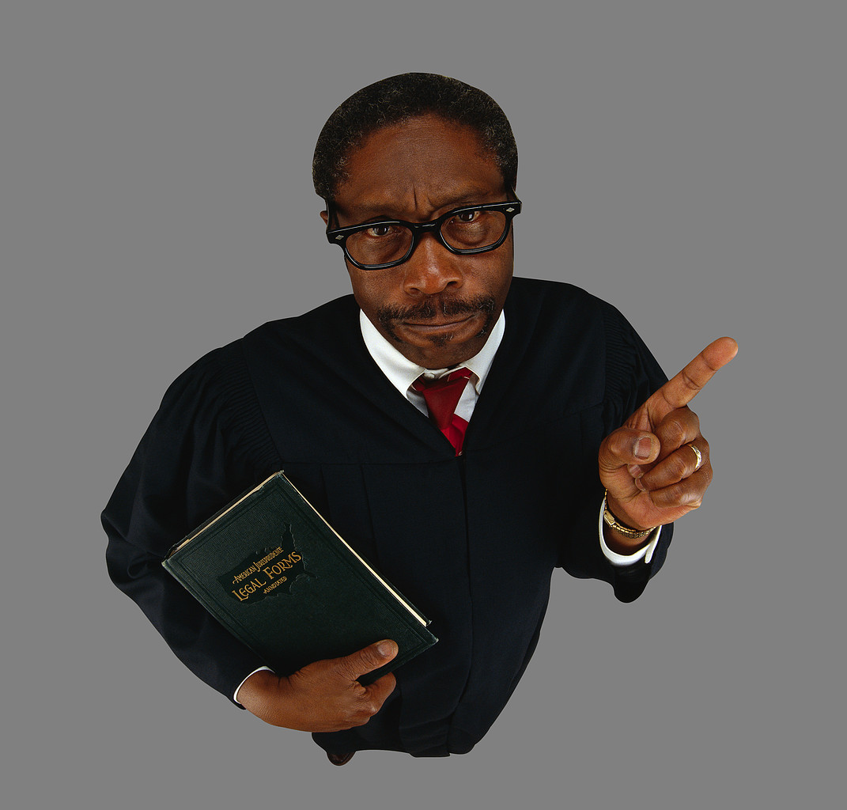
Examples from case law

Slide 29

Charles sells a conservation easement on his farm to the county for $309,000 (their normal rate). He deducts for a bargain sale because his appraised value was $518,000. Result?

Slide 30
Charles sells a conservation easement on his farm to the county for $309,000 (their normal rate). He deducts for a bargain sale because his appraised value was $518,000. Result?
Deduction is valid. The county rate was not fair market rate
Browning v. Commissioner, 109 T.C. 303, 1997

Slide 31

After negotiations fail, highway department sues to take land. The lawsuit settlement pays less than appraised value, so taxpayer claims bargain sale tax deduction. Result?

Slide 32
After negotiations fail, highway department sues to take land. The lawsuit settlement pays less than appraised value, so taxpayer claims bargain sale tax deduction. Result?
Deduction is valid.
Court saw charitable intent in negotiation letters referencing possibility of “contribution/sale”. Consol. Investors Group v. Commissioner, T.C. Memo 2009-290

Slide 33
Bargain Sale
Charitable Gifts
Pictures from www.istockphoto.com

Slide 34

Help me
HERE
convince my bosses that continuing to build and post these slide sets is not a waste of time. If you work for a nonprofit or advise donors and you reviewed these slides, please let me know by clicking

Slide 35

If you clicked on the link to let me know you reviewed these slides…
Thank You!

Slide 36

For the audio lecture accompanying this
slide set, go to
EncourageGenerosity.com

Slide 37

Think you understand it?
Prove it!
Click here to go to EncourageGenerosity.com and take the free quiz on this slide set. (Instantly graded with in depth explanations and a certificate of completion score report.)

Slide 38


Graduate Studies in
Charitable Financial Planning
at Texas Tech University
This slide set is from the introductory curriculum for the Graduate Certificate in Charitable Financial Planning at Texas Tech University, home to the nation’s largest graduate program in personal financial planning.
To find out more about the online Graduate Certificate in Charitable Financial Planning go to www.EncourageGenerosity.com
To find out more about the M.S. or Ph.D. in personal financial planning at Texas Tech University, go to www.depts.ttu.edu/pfp/

Slide 39
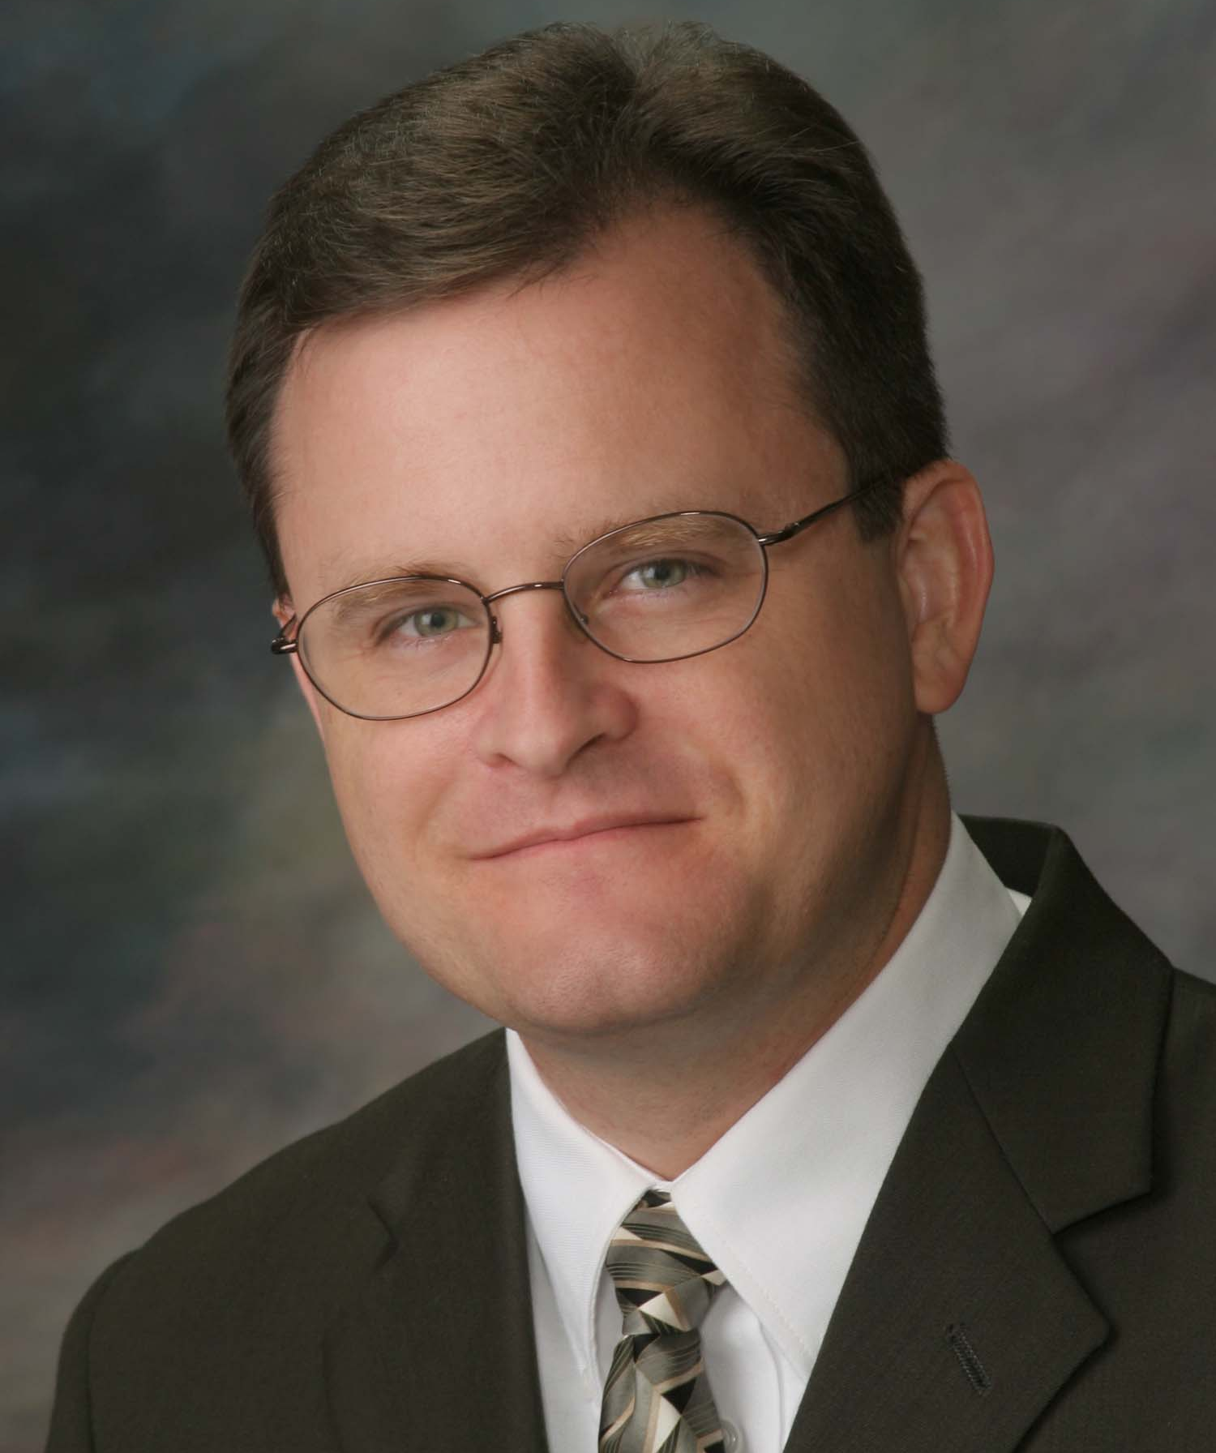
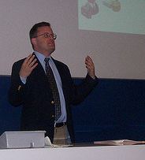
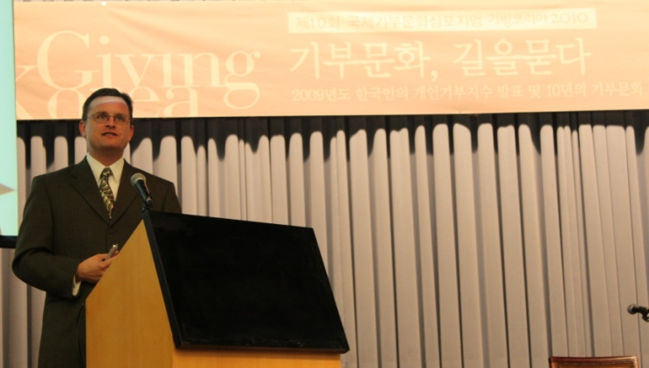
About the Author
Russell James, J.D., Ph.D., CFP® is an Associate
Professor and the Director of Graduate
Studies in Charitable Planning in the Division
of Personal Financial Planning at Texas Tech
University. He graduated, cum laude, from
the University of Missouri School of Law
where he was a member of the Missouri Law
Review. While in law school he received the
United Missouri Bank Award for Most
Outstanding Work in Gift and Estate Taxation
and Planning and the American Jurisprudence
Award for Most Outstanding Work in Federal
Income Taxation. After graduation, he worked
as the Director of Planned Giving for Central
Christian College, Moberly, Missouri for six
years and also built a successful law practice
limited to estate and gift planning. He later
served as president of the college for more
than five years, where he had direct and
supervisory responsibility for all fundraising. Dr. James received his Ph.D. in Consumer & Family Economics from the University of Missouri where his dissertation was on the topic of charitable giving. Dr. James has over 100 publications in print or in press in academic journals, conference proceedings, professional periodicals, and books. He writes regularly for Advancing Philanthropy, the magazine of the Association of Fundraising Professionals. He has presented his research in the U.S. and across the world including as an invited speaker in Ireland, Scotland, England, The Netherlands, Spain, Germany, and South Korea. (click here for complete CV)
Me (about 5 years ago)
Lecturing in Germany. 75 extra students showed up. I thought it was for me until I found out there was free beer afterwards.
At Giving Korea 2010. I didn’t notice until later the projector was shining on my head (inter-cultural height problems).

